Slide 1
Electric Vehicles: The View From California
Paul T. Hunt, Jr. Consultant*
Society of Utility and Regulatory Financial Analysts 54th Financial Forum Richmond, Virginia, April 21, 2023
* All opinions expressed herein are those of the author and do not necessarily represent the views of his current or former employers.

Slide 2
My Background
Ph.D. in Economics from Stanford University
Over 38 years at Southern California Edison Company, retired in 2019; now consultant
Cost of capital testimony and case management before California Public Utilities Commission
Generic cases involving more than one utility; outside of General Rate Cases
Cost of capital testimony before Federal Energy Regulatory Commission
General Rate Cases
Transmission construction work in progress cases
Co-author, "Cost of Capital in Regulated Industries," in Cost of Capital in Litigation: Applications and Examples (John Wiley & Sons, Inc., 2010); revised version appears in The Lawyer’s Guide to Cost of Capital: Understanding Risk and Return for Valuing Businesses and Other Investments (ABA (American Bar Association) Publishing, 2014)
Testimony in two CPUC cases on rate of return on capitalized charging station rebates (A.14-10-014 and A.17-01-021)
Notes:
Six cases before CPUC: 1999, 2003, 2005, 2005, 2008, 2013 test year cost of capital applications; hydro valuation application
Fourteen FERC applications (one as rebuttal witness re Vernon)

Slide 3
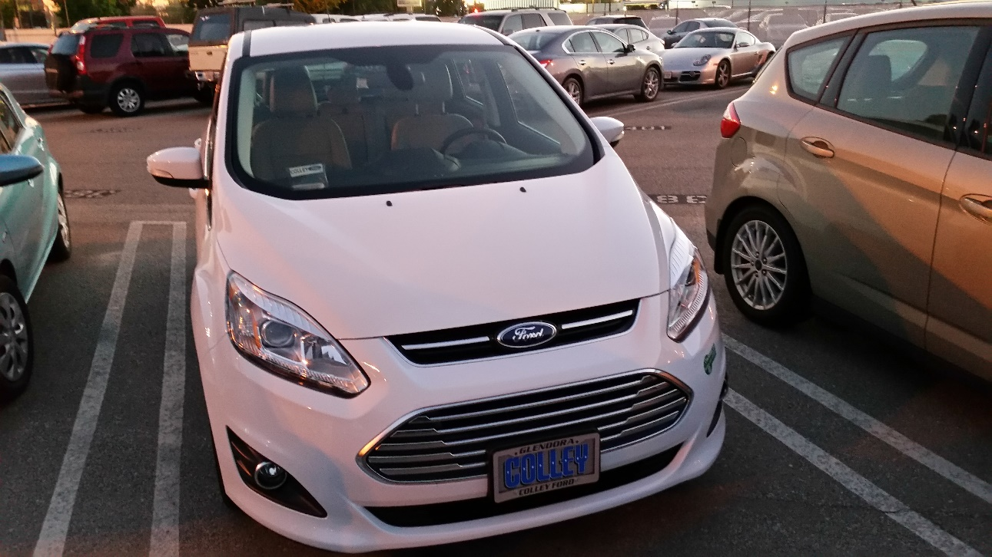
Direct Experience with Electric Vehicles
Owner, 2017 Ford C-Max Energi (plugin hybrid electric vehicle)
Range up to 24 miles on electricity, 600 miles on gasoline
About 85% of travel is on electricity only
Net Energy Metering customer (NEM 1.0) – substantially reduces the cost of charging at home

Slide 4
Topics to Cover
California’s goals and mandates regarding electric vehicles (EVs)
Zero-emission vehicle penetration in California
California Public Utilities Commission (CPUC) actions and initiatives
Rates to encourage off-peak EV charging
Current and future incentives
Can the grid provide sufficient electricity at the time it will be needed?
Will residents of multifamily housing be able to find affordable charging?
Environmental and social justice considerations

Slide 5
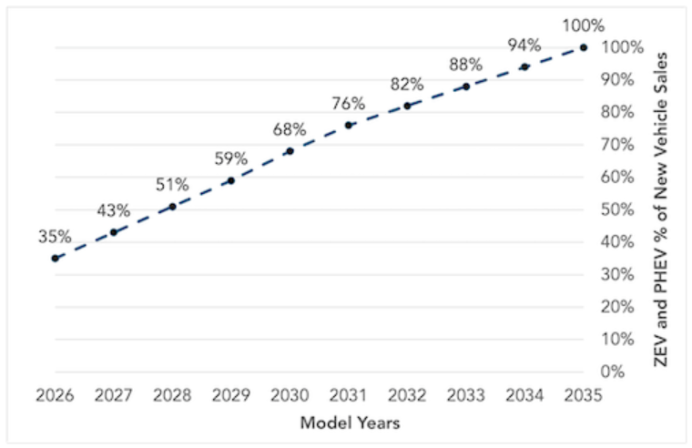
California’s Goals And Mandates Regarding Zero-Emission Vehicle Sales
2012 – Target of one million zero-emission vehicles (ZEVs) by 2025 (E.O. B-16-12)
2018 – Target of five million ZEVs by 2030; 250,000 public EV charging stations, 10,000 to be DC fast chargers (E.O. B-48-18)
2020 – Goal for all in-state sales of passenger vehicles to be zero-emission by 2035; 100% of medium- and heavy-duty vehicles to be zero-emission by 2045 where feasible; plus goals for other types of vehicles (E.O. N-79-20)
2022 – California Air Resources Board codifies standards for new light-duty vehicle sales: 35% of new vehicles are to be ZEVs in 2026, ramping up each year to 100% in 2035

Slide 6
Other States Follow California Air Resources Board (CARB) Standards
Section 177 of the Clean Air Act
States may follow Federal standards or stricter California standards
As of May 2022, Section 177 states adopting CARB’s zero-emission vehicle standards are: Colorado, Connecticut, Maine, Maryland, Massachusetts, Minnesota, New Mexico, New Jersey, Nevada, New York, Oregon, Rhode Island, Vermont, Virginia, Washington (“CARB independent research”)
These states account for about 36% of new light-duty vehicle sales in the U.S.

Slide 7
Current ZEV Penetration in California
At the end of 2021, light-duty zero-emission vehicle (ZEV) penetration in California:
Battery electric – 1.7% (522,445/29,104,630)
Plug-in hybrid – 1.0%
Fuel cell – 0.03%
2022 light-duty zero-emission vehicle (ZEV) sales in California:
Battery electric – 15.9% (292,496/1,835,429)
Plug-in hybrid – 2.8% (50,748/1,835,429)
Fuel cell – 0.01% (2,574/1,835,429)
For 2011 through 2022, California accounts for 40% of all electric vehicles sold in the US
At the end of 2022 second quarter, medium- and heavy-duty zero-emission vehicles in California – 1,943

Slide 8
California State Agencies Involved in Zero-Emission Vehicle Strategy

Slide 9
Who Are the Key State Agencies And What Are Their Roles?
Agency | Role(s)
California Air Resources Board (CARB) | Vehicle pollution standards; zero- emission vehicle (ZEV) mandates; Low Carbon Fuel Standard (LCFS) program
California Energy Commission (CEC) | Energy regulation; funding for charging infrastructure
California Public Utilities Commission (CPUC) | Regulates investor-owned utilities (but not municipal utilities, irrigation districts, or cooperatives); funding for charging infrastructure (IOU programs)
California State Transportation Agency (CalSTA) / California Department of Transportation (Caltrans) | Funding for non-vehicle transportation programs; funding for charging infrastructure, particularly along Alternative Fuel Corridors
Governor’s Office of Business and Economic Development | Coordinate California’s strategy to achieve zero-emission vehicle goals

Slide 10
CPUC Activities and Initiatives
Strategic planning on ZEV policy and investments
Electricity rates and cost of fueling
Distribution infrastructure and planning to support charging infrastructure
Vehicle-grid integration (VGI) policy, pilots, and technology enablement
Charging infrastructure deployment and incentives
Program evaluation and interagency coordination

Slide 11
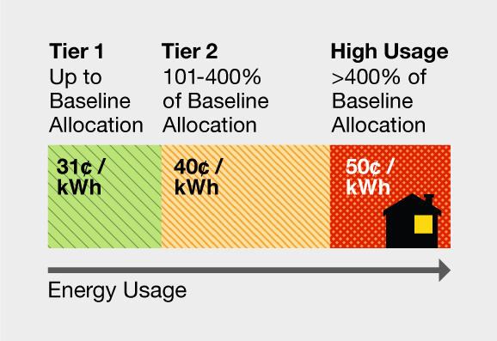
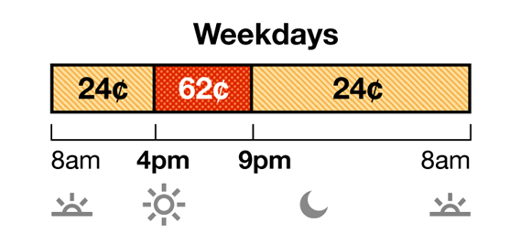
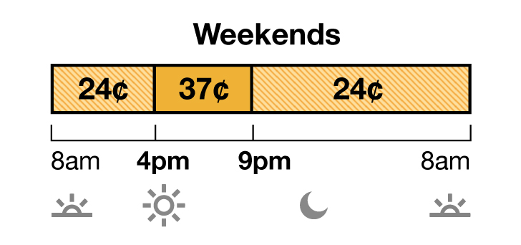
Rates to Encourage Off-Peak EV Charging
Pacific Gas and Electric, Southern California Edison, and San Diego Gas & Electric all have time-of-use rates that encourage off-peak charging of EVs
Illustrative rate structures:
Tiered rate
Time-of-use rate

Slide 12
Submetering and Communication Protocols
Until recently in California, signing up for a time-of-use rate that encourages off-peak usage meant either taking all service for a household under that rate or installing a separate meter for EV charging only
In Decision 22-08-024, the CPUC;
Adopted a plug-in electric vehicle submetering protocol for utilities in its jurisdiction
Allow submetering to measure an EV’s electricity consumption separately from the electricity consumption in the remainder of the household or business
Net energy metering customers are excluded at this time because it is difficult to determine the source of power registered on an EV submeter when solar panels and/or a battery is present.
Submeters should be owned by customers or third parties (not utilities)
Adopted electric vehicle supply equipment (EVSE) communication protocols that apply to EVSE deployed through future transportation electrification efforts (ratepayer-funded or utility-administered programs)
Facilitates vehicle-grid integration

Slide 13
Examples of California Incentives to Purchase EVs
High-Occupancy Vehicle (HOV) lane exemption (limited term)
California Clean Vehicle Rebate Project
Eligibility based on household size and income
Clean Vehicle Assistance Program (financing; aimed at less-qualified buyers)
Consumer Assistance Program Vehicle Retirement
Various Air Quality Management District programs to replace and scrap old gasoline-powered vehicles
California PACE (Property Assessed Clean Energy) Loss Reserve Program (covers EV charging infrastructure
South Coast Air Quality Management District Resident EV Charging Incentive Pilot Program
Rebates for acquiring pre-owned electric vehicles

Slide 14
How Do We Get All These Vehicles Charged?
Charger availability as of 2022 fourth quarter
Total public and shared private (voluntary survey of workplace and multifamily residence) electric vehicle chargers – 80,027
DC fast chargers – 8,528
Level 2 chargers – 71,499
Projected need
1.2 million public and shared chargers by 2030 (for 7.5 million to 8 million light-duty vehicles)
157,000 chargers for 180,000 medium- and heavy-duty trucks and buses
$2.9 billion committed to install 90,000 chargers (December 2022; Clean Transportation Program)

Slide 15
CPUC Infrastructure Funding Cycles (DRIVE Rulemaking, R.18-12-006)
Continues an earlier rulemaking begun in 2013; key recent decision: Decision 22-11-040 (November 2022)
Funding Cycle 0 (Present through 2024)
Continue current portfolio of utility programs; exhaust existing funding authorization
Funding Cycle 1 (2025-2029)
Third-party administered light-, medium-, and heavy-duty infrastructure rebate programs and marketing, education, and outreach (ME&O) programs
30% light-duty, 70% medium- and heavy-duty vehicles
65% of FC1 budget for underserved communities
IOU-administered technical assistance
Eliminate IOU ownership of behind-the-meter infrastructure beginning with Funding Cycle 1
Funding Cycle 2 (2030+)
Based on analysis during Funding Cycle 1
May include continued ratepayer funding of behind-the-meter investments

Slide 16
Alternative Fuel Corridors (Electric)

Slide 17
Reliability of Public Chargers
Federal requirement for projects funded under the Infrastructure Investment and Jobs Act (November 2021): chargers must be functional 97 percent of the time (23 CFR § 680.116)
2022 study of public DC fast chargers in San Francisco Bay area
“Public chargers” exclude Tesla chargers and non-public chargers (paid parking lots, private workplaces, etc.)
Sampled 657 EVSEs at 181 charging stations
72.5% were “functioning,” 22.7% were “not functioning,” for various reasons, and for 4.9%, the cable was not long enough to reach the charging port of a Chevrolet Bolt
This study refers to two other surveys:
In 2022, the California Air Resources Board reported significant barriers associated with membership requirements and the charging station not working
Similarly, also in 2022, Plug in America reported that the most significant difficulty with public DC fast charging was “Chargers are nonfunctional or broken”
Notably, this problem was cited much less often with respect to the Tesla Supercharger network

Slide 18
Vehicle-to-Grid Integration (VGI)
California Senate Bill 676 (2019) directed the CPUC to establish strategies to maximize cost-effective integration of electric vehicles into the electric grid by 2030
Decision 20-12-029 established VGI strategies
Reforming rates and dynamic pricing
Pursuing pilots and demonstration projects
Accelerating the use of EVs for bi-directional non-grid-export power
Reforming interconnection rules for grid-export
In May 2022, the CPUC approved three PG&E pilot VGI programs
Residential, commercial, and microgrid (Public Safety Power Shutoff)
California utilities now have multiple projects to test VGI
A separate proceeding is reviewing electric rate design to advance demand flexibility (Rulemaking 22-07-005)

Slide 19
Environmental and Social Justice (ESJ) Considerations
California has some of the worst air pollution in the United States
Los Angeles Basin
Central Valley (primarily Bakersfield to Sacramento)
Air pollution tends to be worse in low-income communities because of proximity to stationary pollution sources
To date, EV penetration is minimal in these communities
California Energy Commission Clean Transportation Program has a goal of targeting 50% of funding to projects that benefit low-income and disadvantaged communities
CPUC Funding Cycle 1 (2025-2029) reserves 65% of funding for underserved communities

Slide 20
Final Thought
“We can lead the world”

