Slide 1
Cost of Capital Mythology
Roger A. Morin, PhD
Emeritus Professor of Finance
Distinguished Professor of Finance for Regulated Industry
Center for the Study of Regulated Industry
Robinson College of Business, Georgia State University
Chairman & CEO Utility Research International
Notes:
Thanks for opportunity
Reviewing the state of the art of cost of equity estimation; new developments
Reflections observations after nearly half century of regulatory experiences
Some Rough Patches along the way.
MYTH: Sacred foundational truths ism; sacred cows threatened?

Slide 2
Schematic Representation of
Cost of Capital Determination
Cost of Debt
Cost of Equity
Capital Structure
Weights
Weighted Average
Cost of Capital
Allowed
Rate of Return
Notes:
COE Past, present, future

Slide 3
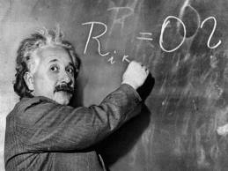
Cost of Equity Methodologies
Comparable Earnings
Discounted Cash Flow (DCF)
Risk Premium
Asset Pricing Models
  - CAPM
  - ECAPM
  - APM
  - FF-3F
  - MDCAPM
  - PRPM
  AI ?
Notes:
78
Arsenal of techniques, models, theories,
3 pillars; are they under attack from new myths??
What does future have in store? Are there better mousetraps?
Models are abstractions; implementations are agenda driven

Slide 4
Risk Premium
Methods of Estimation
Historical returns
  - Example: Duff & Phelps Historical Returns
  - Issues: choice of period, expectations vs realizations
Prospective returns
  - DCF-based risk premiums
Allowed risk premiums
Notes:
See historical risk premium graph on Excel
later AI on historical series
Circularity issue
Credit spread to deal with force majeure situations. 3-Mile Island, AT&T, CA Wild fires, Hurricane, acts of God, general rule

Slide 5
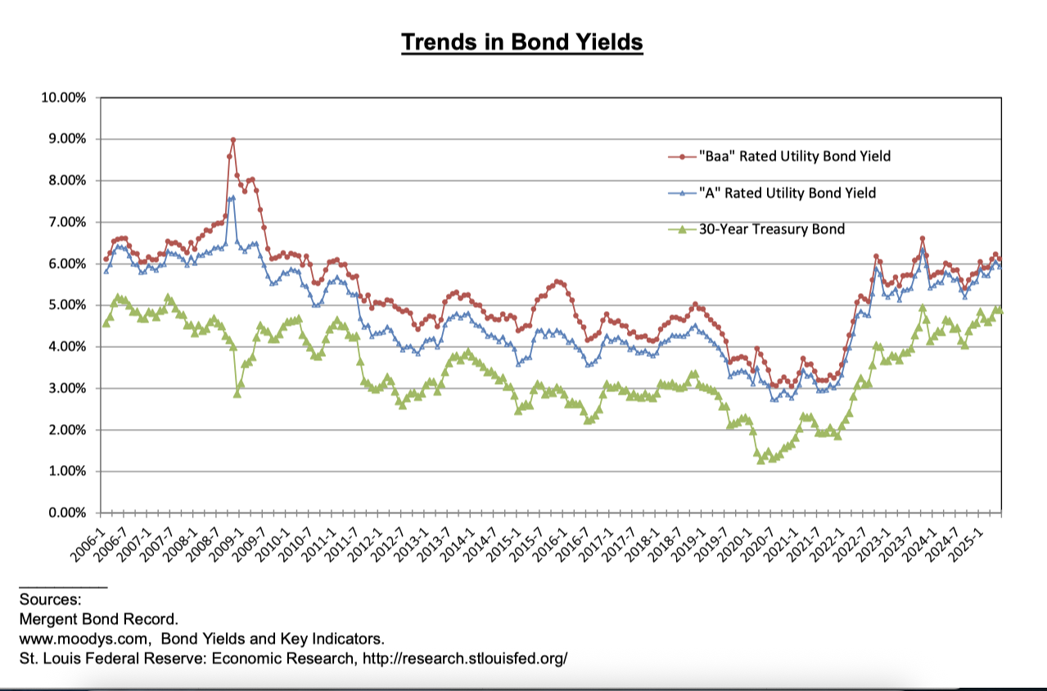
CREDIT SPREADS i.e. BOND YIELD SPREADS

Slide 6
Asset Pricing Models
CAPM
Empirical CAPM (“ECAPM”)
Arbitrage Pricing Model (“APM”)
Multi-Factor Model (Fama-French Model)
Size-Adjusted CAPM
Market-Derived CAPM (“MCAPM”)
Predictive Risk Premium Model

Slide 7
CAPM
Return
SML
K_{DELL}
R_{M}
Market
Portfolio
K_{NEE}
R_{f}
0
b_{NEE}
1.0
b_{DELL}
Risk
Notes:
86

Slide 8
CAPM
Return = Risk free rate + Risk premium
= Risk free rate + Beta (Market price of risk)
K = R_{f} + β(R_{m} - R_{f})
Notes:
2 variables macroeconomic
1 variable company-specific

Slide 9
Risk vs Return
Theory vs.Practice
Return
Theory
Practice
R_{f}
Low beta assets
High beta assets
0
1.0
Beta
Notes:
88

Slide 10
Arbitrage Pricing Model (APM)
Multiple-factor CAPM
Systematic elements of risk, other than market risk (beta), permeate across all securities
        Ex. Changes in economic activity
        Changes in inflationary expectations
        Changes in interest rates
APM: 2 major building blocks
        (1) Linear return generating function
        (2) Absence of risk-free arbitrage profits
Notes:
Industrial production
Changes in default premium on corporate bonds
Shifts in the term structure
Unanticipated inflation
Changes in real interest rates

Slide 11
Fama-French 3-Factor Model
K = R_{f} + β_{m}r_{m} + β_{s}r_{s} + β_{v}r_{v}
    where:
    β_{m} = market coefficient in FF regression
    r_{m} = market risk premium
    β_{s} = small-minus-big (SMB) coefficient in FF regression
    r_{s} = SMB risk premium (hist. mean returns small-cap
    less large-cap portfolios)
    Β_{v} = high-minus-low (HML) coefficient in FF regression
    r_{v} = HML risk premium (hist. mean returns high M/B
    less low M/B portfolios)
Notes:
FF SUPPLY REQUIRED DATA

Slide 12
Size-Adjusted CAPM
K_{e} = R_{F} + β (MRP) + Size Premium

Slide 14
Asset Pricing Models
CAPM
Empirical CAPM (“ECAPM”)
Arbitrage Pricing Model (“APM”)
Multi-Factor Model (Fama-French Model)
Size-Adjusted CAPM
Market-Derived CAPM (“MCAPM”)
Predictive Risk Premium Model
Notes:
is there a better mousetrap?

Slide 15
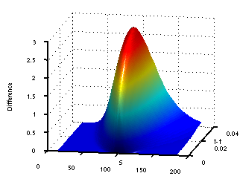
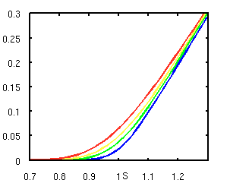
Market-Derived Capital Asset Pricing Model
(MCAPM)
Is There a Better Mousetrap ???
Notes:
options-pricing models give another (better ?) view of COC

Slide 16
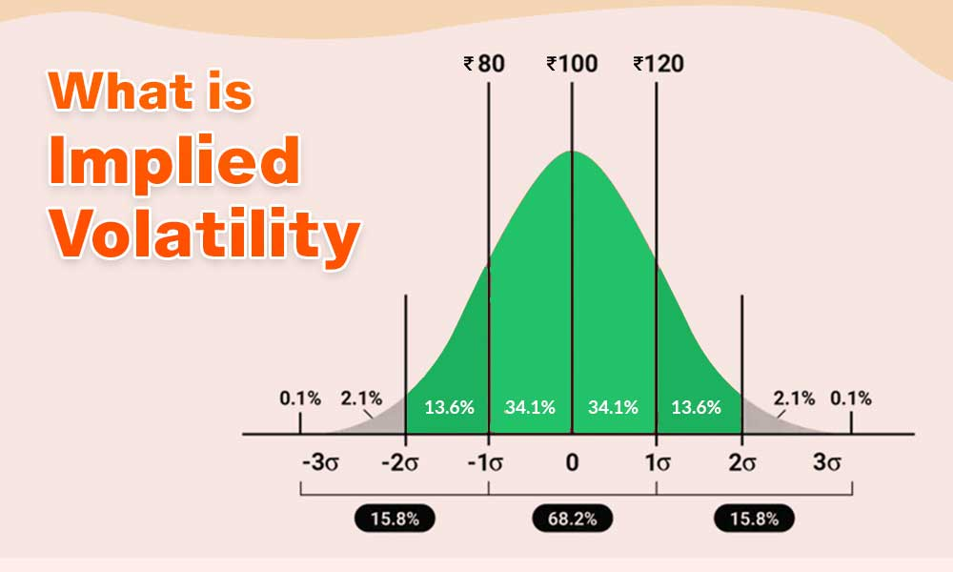
IMPLIED VOLATILITY
Notes:
implied Volatility (IV) is calculated using an iterative process that involves option pricing models and market prices. The most commonly used option pricing model is the Black-Scholes model.
Derived from the price of options

Slide 17
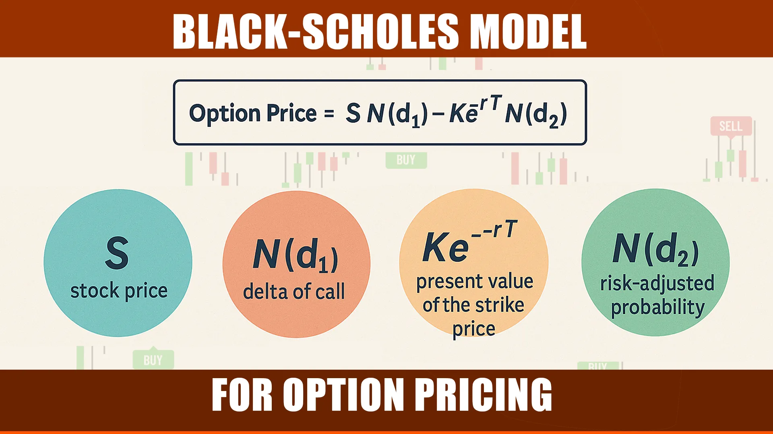
OPTION PRICING MODELS
Notes:
Implied Volatility (IV) is calculated using an iterative process that involves option pricing models and market prices. The most commonly used option pricing model is the Black-Scholes model.

Slide 18
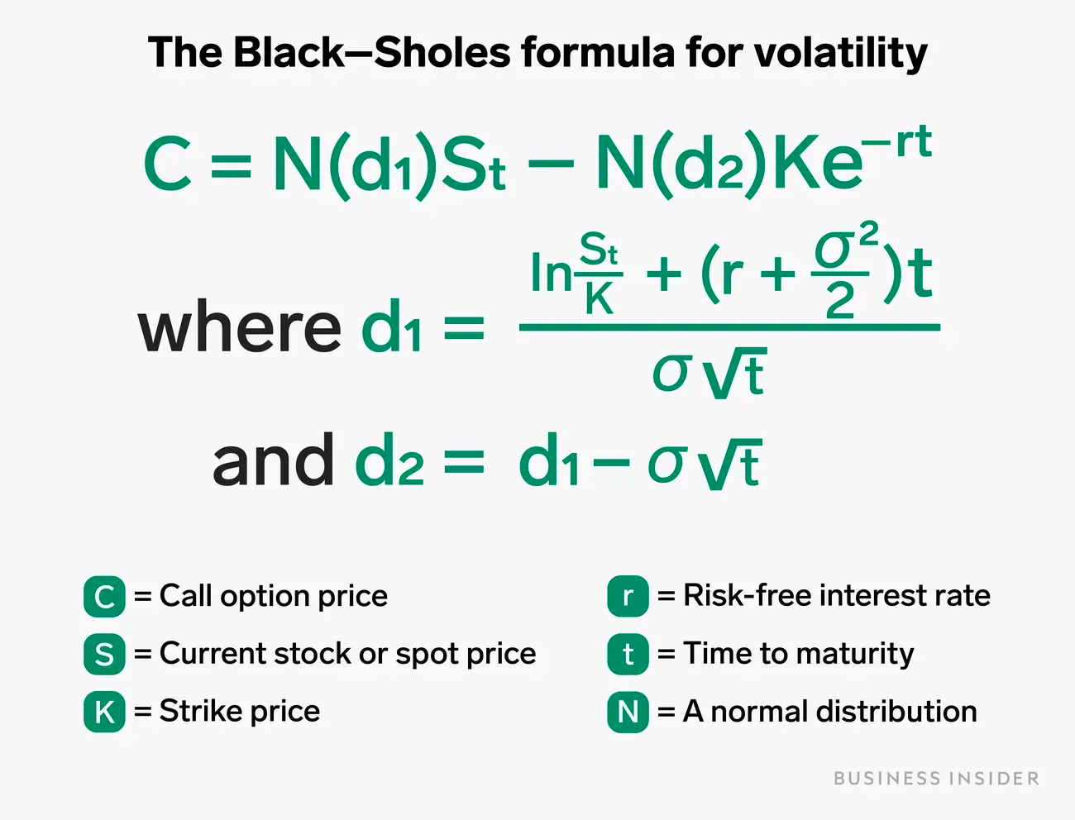

Slide 19
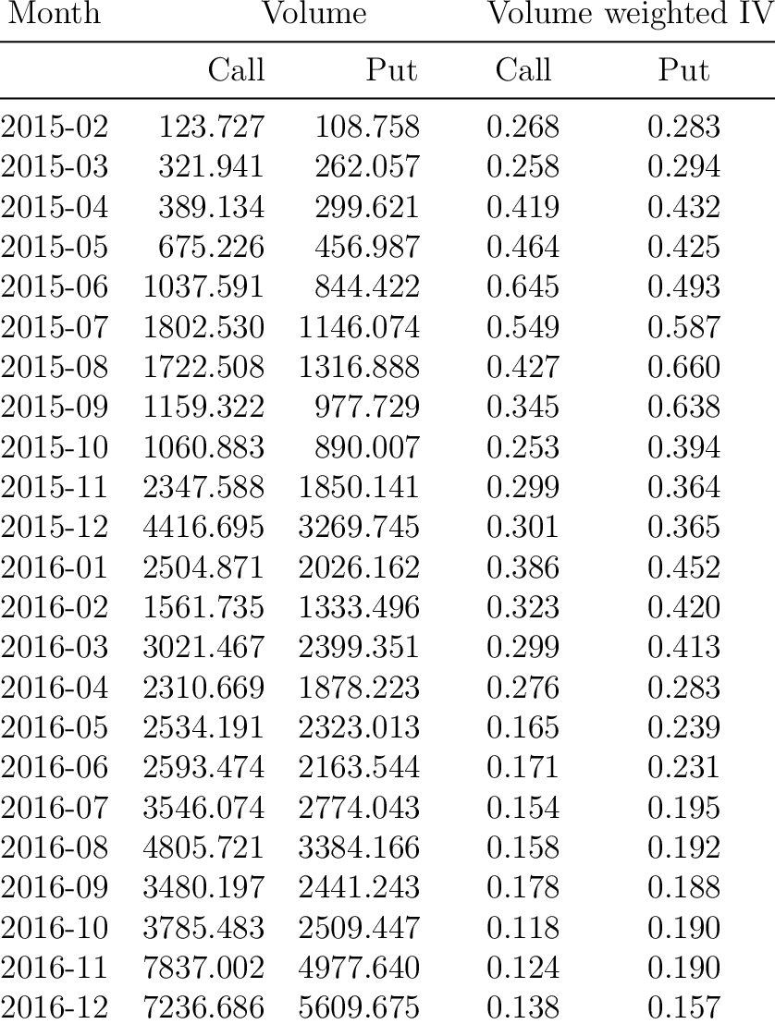
Notes:
Implied Volatility:
Compute the Volatilities Implied by Option Prices Observed in the Market using the SciPy Library
Implied volatility is a forward-looking measure that is not based on historical price movements but is instead derived from the prices of options.

Slide 20
Market-Derived Capital Pricing Model
Equity Return
Risk
Investors should get compensated for 3 kinds of risks:
  Equity return: Risk of being last-in-line, residual claim ➔ Put Option to sell investment at minimum acceptable price
  Corporate default: Risk of loss independent of macroeconomics factors ➔ Premium above treasuries on corporate debt
  National confiscation: Risk of loss because of national policy ➔ Risk-free rate
Corporate
Default Risk
National
Confiscation
Risk

Slide 21
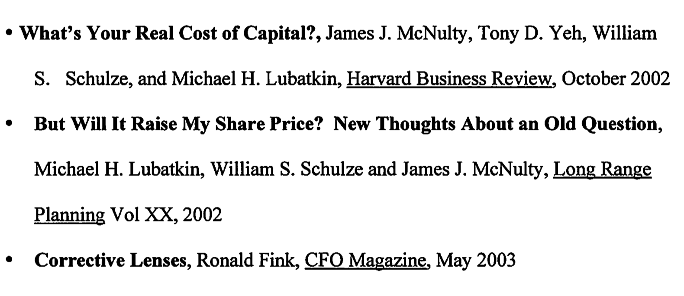
Market-Derived Capital Pricing Model
References

Slide 22
Equity Return Risk
4 Steps:
1. Calculate forward breakeven price
  P_{t} = P₀ (1 + r)^{t}
  where r = r_{debt} - r_{dividends}
2. Estimate stock’s future volatility
  (ISD on call option prices)
3. Calculate cost of downside insurance:
  Cost of put option (insurance premium)
4. Derive annualized excess equity return
Equity Return
Risk
Corporate
Default Risk
National
Confiscation
Risk
Notes:
Forward-looking

Slide 23
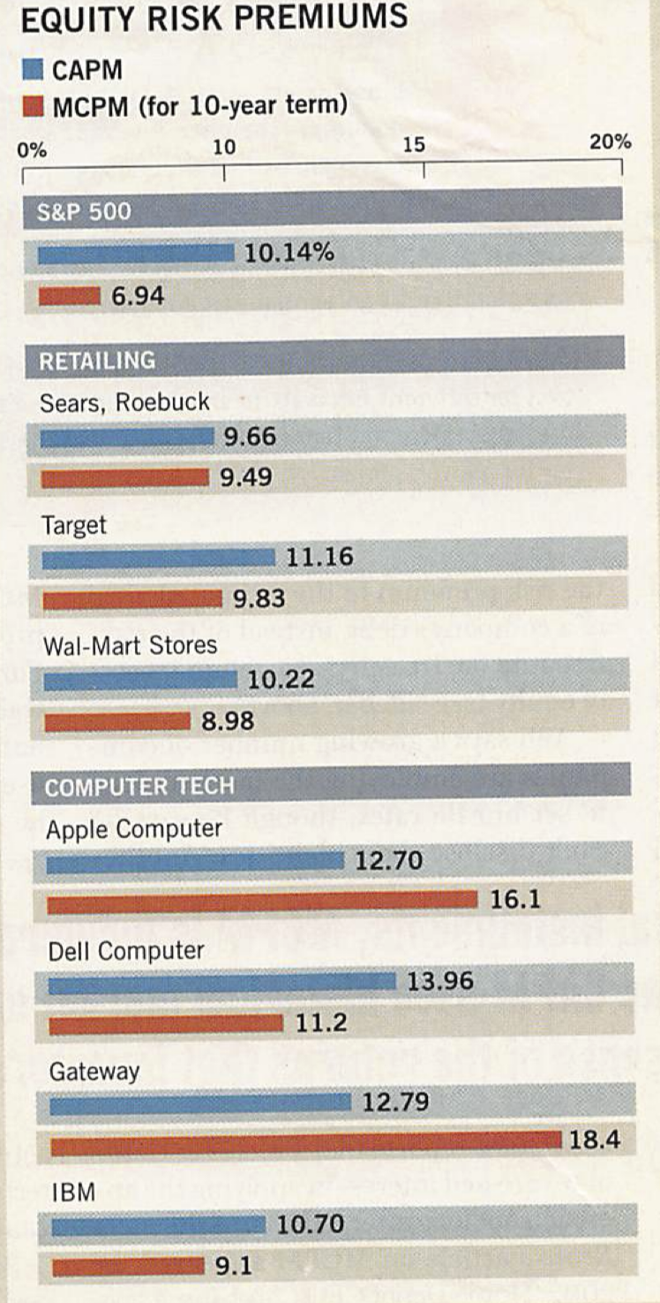

Slide 24
Will Beta ever be Beaten?
MCAPM is only a few years old
Addresses fundamental issues
  Forward looking
  Dissects risk composition
    National confiscation, corporate default, equity return
  Arbitrage/pricing-based
    Black-Scholes
Hard to say, jury still out, promising
Is AI-based ROE the new king??
Notes:
To anticipate, I believe it will!

Slide 25
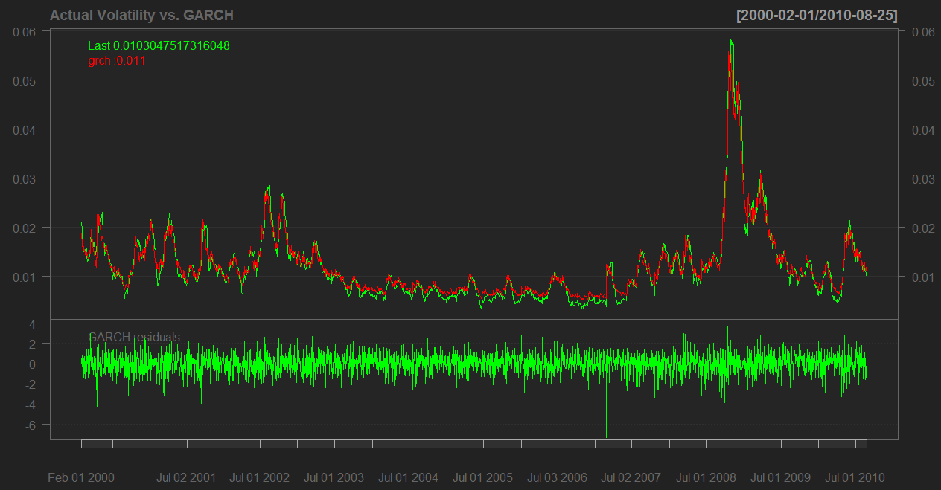
PRPM
Economic time series data analysis
Time-varying volatility
Uses “ARCH” technique
Volatility in stock returns clusters over time
Volatility is predictable
Notes:
Auto Regressive Conditional Heteroschedascity: Auto: not independent period to period; some history
Heteroskedasticity: variance is related to the independent variable
Nobel Prize in Economics awarded in 2003 to Robert F. Engle "for methods of analyzing economic time series with time-varying volatility (ARCH).
• “A New Approach for Estimating the Equity Risk Premium for Public Utilities”, Pauline M. Ahern, Frank J. Hanley & Richard A. Michelfelder, PH.D. The Journal of Regulatory Economics, 12/2011
• Conclusion: a generalized version to estimate the ERP equity risk premium for any firm, including public utilities
deals with non-linearity of historical data! AI Anyone??

Slide 26
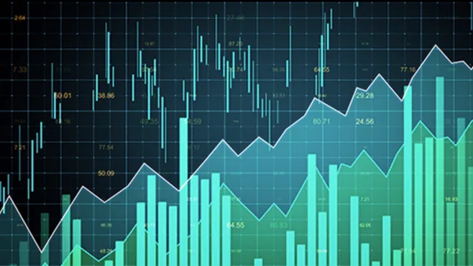
PRPM
Estimates Equity Risk Premium for every utility in the sample
Inputs: monthly returns – T-Bond yield
Using specialized software (ARCH):
  RP = a₀ + a₁σ + e
  ROE results are robust, reasonable
Notes:
Auto: not independent period to period; some history
Heteroskedasticity: variance is related to the independent variable
i.e. develops a return/risk ratio transformed into an equity risk premium
Could also estimate the MRP with the PRPM

Slide 27

Performance-Based Ratemaking
Notes:
proliferation of PBRs

Slide 28
Traditional ROR Regulation
Direct Costs
Quasi-judicial adversarial proceeding
Costly accounting controls required
Frequency and breadth of hearings
Expert testimonies, intervenors
Administrative costs
Notes:
- RITUALISTIC, GAMING, INTRUSIVE , same Rules of Evidence as in a murder trial
- HEARINGS
DEADWEIGHT LOSSES
Multiple set of acctg books

Slide 29

Traditional ROR Regulation
Indirect Costs
Potential for over-capitalization
Potential for inflated operating costs
Regulatory lag dampens incentives to innovate
Lack of pricing flexibility to remove or constrain cross-subsidization
Asymmetric reward / penalty
Prices out of touch with marginal costs
Notes:
LACK OF INCENTIVES
- AJ EFFECT; RATE BASE PADDING; INV’T
DECISIONS NOT GUIDED BY FREE MARKET
- COST PLUS MENTALITY; SPUR, SPIRIT OF
COMP’N GONE
- RL: INCENT TO DECR COSTS! ENOUGH? RISKS?
- CROSS-SUBSID & COST SHIFTING:
DIVERSIF --> COST SHIFTING; REG VS COMP
PREDATORY PRICING (ACCTG, STRUCT SEP.’N
COSTLY)
- ASYMMETRY: “TAILS, I WIN, HEADS YOU LOSE”
- FALSE SIGNALS (FDC vs MC pricing)
- NON-PRICE DIMENSIONS? (QUAL, RELIAB,
SAFETY)
EX. RATE BASE PADDING TO IMPROVE SERVICE

Slide 30
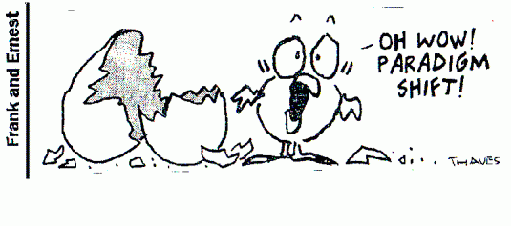
Paradigm Shift in Utility Ratemaking
Increased recognition of the uncontrollability, variability, and unpredictability of a utility’s costs, and customers’ usage levels
Increased awareness that a much more dynamic process is needed to ensure a utility's rates will actually recover the costs of service
Increased recognition that the majority of a utility’s costs are fixed, yet they are recovered through the volumetric component of its rate structure – which creates financial instability
A desire to streamline the regulatory process by reducing the number of general rate cases
Innovative ratemaking mechanisms have appeared more frequently in utility rate case filing
Notes:
Fortunately, response from regulators has been and continues to be constructive

Slide 31
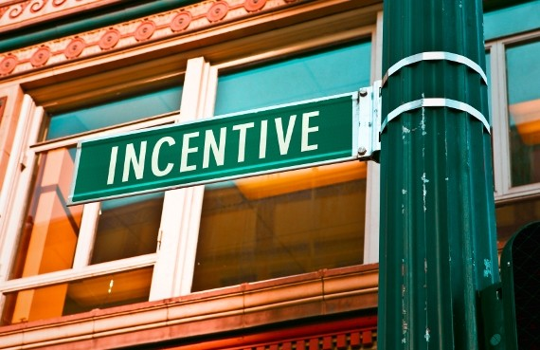
Incentive Regulation
Wide variety:
Regulatory Oversight
Formal Plans
Notes:
Eclectic nature of PBRs
No one dominant stand-alone model
Most ARFs are combinations,
Lego set analogy

Slide 32
Automatic Rate Adjustments
Individual cost component recovery
Fuel adjustment clause
Purchased gas costs for LDCs
Demand-side management; decoupling
ROE benchmarks
Alabama “RSE” plan
Mississippi “PEP” plan
Notes:
popular in high inflation
adjustments applied to major exogenous cost
RSE: when ROE<band, qtly adjustment of bills
RSE: avoid large rate increase
ROE benchmarks, i.e., generic ROR
ex. FERC benchmark
- DSM: decoupling of profits from revenues:
customer bills adjusted thru volume true-ups to
offset lost revenue from conservation

Slide 33

Mississippi Power Company
Performance Evaluation Plan (“PEP”)
Indexes the allowed range of return to performance
Purpose: To lessen the impact, frequency, and size of rate increase requests by permitting limited rate adjustments in order to maintain an approved return while providing an incentive to be efficient, reduce costs and improve productivity
Notes:
- Two particular PBRs are representative of creative responses of regulators
- RSE + one step
- Alabama RSE: little pricing flexib
limited options
limited incentives
(approach top of band, increase costs)
- PEP: a formal comprehensive integrated
in contrast to piecemeal focused plans

Slide 34
Mississippi PEP Plan
ROE Bands
ROE
11.0%
10.5%
10.0%
9.5%
9.0%
8.5%
I
II
III
IV
V
PEP Score

Slide 35
Benchmark ROE
Simple average ROE
    DCF
      30-day stock price
      Analysts’ growth forecast
    Risk Premium
    CAPM
A-Rated Non-nuclear Electric Utilities

Slide 36
Mississippi Power Company
Performance Evaluation Plan (“PEP”)
Annual Rate Adjustment Procedure
    Calculate weighted average of performance indicators
    Calculate allowed ROI based on formula
    Develop performance adjustment to allowed ROI
    Develop Range of No Change around allowed ROI
    Compare company’s projected ROI for the next 12 months with allowed range of ROI

Slide 37
Mississippi Power Company
Original Performance Measures
Residential rate comparisons 20%
Equivalent availability 16%
Service reliability 16%
Customer satisfaction 15%
Safety 11%
Contribution to load factor 11%
Construction performance 11%
Notes:
- Limits: max 2% per quarter
max 4% per year

Slide 38

Mississippi Power Company
Current Performance Measures & Weight
Average rate comparisons 40%
Service reliability 40%
Customer satisfaction 20%
Notes:
Limits: max 2% per quarter
max 4% per year

Slide 39
PEP Scoring
ROI
Residential Rates
8-10
V
Service Reliability
6-8
IV
4-6
III
Customer Satisfaction
2-4
II
0-2
I
0
2
4
6
8
10
8.5 Average Grade

Slide 40
PEP Scoring
Performance-adjusted ROE equals Benchmark ROE plus 10% of performance score
Example:
    Benchmark ROE = 9.50%
    Performance score = 8.5 (out of possible 10)
    Performance-adjusted ROE = 9.50% + 0.85 =10.35%
Notes:
Actually based on ROI, not ROE

Slide 41
Mississippi Power Company
Performance Evaluation Plan (“PEP”)
Accomplishments since inauguration:
  Limited scope and frequency of rate cases
  Provided incentives considerably higher than orthodox RORR for cost minimization and innovation
  Improved administrative efficiency through simplicity, predictability and flexibility
  Equitable to all parties
  Reduced investor risk perceptions
  Reduced regulatory lag by incorporation of future test year

Slide 42
Mississippi Power Company
Performance Evaluation Plan (“PEP”)
Drawbacks
  Performance standards, weights somewhat arbitrary
  Measurement difficult (agreeing on what to measure is the most difficult; the actual measurement mechanisms have been institutionalized)
  Scarcity of benchmarks
  Scarcity of comparable companies
  No additional flexibility to adjust prices in response to competitive forces (this flexibility can be provided through other legislation, not through PEP)

Slide 43

FPSC Leverage Formula
ROE = 7.13 + 1.610 / ER
Range: 8.74% - 11.16%
Docket No. 110006-WS – Water and wastewater industry annual reestablishment of authorized range of return on common equity for water and wastewater utilities pursuant to Section 367.081(4)(f), F.S.

Slide 44
Leverage ROE Formula
Example
ROE = 7.13 + 1.610 / ER
Equity Ratio = 40.00%
ROE = 7.13 + 1.610 / 0.40 = 11.16%

Slide 45
Formula Appraisal
Relies on DCF and CAPM methodologies
Allows for differences in risk
Includes flotation cost adjustment
Small size adjustment 50 b.p.
Private placement adjustment 50 b.p.
Natural gas distribution companies as proxies

Slide 46
Formula Key Assumptions
Business risk is similar for all WAW utilities
k_{e} rises exponentially with the debt ratio
WACC is constant over the equity ratio range of 40% to 100%
Cost of debt = Baa3 + private placement premium + small size premium

Slide 47
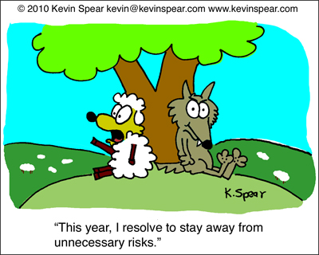
Risk-Mitigating Mechanisms
Notes:
responses

Slide 48

Risk Reduction Mechanisms
Fuel & purchased power recovery clauses
Forward test year
CWIP in rate base
Pre-approval of major capex
    New generating facilities
    Environmental compliance plans
    Environmental cost recovery
Riders & Trackers
Rate Design
    Revenue Decoupling
    Block rate adjustments
    Unbundled services & rates
ROE Adjustment Formulas
Zones of Reasonableness
Notes:
Block rate adjustments (declining, flattening, inverted, block restructuring)
Other mechanisms: low income rate structure, budget billing programs
Depreciation trackers
“The Birds”

Slide 49

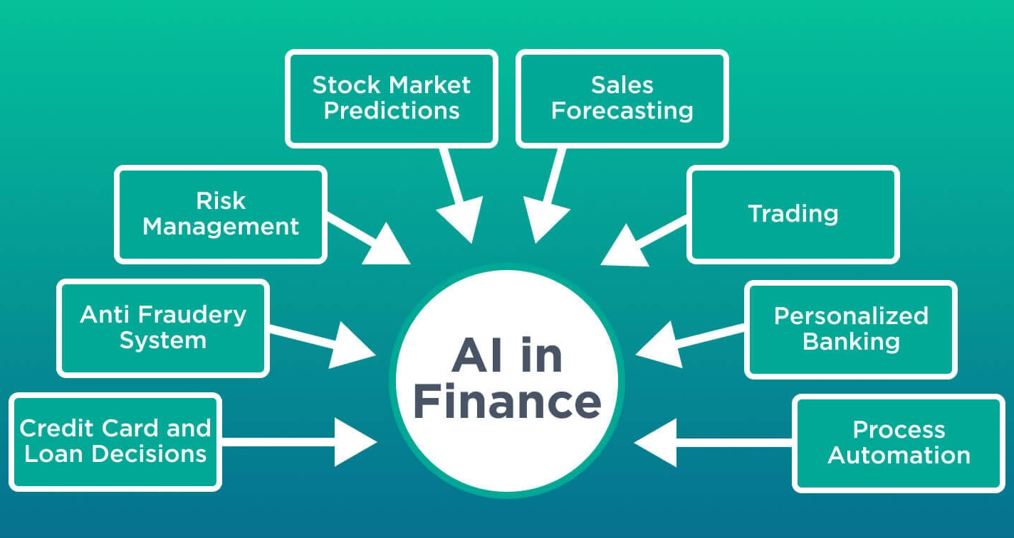
Notes:
Ubiquitous juggernaut Behemoth in all aspects of life, finance no exception. Ongoing revolution in all facets of finance, including COC
ChatGPT, ClaudeAI from Anthropics

Slide 50

AI AND THE COST OF CAPITAL

Slide 51
AI COST OF CAPITAL REFERENCES
“The Role of AI in Capital Structure to Enhance Corporate Funding
Strategies”
By Ashkan Eliasy & Justyna Przychodzen
www.elsevier.com/journals/array/2590-0056
“Explainable Machine Learning to Predict the Cost of Capital”
By Niklas Bussmann, Paolo Giudici, Alessandra Tanda, and Ellen Pei-Yi Yu
“AI-Based Prediction of Capital Structure: Performance Comparison of ANN
SVM and LR Models”
by Jesus Cuauhtemoc Tellez Gaytan, Karamath Ateeq, Aqila Rafiuddin, Haitham M Alzoubi, Taher M Ghazal, Tariq Ahamed Ahanger, Sunita Chaudhary, G K Viju.
“Ditch The Beta: Why AI Is The New Cost Of Capital King”
by Glassbury AI Digital Innovation

Slide 52
“The Role of AI in Capital Structure to Enhance Corporate Funding Strategies”
One year of historical data was used to calculate traditional CAPM value and also train the Recurrent Neural Networks (RNN) to predict stock prices of the upcoming year. A generic deep learning network architecture was developed with the use of Long Short Term Memory (LSTM) and dropout layers. After calculating the returns using traditional and AI approaches, two methods for calculation of CAPM were proposed and compared. It was found that the use of AI improved the accuracy of cost of equity estimations by over 60%. The strong ability of the selected deep learning neural network to predict stock prices, increased the accuracy of estimating returns by at least 18%. This study concluded that AI has significant potentials to replace traditional asset pricing models in the near future.”
Ashkan Eliasy & Justyna Przychodzen

Slide 53
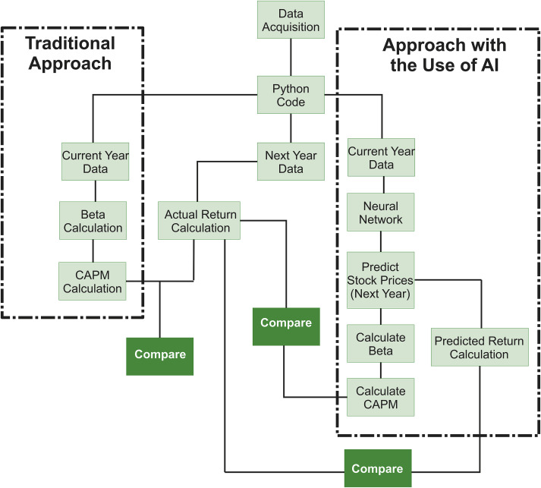
Ashkan Eliasy & Justyna Przychodzen

Slide 54
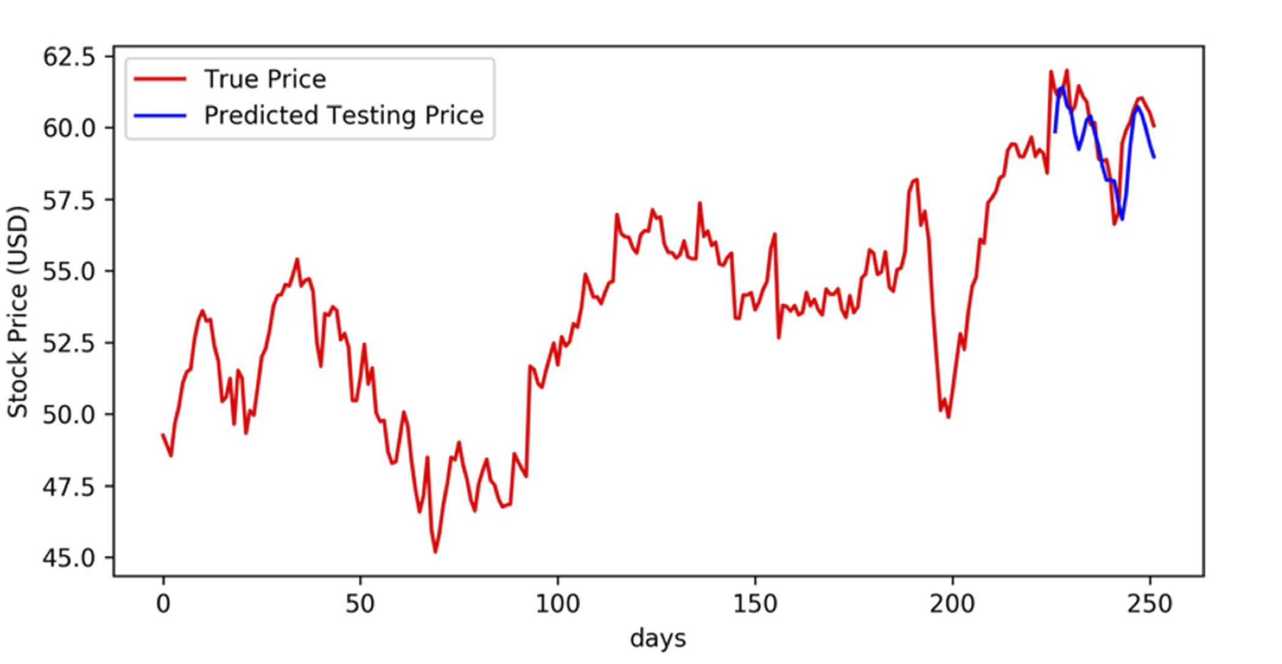
Ashkan Eliasy & Justyna Przychodzen

Slide 55
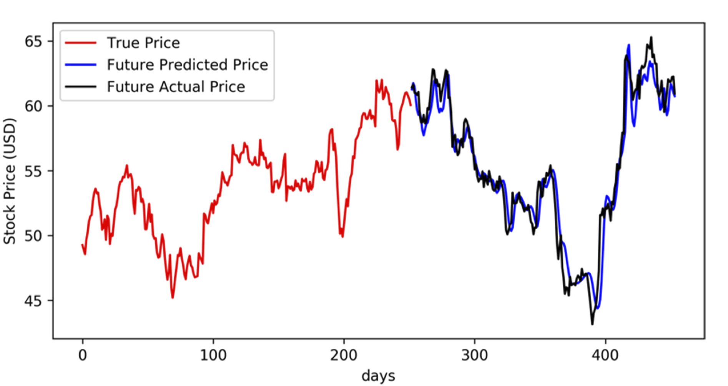
Ashkan Eliasy & Justyna Przychodzen

Slide 56

AI COST OF CAPITAL CALCULATIONS
Superior Accuracy
Predictive Power
Instantaneous Analysis
Replacing Beta
Interpretability Challenge
Notes:
1. Al methods using (LSTM) neural networks, improve the accuracy of COE estimates by over 60% compared to traditional CAPM estimates
2. Al can process sequential non-linear data to better forecast future stock performance and risk.
3. Al can estimate COE instantly, enabling CFOs to optimize their capital structure and financial decision-making in real-time.
4. Traditional risk metrics like "Beta" are becoming obsolete because Al can more reliably predict future returns, necessitating new parameters for defining risk.
5. "black box" issue, making it difficult to interpret how a specific COE figure was derived without using Explainable Al (XAl). methods

Slide 57
AI-POWERED COST OF CAPITAL ESTIMATION TOOLS
MLQ.ai CAPM Calculator
  Calculates Expected Return E(R)
  Uses R_{f} MRP, β
Jenova.ai Fundamental Stock Analysis
  DCF-based valuation
PrometAI Estimation Blueprint
  Step-by-step WACC calculation
  Combines cost of equity and cost of debt
Manus AI Pricing Tool
  Provides comparable financial data
Notes:
Free on-line AI-powered tools enable fast, automated estimation Cost of Equity (CAPM) and WACC
Key Takeaway
AI tools make cost of capital estimation faster, more accessible, and data-driven

Slide 58

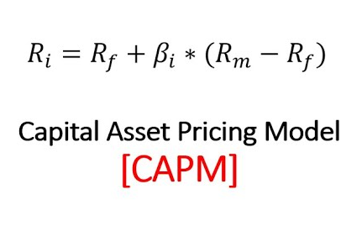
Is AI The New Cost Of Capital King?
X

Slide 59
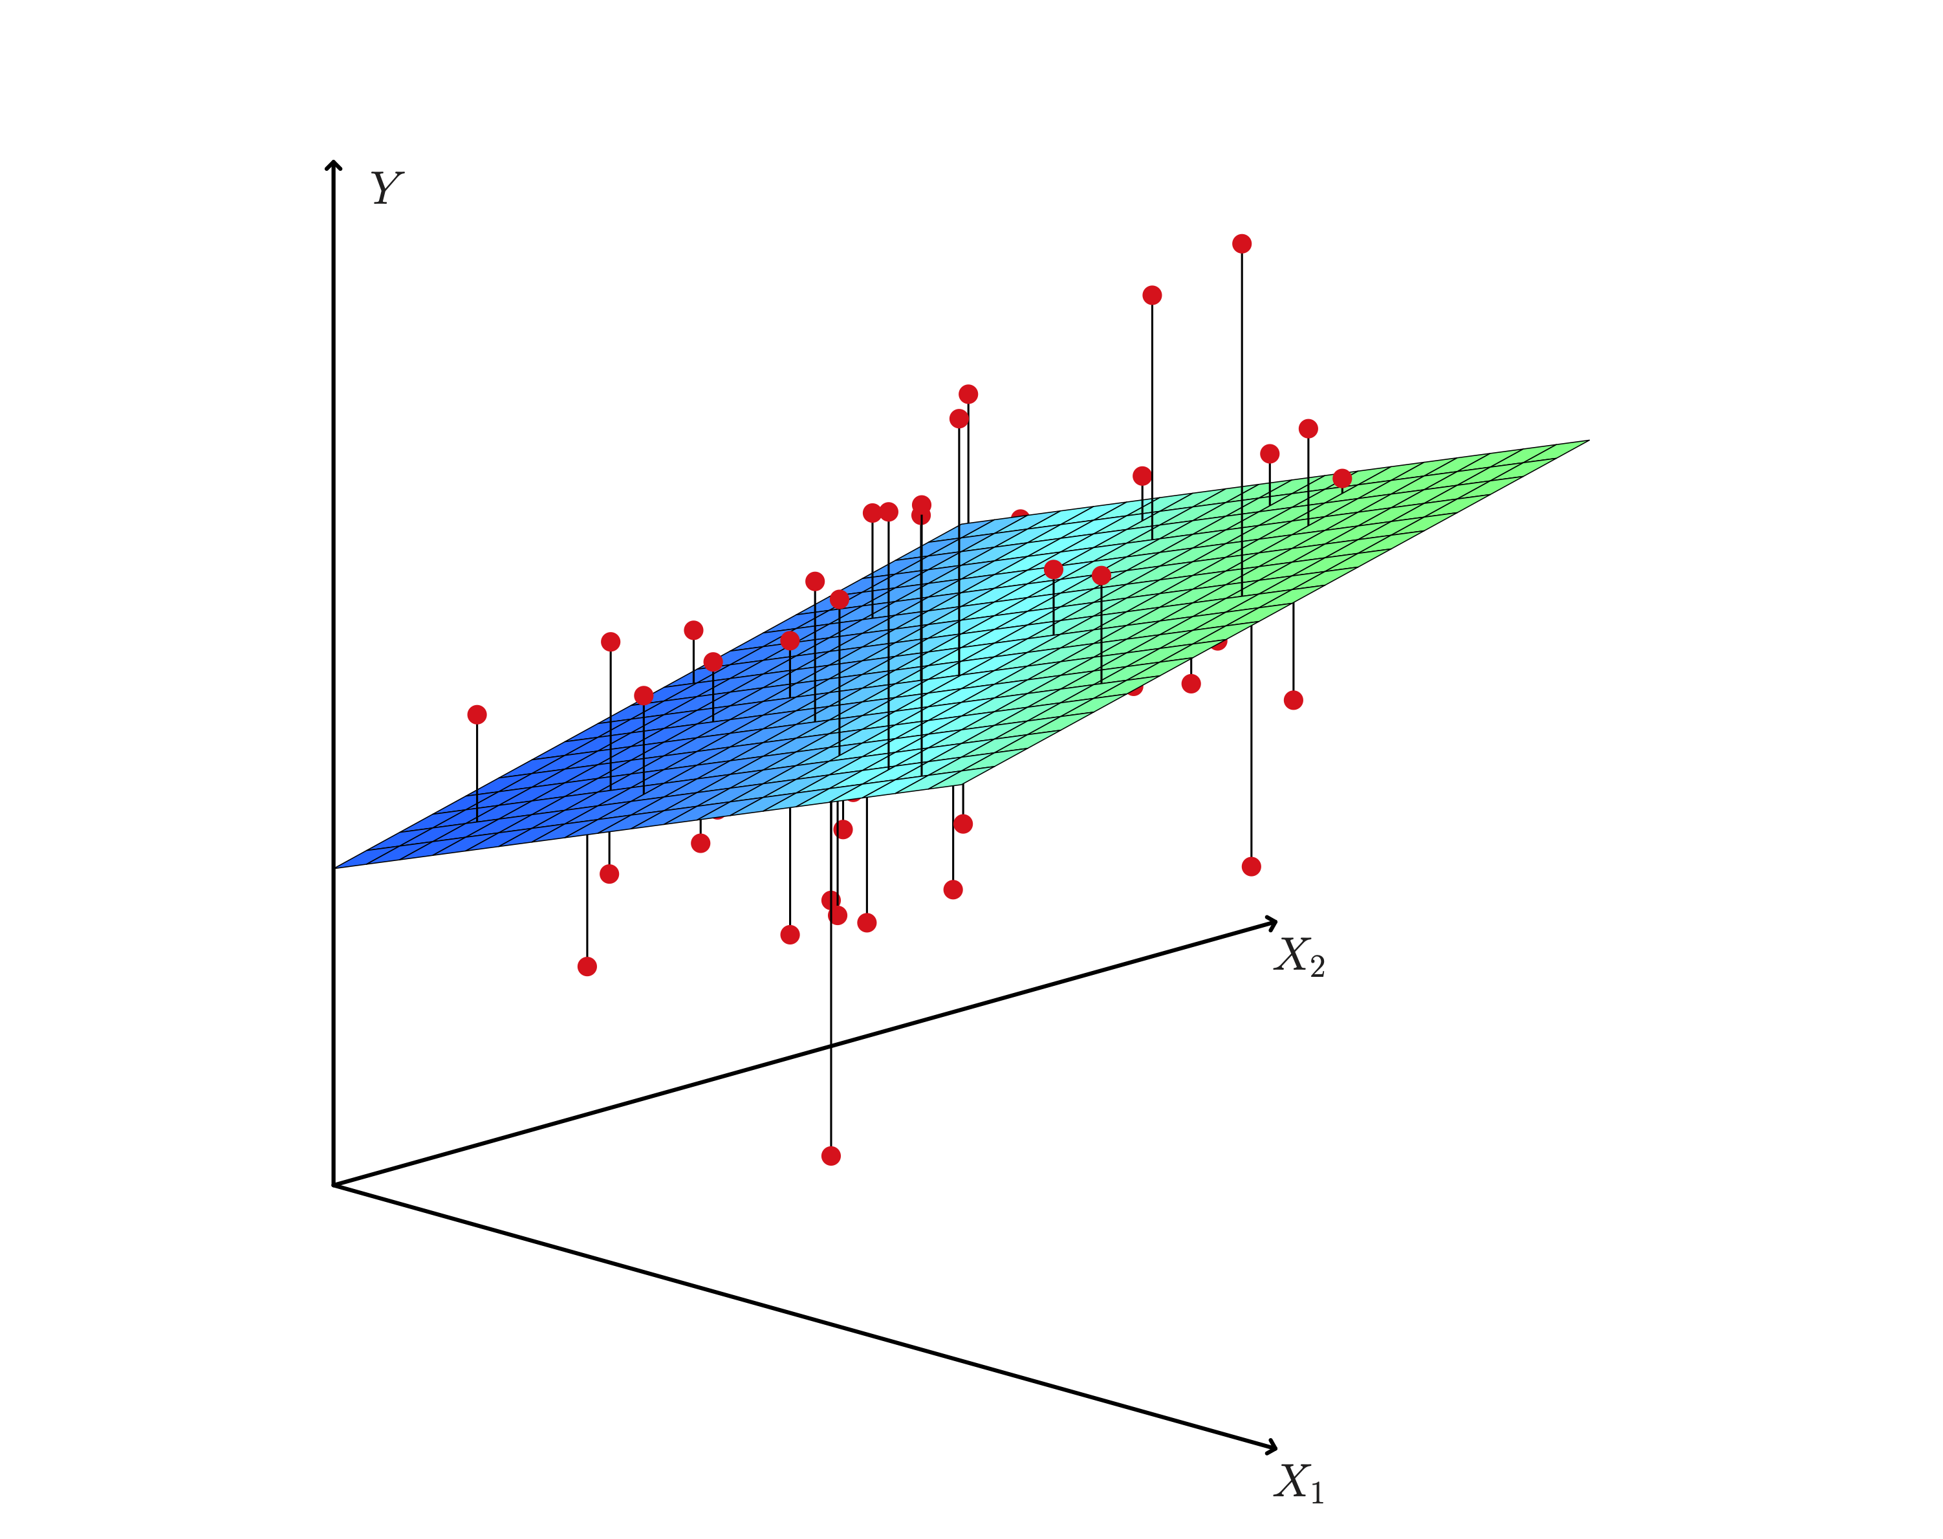
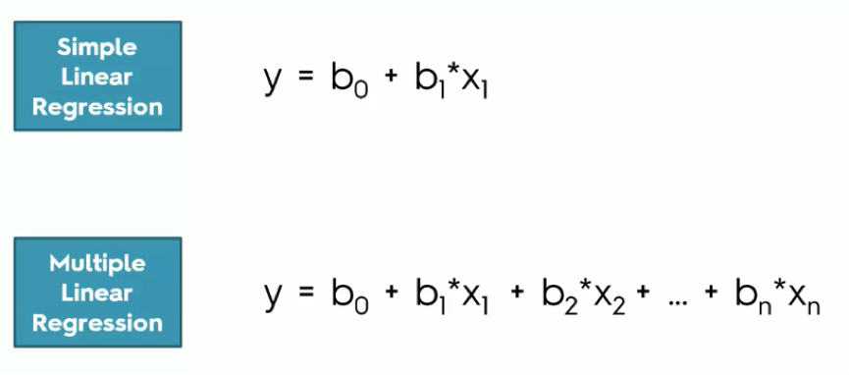
THE GREAT “SERM” BUBBLE
Notes:
HAS THE GREAT “SERM” BUBBLE BEEN SHATTERED? Is BETA on life support, or is it too early to bring the ressuccitator?
CAPM LIVES IN A NARROW WORLD OF LINEARITY AND NORMALITY! THE DAM HAS SPRUNG SOME LEAKS!
CAN WE ESCAPE FROM THIS NARROW LINEAR WORLD?
AI SAYS YES WE CAN; remember PRPM?

Slide 60
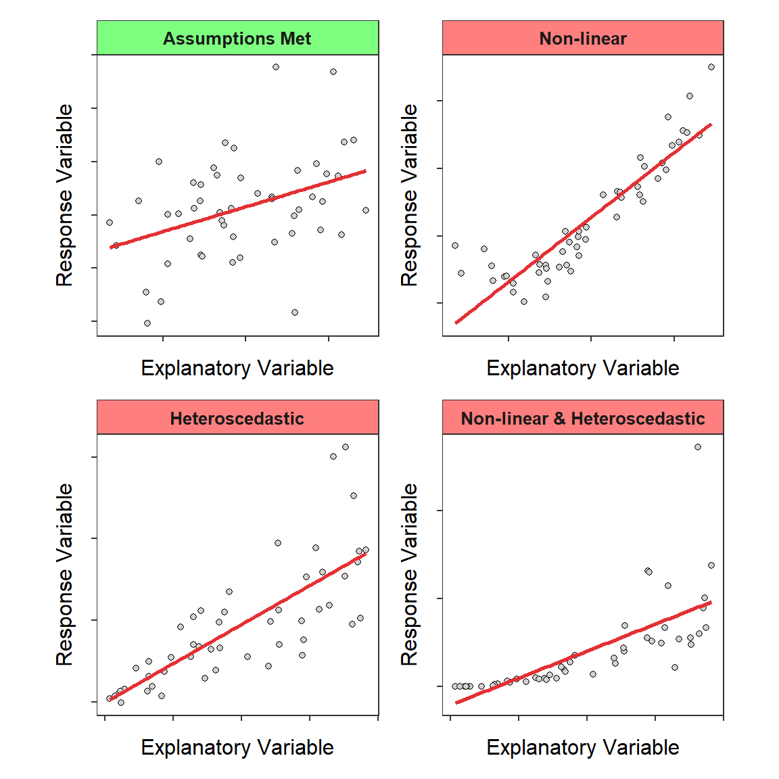
Notes:
THE DAM HAS SPRUNG LEAK
WHEELS COME OFF THE BICYCLE
Cigarette butts in the ashtray.

Slide 61
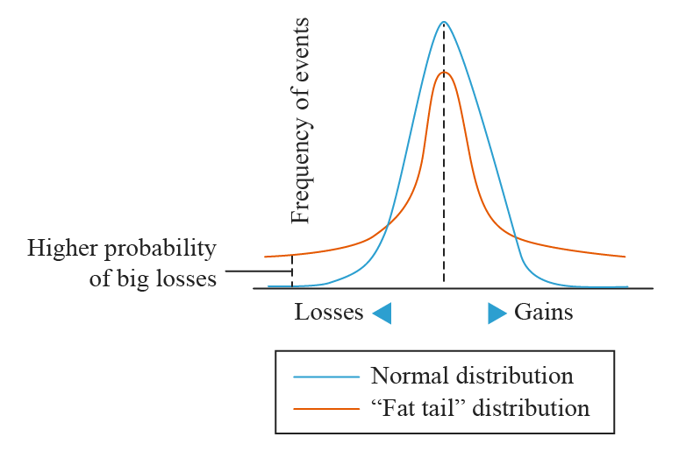

Slide 62
Cost of Capital Issues
Rebuilding A-level credit ratings
    Spreads have fluctuated
    Strong credit may be least-cost for customers
New methods for estimating the cost of capital
    The DCF and CAPM have some flaws
    New methods are needed to capture new risks
    PRPM and MDAPM
    AI estimates most promising
New mechanisms & procedures for tracking market variability
    Single point estimates will not work well if markets remain variable
    Can we treat cost of capital like we do fuel costs (i.e., via a tracker)?
Notes:
OPTIMAL BOND RATING SIMULATION
Sam Hadaway study of residential rates vs bond rating
NJ Reform New Utility Business Model: Performance-based ratemaking, multiyear rate plans and lower utility returns are all options the NJBU plans to consider.

Slide 63
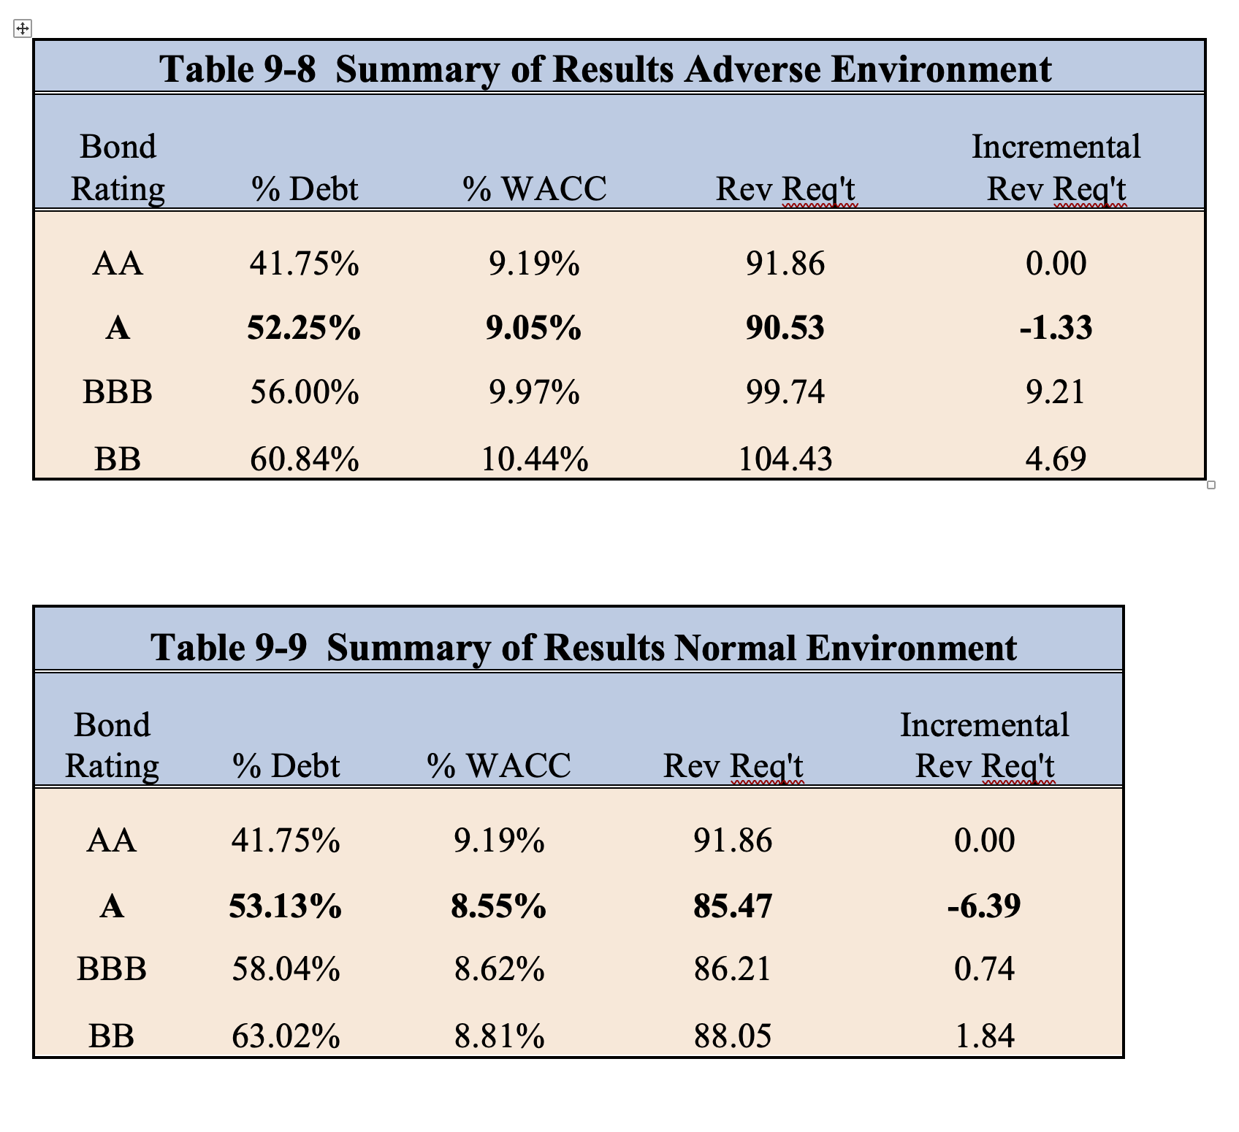
Optimal Bond Rating

Slide 64

Dr. Morin’s Top Industry Issues
Aggressive capital spending
Distributed Generation, PV
Rising Costs
Affordability
Ambitious regulatory agenda
Risk Mitigating Mechanisms
Industry consolidation
PBR Innovations
AI Revolution
Uncertain macroeconomy
Notes:
Duke Energy $100M. $1T. SO $90M
Aging infrastructure. AI centers energy requirement Data Center Boom
Focus on system reliability
Prices & Volatility increasing
Perfect Storm
AI is outpacing America’s power grid. Nuclear must become a national priority.
Utilities face cost-recovery risk as infrastructure costs, demand rise:
affordability: cake already baked?

