Slide 1
Economic Outlook
Travis Kavulla – Head of Policy, Base Power Company
Society of Utility & Regulatory Financial Analysts, Charlotte, NC
Apr 16, 2026

Slide 2

Introduction: Travis Kavulla
Head of Policy, Base Power Company
Lecturer, University of Chicago, Harris School of Public Policy: “Utilities & Electricity Markets: Regulation in the United States”
Previously:
Vice President, Regulatory Affairs NRG Energy
Director, Energy & Environmental Policy, R Street Institute
Board Member, Western Energy Market (operated by the CAISO)
Chairman, Montana Public Service Commission, and President, National Association of Regulatory Utility Commissioners (NARUC)

Slide 3
Outline
01 What’s Real?
03 A Bifurcated Market
Significant uncertainty permeates power sector demand projections, with growth highly concentrated in a single industry. Since at least part of this growth is supplied by a deregulated commodity market, we can observe what people with actual “money down” are doing
Both commodity and regulated-utility services are likely to be expressly bifurcated as to facilitating data centers’ electricity-service needs
02 Double Whammy
04 Affordability
Materials price inflation and a rising cost of capital are creating an environment where marginal costs exceed embedded, average cost of service
Bold approaches to constrain everyday consumers’ bills are on the table, with a potentially significant rebalancing of regulated-utility business models and returns

Slide 4
What’s Real? Load forecasts…

Slide 5
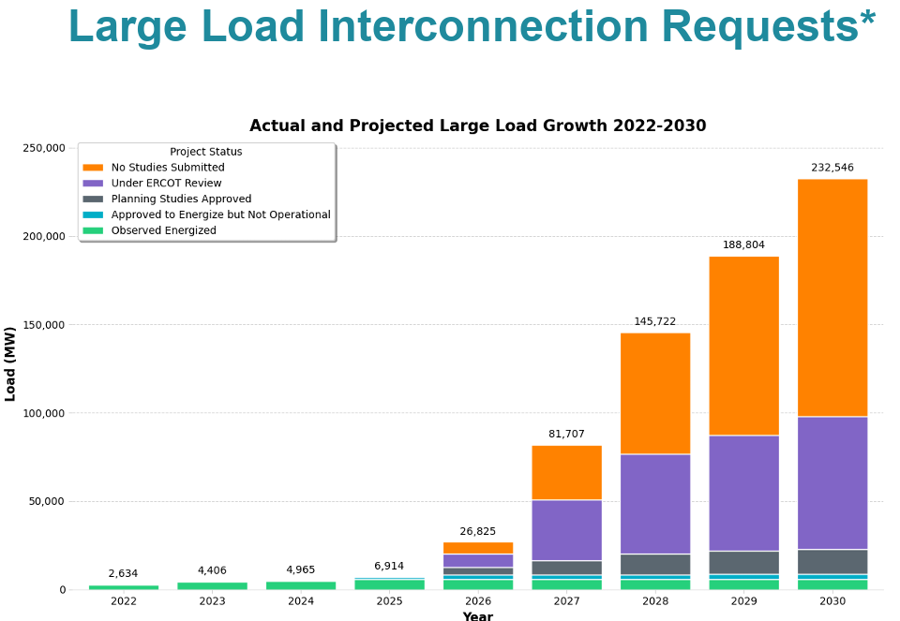
So Bullish that It’s…Bearish?
ERCOT All-Time Peak Demand
85,508 MW
(Aug 10, 2023)
ERCOT’s 2025 Bottom-Up Load Forecast for 2027
138,000 MW
(a 61% increase in 2 years)
ERCOT’s “More Reasonable” Adjusted Load Forecast for 2027
103,725 MW
(a 23% increase in 2 years)
ERCOT’s “More Reasonable” Adjusted Load Forecast for 2031
145,000 MW
(a CAGR of 6.8% per year)
ERCOT, Feb. 2026
Source: ERCOT’s Revisions to Adjusted Load Forecasts and Amended Draft Proposed Order.
Source: ERCOT Board Meeting, Feb. 2026

Slide 6

Impact of Projections

Slide 7
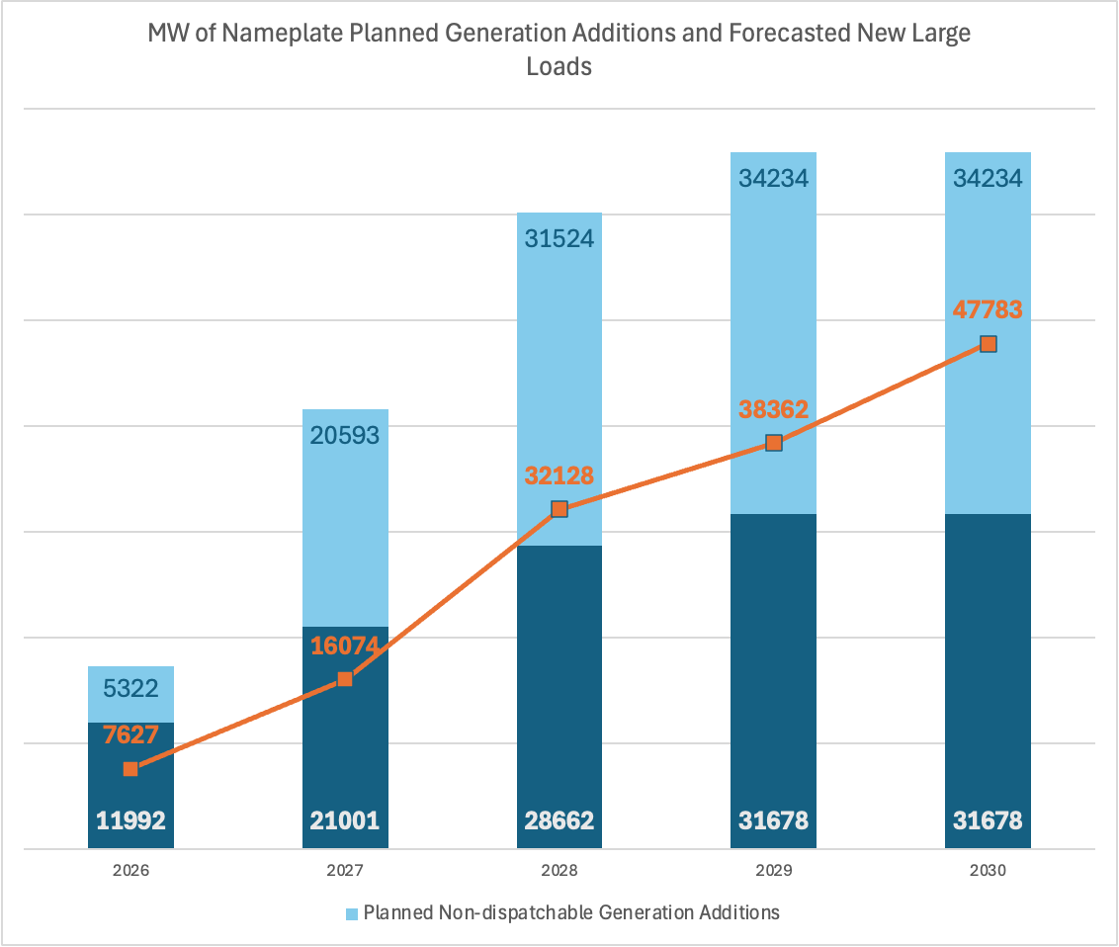
Resource Additions
Generation additions in ERCOT cannot keep pace with the large load demand forecast
Cumulative Loads includes only Large Loads (Contracted and TSP Officer Letter)
52% of Planned Generation is non-dispatchable Solar, while data center loads have very high load factors
Even within the block of dispatchable generation, 82% of it is battery energy storage
Source: ERCOT Dember 2025 CDR, 2026-2030.

Slide 8
Trading for forward years doesn’t suggest the scarcity indicated
by administrative projections of demand/supply

Slide 9
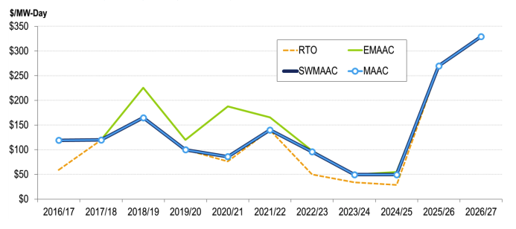
Sudden (Projected) Demand in Commodity Markets: Marginal-Cost Price Exposure
PJM Capacity Prices

Slide 10
Double Whammy: Utility Costs

Slide 11
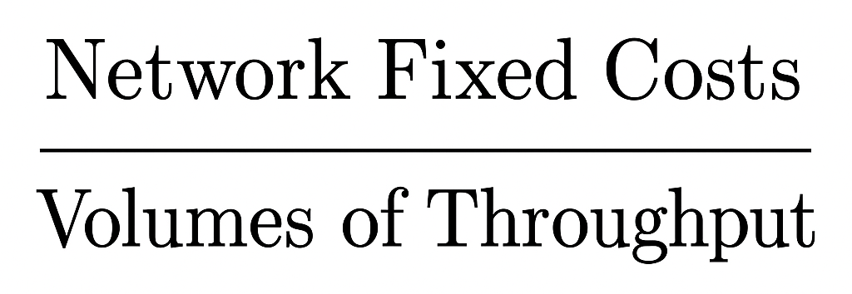
Marginal-Cost Pricing? What’s That?!
The grid, which is mostly large capital costs of a fixed nature with a good measure of ‘fixed’ O&M to support it, is subject to cost-of-service regulation where price results from:
The math is not hard!
If you add demand to the system without triggering new fixed costs, rates are lower for everyone. New demand pays average rates: the type of subsidy everyone loves!
But if you add 1 unit of demand but that triggers 2 units of new fixed costs, rates go up for everyone (unless costs are directly allocated to the new demand): the type of subsidy everyone hates!

Slide 12
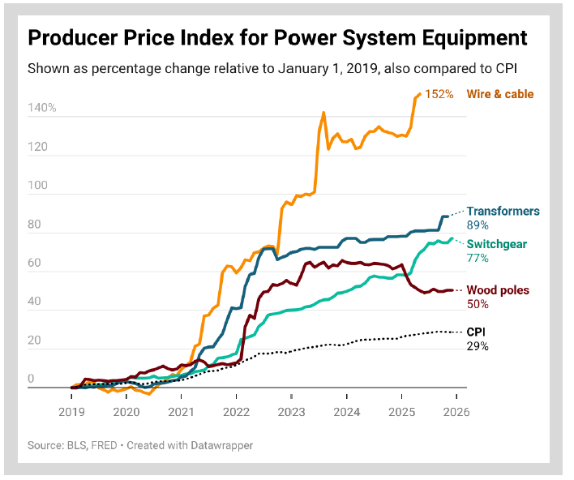
Regulated Utility Costs
Capital items that are the ingredients for regulated-utility service are rising in cost significantly
Replacement cost > depreciation expense on a unit basis, and…
In a load-growth environment, additional volumes will not recover costs if rates are charged on an averaged, embedded-cost basis
In short, Marginal Cost > Stated Rates. This creates a rate-increase environment even if volumes were not increasing, the moreso if volumes expand in ways that require cap-ex
But wait there’s more

Slide 13
Interest Rates
UTILITY | EMBEDDED DEBT COST (used in ratemaking) | RECENT ISSUANCE RATE(S) (2025–2026 offerings) | GAP (new minus embedded) | DEBT MATURING (through Dec 2030)
Oncor Electric Delivery - TX | 4.39% | ~5.0–5.5% | +1.11% | ~$1.5–2.0B est.
Pacific Gas & Electric (PG&E) - CA | ~4.7–5.0% | 5.20% / 6.00% | +0.85% | ~$4–5B
San Diego Gas & Electric (SDG&E) - CA | ~4.5–4.8% | 5.20% / 5.95% | +1.04% | ~$1.0–1.5B
DTE Electric - MI | ~4.3–4.6% | 4.85% / 5.55% | +0.86% | ~$1.5–2.0B
Northern States Power (Xcel sub.) - MN | ~4.0–4.4% | 4.85% / 5.55% | +1.16% | ~$1.5–2.0B
Duke Energy Carolinas- NC/SC | ~4.0–4.5% | ~5.0–5.5% (est.) | +1.46% | ~$1.5–2.5B
Duke Energy Corp (HoldCo) - Various | ~3.8–4.3% | 5.45% / 5.80% | +1.79% | ~$7–9B
Dominion Energy (Virginia Power) - VA | ~4.2–4.6% | 4.60% / 5.00% / 5.45% | +0.78% | ~$4–6B
Ameren Missouri / Illinois (Union Electric)– MS/IL | ~4.3–4.7% | 4.80% / 5.55% | +0.83% | ~$1.5–2.5B
Portland General Electric - OR | ~4.5% | ~5.0–5.5% (est.) | +1.00% | ~$0.5–1.0B est.

Slide 14
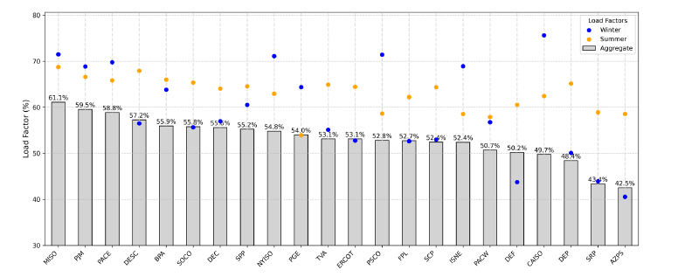
Grid still Underutilized
Source: Duke Nicholas Institute (2025)

Slide 15
Bifurcated Markets: A Utility for Data Centers

Slide 16

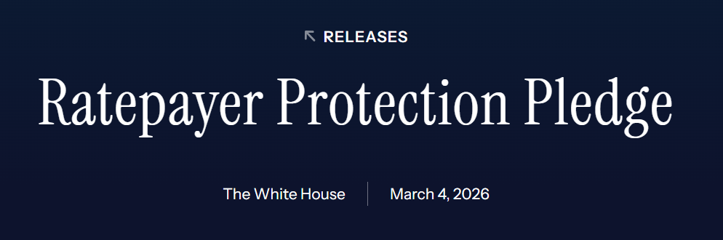
A Separate Customer Class…
Or a Parallel Industry?
Utilities have long mutualized the incremental costs of demand growth by charging both new and existing users average, embedded-cost pricing – sometimes with incremental costs defined by a relatively limited allowance. That seems to be changing!
In March 2026, Hyperscalers & White House announced the “Ratepayer Protection Pledge” which for grid costs defines a “but for” principle (allocating incremental costs that would not exist but for data centers to those particular customers) and announces a Bring Your Own Generation construct for supply
Let’s look at how those might be achieved…

Slide 17
Allocating Scarce Grid Capacity to Large Load
Criterion | Option 1 — preferred Open season auction | Option 2 — preferred Customer prepayment of incremental costs | Option 3 — distant third Transmission security agreements (TSAs)
Direct cost allocation | Incremental cost Winning bidders pay at least the full incremental cost of grid expansion to serve them; surplus revenues benefit other ratepayers. | Incremental cost Data center pre-funds the utility’s own estimate of the cost to serve it, holding other customers harmless dollar-for-dollar. | Averaged cost Revenue guarantee is keyed to the existing average embedded-cost rate, not incremental cost — a greenfield build and a brownfield redevelopment yield the same obligation.
Value-based vs. cost-of-service pricing | Value-based NPV-scored auction lets data centers reveal willingness to pay and compete on flexibility, speed, and location — not a simple pass-through of embedded rates. | Hybrid Starts from cost-of-service logic (prepay the utility’s estimate) but allows a follow-on value analysis to rebate joint benefits back to the data center over time. | Cost-of-service Extends conventional average-cost pricing to an environment where it has reached “its breaking point.” No mechanism rewards efficient siting or operational flexibility.
Risk allocation: data center vs. legacy ratepayers | DC bears risk Binding financial commitments secured before utility capital spending begins; tradeable rights protect against default or obsolescence without stranding costs on others. | DC bears risk Full prepayment eliminates cost-shift risk to other customers on the front end. Utility retains ability to seek cost-sharing later only for demonstrably joint benefits. | Mixed / residual on ratepayers Collateral or parent guarantee reduces but does not eliminate risk. If a TSA does not cover incremental cost and the data center defaults, stranded costs likely recirculate onto legacy ratepayers via utility rate base.
Efficiency of grid siting & capacity use | High NPV scoring rewards data centers that avoid peak demand and choose locations with existing infrastructure headroom; iterating open seasons right-sizes expansion to actual demand. | Moderate Ad hoc and location-neutral; does not actively steer data centers toward lower-cost grid locations, but a regulator can add a value analysis for oversized, jointly beneficial projects. | Low Sends no locational or temporal price signal. A data center pays the same whether it builds in a grid-constrained area or a well-served one, and has no incentive to curtail at peak times.
Speed & access to interconnection | Structured clarity Replaces speculative first-in-time queues with a defined plan, awarded rights, and an iterative cycle — reducing the Gold Rush dynamic that produces inflated demand projections and bureaucratic snarls. | Can expedite Customer-contributed capital should accelerate service; removes utility balance-sheet constraints and regulatory preapproval hang-ups as barriers to timely interconnection. | Partial improvement Filters out pure speculators (only committed data centers take on the revenue guarantee), but does not fundamentally reform the queue or accelerate utility capital deployment.
Alignment with utility incentives | Tension Requires utilities to share interconnection planning with a competitive process, limiting their monopoly on capital-spending opportunity; utilities may resist. | Opposed by utilities Utilities have actively litigated against customer-contributed capital because it competes with their own rate-base investment opportunity. Regulatory reform needed to overcome resistance. | Utility-preferred Monopolizes the capital opportunity, prices at average cost, obtains a revenue guarantee, and shifts residual stranded-cost risk back to regulators — secures utility profits while limiting downside.

Slide 18
Bring Your Own Generation
Risks to Utility Customers
Does “BYOG” impose a mere expectation on data centers to build, buy, or pay for data centers – or does it prohibit regulated utilities from co-mingling regulated rate base with generation investments to new large loads?
BYOG approaches exist both in regulated utilities (sleeves for generation that don’t touch utility balance) and, of course, restructured utilities (which have no obligation to serve except as a provider of last resort, and then for certain customer classes)
With genuine BYOG contracts, counterparty relationship is between supplier/data center, with no intermediation by PUC + captive customer base
Let’s assume you want utilities to play a role. Here are some protections to have in mind:
1. Is the utility ring-fenced adequately (is it co-mingling regulated rate base with generation investments to new large loads)?
2. If the PUC hasn’t ring-fenced the investment, are the marginal costs (both fixed & variable) of generation fully allocated to the new load?
3. Is the load adequately collateralized and under an obligation to pay full freight for the asset?
We should be prepared for, like in previous technological revolutions, many defaults!

Slide 19
Affordability

Slide 20
Spend more, make more
American utility regulation conveys incentives to investor-owned utilities
Spend as much capital as possible to increase profit, so long as authorized return > actual cost of capital
Do little to make the most use out of the capital infrastructure that’s been invested in
Utilities acting under this incentive are a significant contributor to the affordability crisis American ratepayers are experiencing today.
The introduction of what is called “Performance-Based Regulation” usually has meant either
Trivial ROE adjustments, not large enough to motivate actions in view of stronger countervailing rate-base incentive
Multi-Year Rate Plans, which are not “PBR” at all, but instead an extension of cost of service regulation that further annuls ordinary competitive incentives
Notes:
The only way a utility earns a profit under this mechanism is to grow rate base. It earns a return on meters but not meter readers.
The old joke is that it is the only business that earns a return when it redecorates the CEO’s office. It earns the highest returns the first year an asset is in service, and it earns nothing when it is fully depreciated.
It has no incentive to utilize capital assets more productively – to “do more with less” – in fact, it has a perverse incentive not to do that, because making use of the system more efficiently might avoid the need for incremental capital spending.

Slide 21
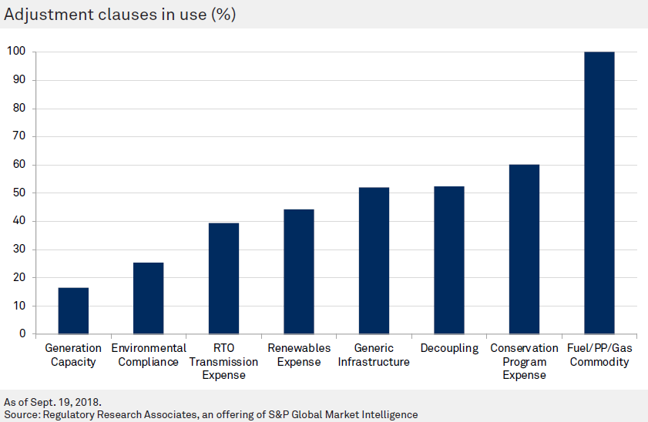
Less ‘skin in the game’, more immediate pass-throughs of costs to consumers
Utilities used to be ‘on a budget’ – with rates periodically reset, their bottom line would then be exposed to any deviations in costs. Under this approach, they would share the pain of rising costs with consumers.
However, the introduction of ‘adjustment clauses’, ‘riders’ or ‘trackers’ has eroded this incentive over time.
These rate adjustors recover to the utility whatever it happened to spend, regardless of the initial ‘budget’ for these costs.

Slide 22
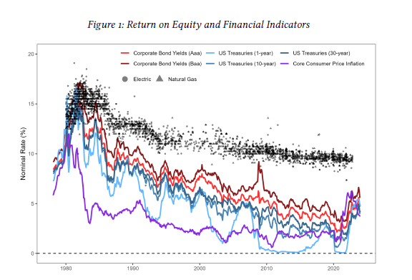
Less risk…. More reward?
Regulator-authorized profits (Return on Equity) reached an all time high in 2020, net of the “risk-free” rate (as measured by 30-Y Treas bonds)
Recent increases in Fed borrowing rates have eroded the most extraordinary profits
Nevertheless, investors in utilities can make either a 4.5% Treasury return vs a ~9-10% return in a utility sector whose investors face few risks
Utilities also have ‘thick’ equity ratios, higher than other infrastructure sectors
Source: Werner & Jarvis (2025) “Rate of Return Regulation Revisited” – Energy Institute at Haas

Slide 23
DEBT-EQUITY RATIOS OF OTHER INFRASTRUCTURE INDUSTRIES
Ticker | Company | Book debt % | Book leverage bar (debt | equity) | LT Debt | Book Eq
 | Renewable IPPs Yieldcos, contracted renewables, and global renewable IPPs
NEP | NextEra Energy Partners | 28% |  | $5.2B | $13B
BEP | Brookfield Renewable Partners | 48% |  | $22.2B | $24B
CWEN | Clearway Energy | 59% |  | $8.1B | $5B
AES | AES Corporation | 79% |  | $29.0B | $7B
AY | Atlantica Sustainable Infra. | 77% |  | $5.4B | $1B
AVG | Renewable IPP simple avg | 58%
 | Traditional Merchant / Thermal IPPs Unregulated generators; commodity price exposure; leveraged legacy structures
NRG | NRG Energy | 84% |  | $11.8B | $2B
VST | Vistra Corp. | 75% |  | $16.7B | $5B
CEG | Constellation Energy | 44% |  | $10.7B | $13B
AVG | Merchant IPP simple avg | 68%
 | Infrastructure Industry Averages (Damodaran Jan 2026) For reference — book D/(D+E) sector averages; number of firms shown
N=23 | Airlines (air transport) | 71% |  | - | -
N=9 | Cable TV / broadband | 65% |  | - | -
N=23 | Oil & gas distribution (pipelines) | 63% |  | - | -
N=21 | Telecom (wireless) | 52% |  | - | -
N=29 | Chemical (basic / commodity) | 52% |  | - | -
N=142 | Oil & gas (E&P) | 33% |  | - | -
28%
72%
48%
52%
59%
41%
79%
21%
77%
23%
58%
42%
84%
16%
75%
25%
44%
56%
68%
32%
71%
29%
65%
35%
63%
37%
52%
48%
52%
48%
33%
67%
Quick reference — segment book debt % range:
Renewable IPPs
28 – 79%
~58%
Thermal IPPs
44 – 84%
~68%
Airlines
~71%
sector avg
Cable TV
~65%
sector avg
Pipelines
~63%
sector avg
Telecom wireless
~52%
sector avg
Chemicals (basic)
~52%
sector avg
Oil & gas E&P
~33%
sector avg
Book debt % = long-term debt (incl. current portion) ÷ (debt + book equity including NCI). Individual company data from FY 2024 10-Ks. Industry averages from Damodaran NYU Stern (Jan 2026).

Slide 24
Will PUCs require a refinance of utility spending?
The utility sector is a system with substantial capital spending, and if that capital is not financed in the lowest-cost way possible, then customers will be overpaying and the perverse incentives described before will be magnified.
Three possible options
Securitization. Utilities and gov’ts issue low-interest ‘securitized bonds’ secured by future ratepayer collections, at an interest rate similar to municipal or state bonds.
Re-balanced capital structure. PUCs should require greater leverage, moving away from a ~50% equity ratio. Greater ‘leverage’, or debt financing, would align electric utilities with telecom, rail, airlines, and other infrastructure industries.
Competitive equity. At present, PUCs are in the position of guessing what the appropriate return on equity should be for utilities, which is then built into rates. A better approach is an innovative new idea “competitive direct equity,” where utilities would raise equity through an auction for incremental capital spending they engage in. (Credit to Mark Ellis of the American Economic Liberties Project for this idea.)

Slide 25
Securitization: How far could it go?
Consider PSE&G’s electric utility, which serves 2.4MM customers in New Jersey, where the newly elected governor has promised to ‘freeze’ electricity rates by executive order.
The state PUC (the New Jersey Board of Public Utilities) has set rates for PSE&G customers with:
a Return on Equity (shareholder profit) of 9.6%, or 13.7% pre-tax (ratepayers pay for the utility’s income taxes through utility rates), at
a 55% equity ratio, for a ‘Weighted Average Cost of Capital’ (WACC) of 9.33%
$1.2B annual return, based on WACC & capital invested its distribution system, $12.7B
Issuing securitized bonds (the % interest rate reflects issuances since 2022) would pay off the principal in rate base, removing it from the utility books. The high-cost utility return would be replaced by low-interest debt. This produces annual savings to consumers of $543M. (For context, total PSE&G electric revenue from NJ customers in 2024 was $4.37B).
Consumer savings from securitization ($ millions)
 |  | Total Return/Profit
 | Principal |  | Utility | Securitization | Annual Savings
Rate |  |  | 9.33% | 5.04% | 4.29%
Distribution Rate Base | $ 12,662.0 |  | $ 1,180.9 | $ 638.2 | $ 542.7
Sources:
FERC Form 1 (PSE&G 2024), EIA Form 861; NJ BPU Order approving PSE&G rates (Oct 2024)
Notes:
A 9.6% ROE is 13.7% pretax (9.6 / [1-0.3 FIT & SIT]),, which blended with debt cost of 3.98% at 45% debt ratio is . (13.7 * 0.55 = 7.535%) + (3.98% * .45 = 1.791%) = 9.326% WACC pretax

Slide 26
! Travis Kavulla tkavulla@basepowercompany.com follow on X at tkavulla
Some Concluding Thoughts
Much demand growth is concentrated in a single sector. History counsels that even if aggregate growth emerges, it will come with many defaults and disruptions along the way.
This is a high-risk moment in time, though there are obvious options for regulators / utilities to lay off that risk to data centers.
The industry as a whole should be trying to find nimble assets and avoid heavy capital spending.
Capital spending is, of course, unavoidable but cap-ex that serves multiple purposes and provides an off-ramp (optionality) for the bets made should be advantaged in regulatory decision-making.
There is a need to use the grid much more flexibly than we have, and to provide regulatory pathways to facilitate this.
Utilities should expect to face margin pressure in view of customer affordability concerns. For that matter, even merchant generators should not expect to obtain marginal-cost pricing advantage on rocketing demand.

