Slide 1
The Affordability Paradigm
April 17, 2026
SURFA Conference

Slide 2




Edison International leads the transformation of the electric power industry
Focused on opportunities in clean energy, advancing electrification, building a modernized and more reliable grid, and enabling customers’ technology choices
One of the nation’s largest electric-only utilities, with over 5 million customer accounts in 50,000 square-mile service area
EIX’s principal subsidiary, with $38–41 billion electric infrastructure investment opportunity from 2026 through 2030
Growth driven by investment in strengthening and modernizing the grid and advancing California’s aggressive climate goals
Wires-focused rate base, with limited power generation ownership (<20% of power delivered from owned generation)
Partners with large commercial, industrial, and institutional organizations to navigate the energy transition by providing integrated energy management and sustainability solutions
Clients include 48 of the world’s largest companies

Slide 3




Wires-focused utility investing in reliability, resiliency, and climate adaptation to enable clean energy transition
Decoupling of sales
Forward-looking ratemaking
Wildfire prudency standard
Constructive California and Federal regulatory structures
California GHG reduction
Helping customers make clean energy choices
Aggressive climate goals met with clean, efficient, economywide electrification
Address wildfire risk and climate adaptation needs
Infrastructure replacement
Electrification infrastructure
Significant investment required to ensure the grid is reliable, resilient, and ready for widespread electrification
~7% 2025–2030 rate base CAGR
Target dividend payout of 45–55% of SCE core earnings
Investment in electric-led clean energy future results in strong rate base and dividend growth

Slide 4
California’s regulatory mechanisms provide revenue certainty
Revenue Decoupling means earnings aren’t affected by changes in electricity sales | Long-standing regulatory mechanism that breaks the link between retail electricity sales and revenue; promotes energy efficiency, helps stabilize customer bills, and supports environmental goals Changes in sales only affect timing of cash collection
Balancing Accounts allow SCE to collect and refund differences to authorized revenue | SCE has several balancing accounts, including for variances in sales volume, such as those related to weather Fuel & purchased power recovered on forecast basis, with over/under-collections trued-up via balancing accounts
Forecast Ratemaking reduces regulatory lag | Four-year GRC cycle with forward-looking test year and attrition year increases CPUC has historically authorized mechanism that gives SCE opportunity to offset some inflationary price increases based on utility-specific indices Cost of capital proceedings on three-year cycle separate from GRC with mechanism to reasonably adjust cost of capital if market conditions change significantly during cycles

Slide 5
How does SCE view affordability from the regulatory perspective?
Affordability is embedded in regulatory decision‑making, but it operates within, not outside of, established constitutional standards
Cost of capital determinations remain governed by Hope and Bluefield, which require returns sufficient to:
Maintain financial integrity
Support credit quality
Enable access to capital on reasonable terms
Cost‑of‑capital proceedings are generally recognized as ill‑suited for granular affordability determinations, since they set returns, not spending levels
Affordability functions as a policy constraint and analytical lens, not a substitute for Hope/Bluefield
In California:
Affordability metrics are required disclosures in proceedings with material revenue impacts
Commissions use them to inform pacing, design, and implementation, not to disallow prudent costs

Slide 6
SCE is focused on affordability for all customers; our goal is to meet the state’s needs and do it affordably
SCE is investing customer dollars to:
Reduce outages and safely speed up restoration times;
Improve electric grid safety for the public, first responders and our workforce;
deliver affordable, reliable power on a resilient grid while transitioning to 100% carbon-free energy as quickly as possible
To meet this challenge and achieve net-zero emissions in California, SCE supports an “all of the above” strategy with flexible timelines focused on meeting increased demand affordably and reliably
Electricity demand is growing faster than it has in decades. At the same time, threats to keeping the electric grid safe and reliable (like extreme weather events and cyber-attacks) are becoming more frequent, significant and costly
For about 20 years, from 2001-2019, SCE rate increases tracked near or below the local inflation rate (generally 2%-3%)²
Between 2019-2024, SCE rate increases rose above inflation as operational and purchased power costs rose much higher than expected
About 68% of SCE’s rate increases during the 2019-2024 period were due to external events (45% power supply and weather + 21% wildfire prevention)

Slide 7
Over 85% of SCE’s capital investments are in its distribution grid and essential to reliability, resiliency, and readiness objectives
SCE forecasts investing $38–41 billion from 2026 to 2030 to support SCE’s wildfire mitigation strategy and clean energy transformation in California
Percentage of 2026–2030 capital plan
Load Growth & Electrification
Infrastructure Replacement
Inspections & Maintenance
Wildfire Management
Transmission
Other Distribution
Advanced Metering Infra.
Generation
>85%
distribution grid

Slide 8
Projected ~7% rate base growth driven by investments to enable customer-driven load growth
2025–2030 SCE Rate Base
Forecast through 2030 includes:
2025 GRC approval
CAISO-awarded FERC transmission projects
Advanced metering infrastructure program (~50% of total >$3bn projected spend is 2026–2030)
Planned 2029 GRC request
Beyond 2030, continued long-term capital investment opportunities to serve customers
2029 GRC investments
CAISO-awarded FERC transmission projects (~$2bn)
Advanced metering infrastructure program (~50% of total >$3bn projected spend is 2031–2033)
Weighted Average Rate Base, $ in Billions
~7% CAGR
2025–2030
FERC
CPUC
Range Case | (Recorded) | $50.8 | $54.3 | $57.7 | $61.7 | $66.1

Slide 9

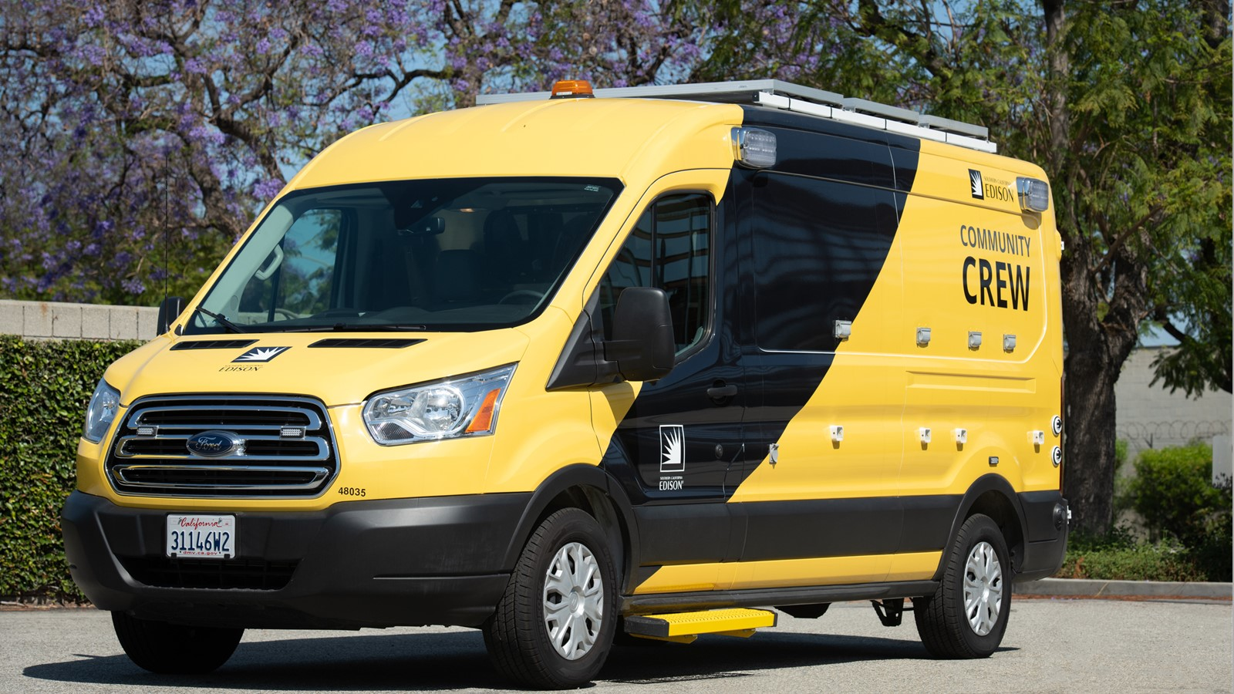
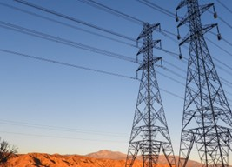
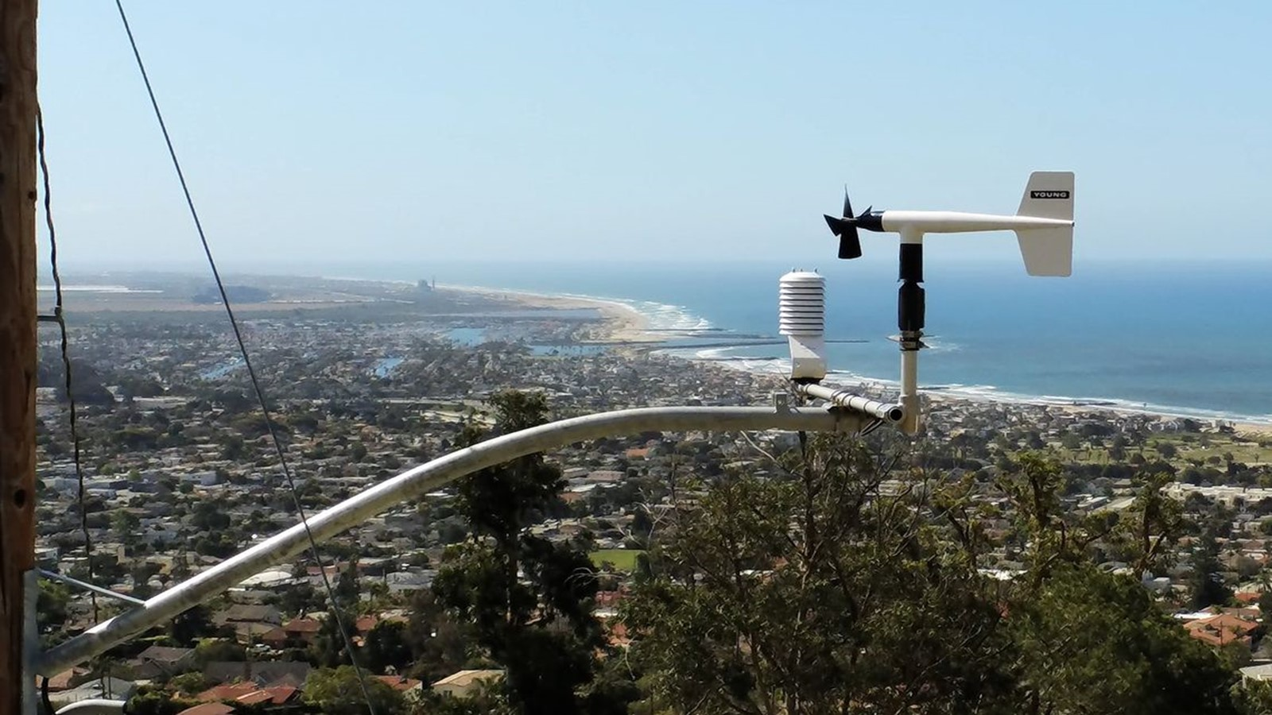
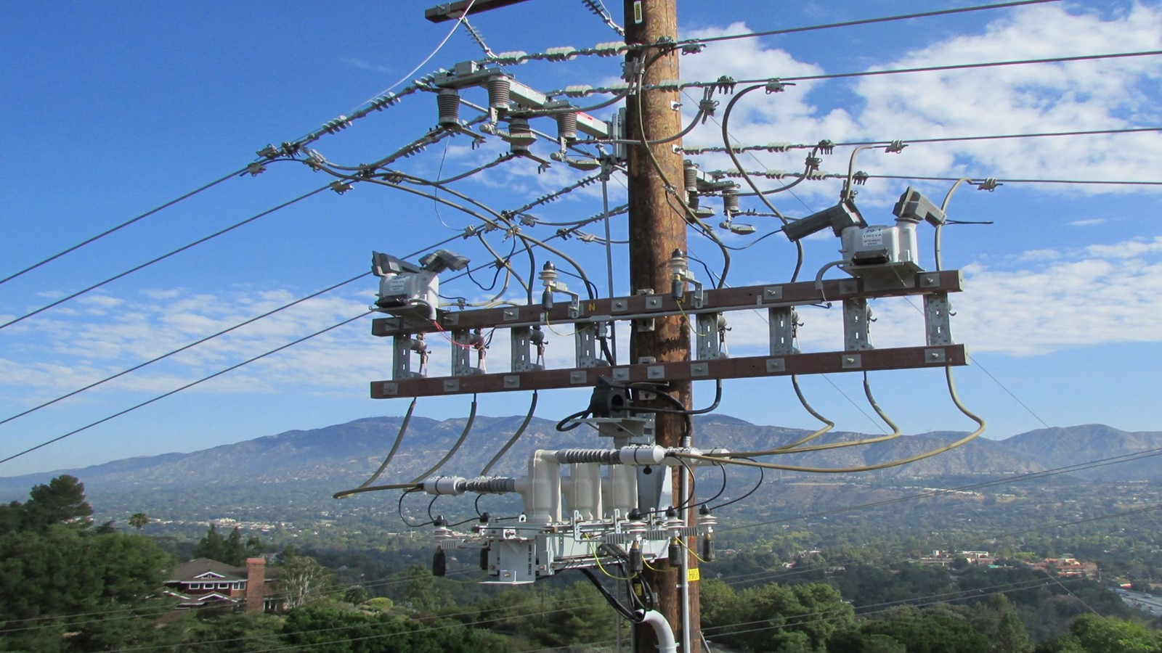


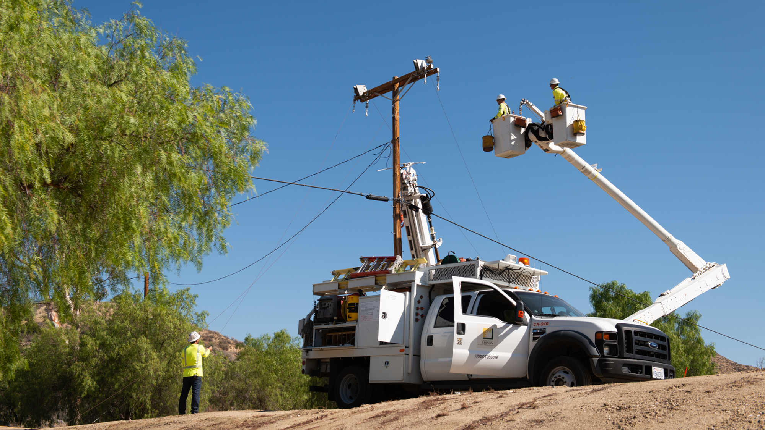
SCE’s 2026–2028 Wildfire Mitigation Plan is a layered defense strategy to safeguard our communities
Distribution hardening
Additional 700+ miles of covered conductor and targeted undergrounding
Public Safety Power Shutoffs (PSPS)
Last-resort tool to prevent ignitions during extreme weather; focused on reducing impacts
Transmission hardening
Enhanced standards and proactive upgrades to reduce ignition risk on transmission infrastructure
Situational awareness
Using weather stations, HD cameras, and forecasting to monitor and respond to wildfire risk
New technology deployment
Deploying new and expanded tools to identify and prevent ignition risks early
Vegetation management
Removing hazardous trees and maintaining clearances to prevent vegetation-related ignitions
Aerial suppression
Supporting aerial firefighting resources to improve rapid wildfire response and public safety
Refine other strategies
Continuously improving mitigation through lessons learned, modeling, and utility collaboration
Continued investment builds on ongoing efforts to reduce the risk of wildfires associated with utility equipment while applying latest learnings

Slide 10
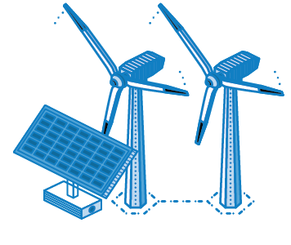
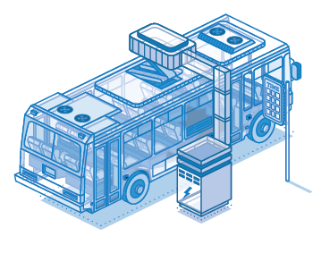
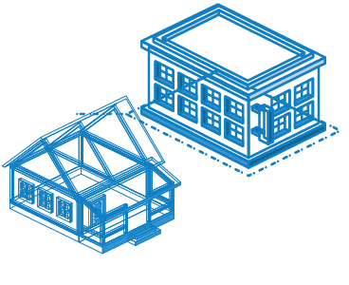
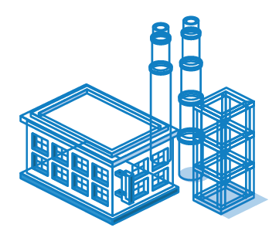
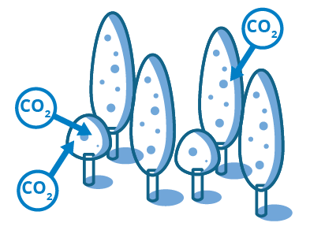
Reaching California’s 2045 GHG goals requires a near-complete transformation of energy use economy wide
Decarbonize electricity
Electrify transportation
Electrify buildings
Use low-carbon fuels
Sink remaining carbon
100% RETAIL SALES
90% OF VEHICLES
95% OF BUILDINGS
48% NON-ELECTRIC ENERGY
75 MMT CARBON SINK
100% of grid sales with carbon-free electricity
~90 GW of add’l utility-scale clean generation
~25 GW of add’l utility-scale energy storage
>15 GW each of add’l behind-the-meter solar and storage
90% of light-duty vehicles need to be electric
90% of medium-duty vehicles need to be electric
54% of heavy-duty vehicles need to be electric
Zero emission appliance regulations expected to drive >95% building electrification
98% and 90% of commercial water and space heating to be electrified by 2045, respectively
20% and 13% of pipeline natural gas volume to be hydrogen and RNG, respectively
37% of heavy-duty vehicles to be hydrogen fuel cell vehicles
20% of buses to be hydrogen fuel cell vehicles
25 MMT from carbon capture and storage (point source)
25 MMT from natural and working lands
25 MMT from other (e.g., direct air capture)
Edison is partnering with state government and other stakeholders to advance policies that rapidly cut GHG emissions in a feasible and affordable way

Slide 11







SCE’s load growth driven by economywide trends with broad customer and climate benefits
SCE’s diverse and durable drivers of demand…
…expected to result in sustained load growth
Transportation Electrification
Rapid growth potential supported by strong CA EV sales, fleet electrification, and public charging
Near-term
(2025–2030)
~1–3%
annualized sales growth
Residential
New housing development and population growth, partially offset by solar adoption
Mid-term
(By 2035)
~30–40%
cumulative sales growth¹
Commercial & Industrial
High-tech warehouses, data centers, and building electrification
Long-term
(By 2045)
~100%
cumulative sales growth¹
Clean load growth supporting both affordability and decarbonization
Relative to 2025

Slide 12
Load nearly doubling by 2045 requires a significant acceleration in grid expansion
At least half of incremental grid investment fits squarely within IOU jurisdictions
New transmission and distribution grid projects need to be added at up to 4x and 10x historical rates, respectively
SCE expects distribution system to be 25% larger by 2045
Equivalent of 85 new distribution substations
Upgrades to 345 of 900 existing substations
1,400 new distribution circuits (30% more than today)
+20,000 circuit miles of 500 kV transmission CAISO-wide to interconnect new resources
Incremental CAISO-wide grid investment
~$125 billion
(2023$)
Transmission for
Out-of-State Imports
Infrastructure to interconnect and integrate resources
May be mix of investment by utilities, generators, and other market participants
ISO Interconnections
Subtransmission
Utility infrastructure additions and upgrades
Predominantly investments by utilities in their service areas
Distribution
Source: SCE’s Countdown to 2045 analysis. See Countdown to 2045 Appendices for additional information on the analysis and its methodology

Slide 13
Adoption of electrified technologies results in significant savings for average SCE customer household
Total annual energy expenses for the average SCE customer household decreases by ~40% by 2045
By 2045, electricity demand is projected to nearly double from 2025, primarily due to electrification
Households will benefit from these savings well before 2045, with the average SCE household expected to see more than 10% savings by the early 2030s
Household savings driven by reduced fossil fuel expenses more than offsetting increase in electricity expense
Improvements in equipment efficiency, energy efficiency, and demand response programs reduce consumption
Annual residential household energy expenses (2023$)¹
$6,680
Home Solar
Electricity Bill
Home Gas Bill
$3,880
Gasoline
Share of wallet²
>7%
<3%
Reflects annual energy expenses using SCE data. Vehicles and appliance costs are not included. Assumes the average SCE customer in 2045 would have electric vehicle, solar, and electric water and space heating
Reflects the proportion of household income spent on energy. For 2045, projected median household income based on historical growth rates, then normalized to 2023$
Source: SCE’s Countdown to 2045 analysis

Slide 14
Total energy share of wallet in SCE’s service area below median and can decrease with higher levels of electrification
Electricity and energy share of wallet in SCE’s service area compare favorably to those in other states
2024 Est. Avg. Residential Customer Share of Wallet (% of Income)¹
For customers of large utilities in:
Electricity
Nat. Gas
Gasoline
EIX analysis and assumptions based on representative utilities in each state, median household income data from U.S. Census Bureau, electricity expenditure data from EIA, natural gas expenditure data from AGA and EIA, gasoline price data from EIA, and gasoline consumption calculated from vehicles per household from the US Census, vehicle-miles traveled per vehicle from FHWA Highway Statistics Series, and gas mileage from Bureau of Transportation Statistics

Slide 15
Rate increases below inflation for 20 years. External drivers largely drove 2019–2024. Expect return to inflation-level growth
2001–2019 SCE’s rates trend below local inflation for nearly 20 years
2019–2024: SCE’s rate trend outpaced inflation (~11% vs. ~4%)
2019–2024
2024–2028 Expect system average rate growth at or below inflation¹
2024–2030
Cents per kWh
2019–2024 rate increases largely driven by external events
% of Total Increase
45%
Power Supply and Weather³
68%
from external events⁴
Local inflation
21%
Wildfire
28%
Load Growth / Infrastructure Replacement
32%
from standard operations⁴
SCE System Average Rate²
Forecast subject to change. Actual rates will vary based on actual authorized rates, changes in market prices, variability in sales, collections, timing of regulatory decisions, and other factors
All rates include California Climate Credit
Includes items such as undercollection of rates in 2023 due to milder than anticipated weather and other one-time events
External events also includes 2% from Public Purpose Programs. Standard operations also includes 4% from Power Supply — Clean Energy

Slide 16
SCE delivers on California’s energy goals while managing affordability—despite higher policy-driven cost burdens
SCE vs. LADWP: Average Non-CARE Residential Bill¹
$ per Month; Based on 500 kWh consumption
IOU customers fund broader set of public mandates—including wildfire mitigation, decarbonization, and equity programs—not reflected in municipal utility bills
+38%
vs. SCE
+37%
vs. SCE
Other²
Public Purpose³
Wildfire
Taxes⁴
Power Supply
Despite these added responsibilities, IOUs operate efficiently—maintaining grid reliability, advancing clean energy, accessing deep capital markets, and delivering shareholder returns (i.e., reflecting regulated cost of capital)
Transmission & Distribution
Customers per Sq. Mile⁵:
…while serving significantly larger area with lower customer density
~105
~3,200
Including Utility Users Tax (UUT). UUT is a local tax levied by cities on utility services, which is not part of SCE’s revenue requirement. Utilities collect the UUT through customers’ electric bills and remit the funds to the appropriate local government
Other includes Wildfire Fund Charge, Nuclear Decommissioning Charge, Public Utilities Commission Reimbursement Fee
Public Purpose Programs also includes CARE surcharge / discount, extension of Diablo Canyon operations costs
Taxes includes Federal & State Income Tax, Property Tax, Franchise Fees & Uncollectibles, and UUT
Southern California Edison (SCE) serves a 50,000 square mile area in Central, Coastal, and Southern California. The Los Angeles Department of Water and Power (LADWP) serves a ~473 square mile area

