Slide 1

The Affordability Paradigm: Delivering Reliable Service Amid Rising Costs
Monica Hlinka, Senior Principal Analyst
April 2026

Slide 2
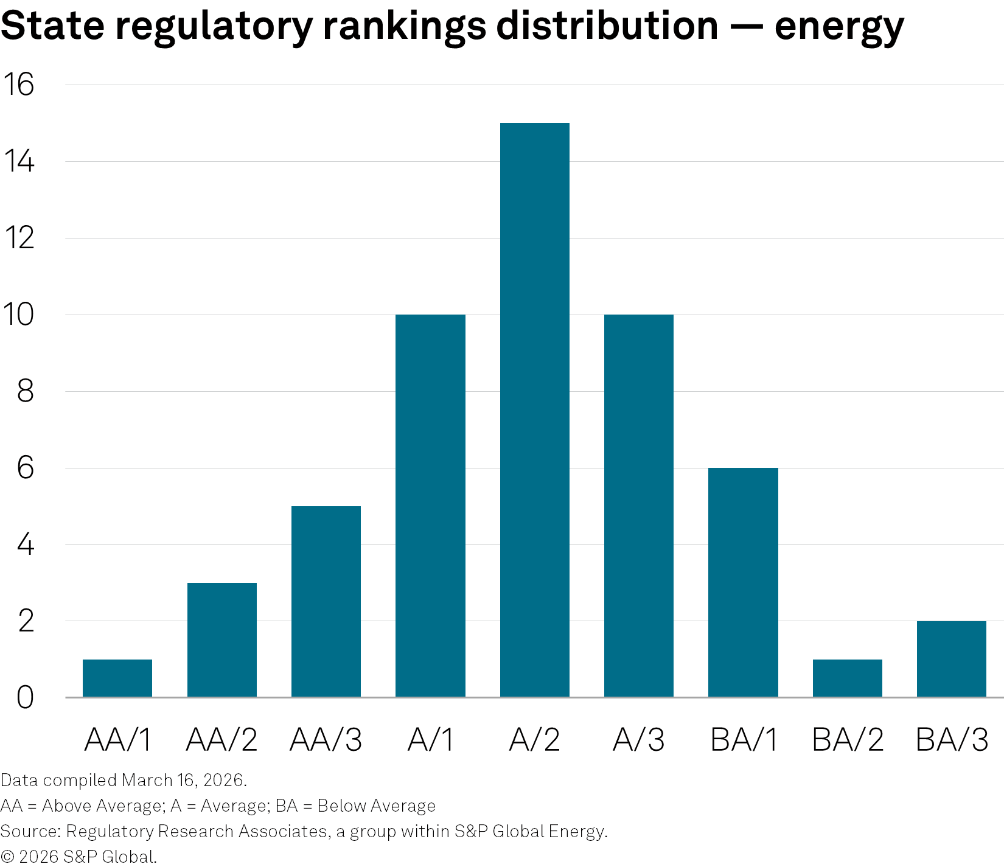
Investor perspectives on regulatory risk — RRA state regulatory evaluations
Political
Governor, Legislature, Courts
Commission selection/makeup
Intervenors
Rate case policies, outcomes
Rate base, test period
Interim rates
Accounting rules
ROE, Capital structure
Rate design
Settlements
Ability to earn authorized return
Other
Regulatory innovations
Energy transition
Industry restructuring, retail competition
Merger policies, conditions
Responses to emerging issues
Affordability,
Data center impacts,
Severe weather events

Slide 3
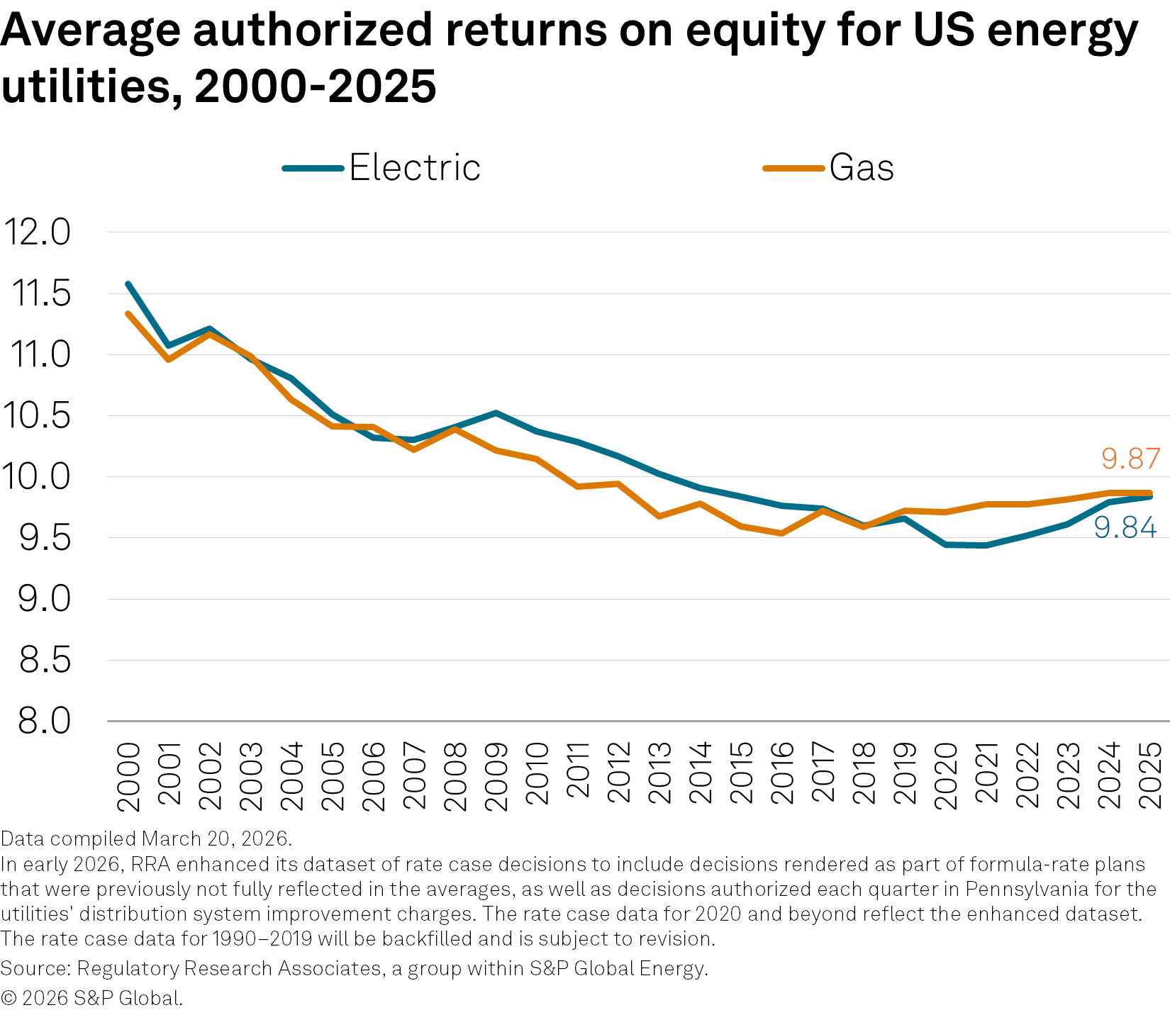
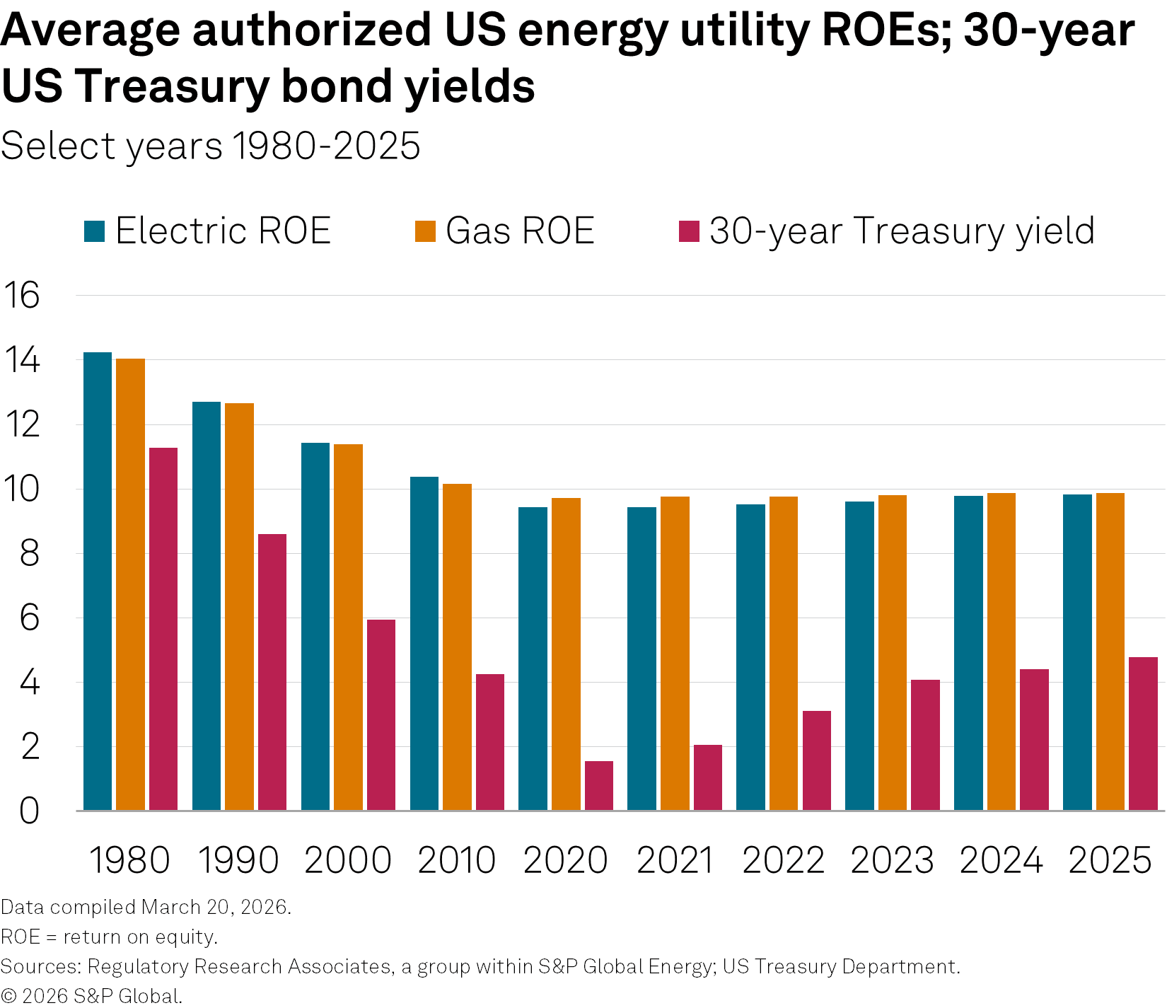
Affordability concerns stem rise in authorized equity returns
(unit)
(unit)

Slide 4
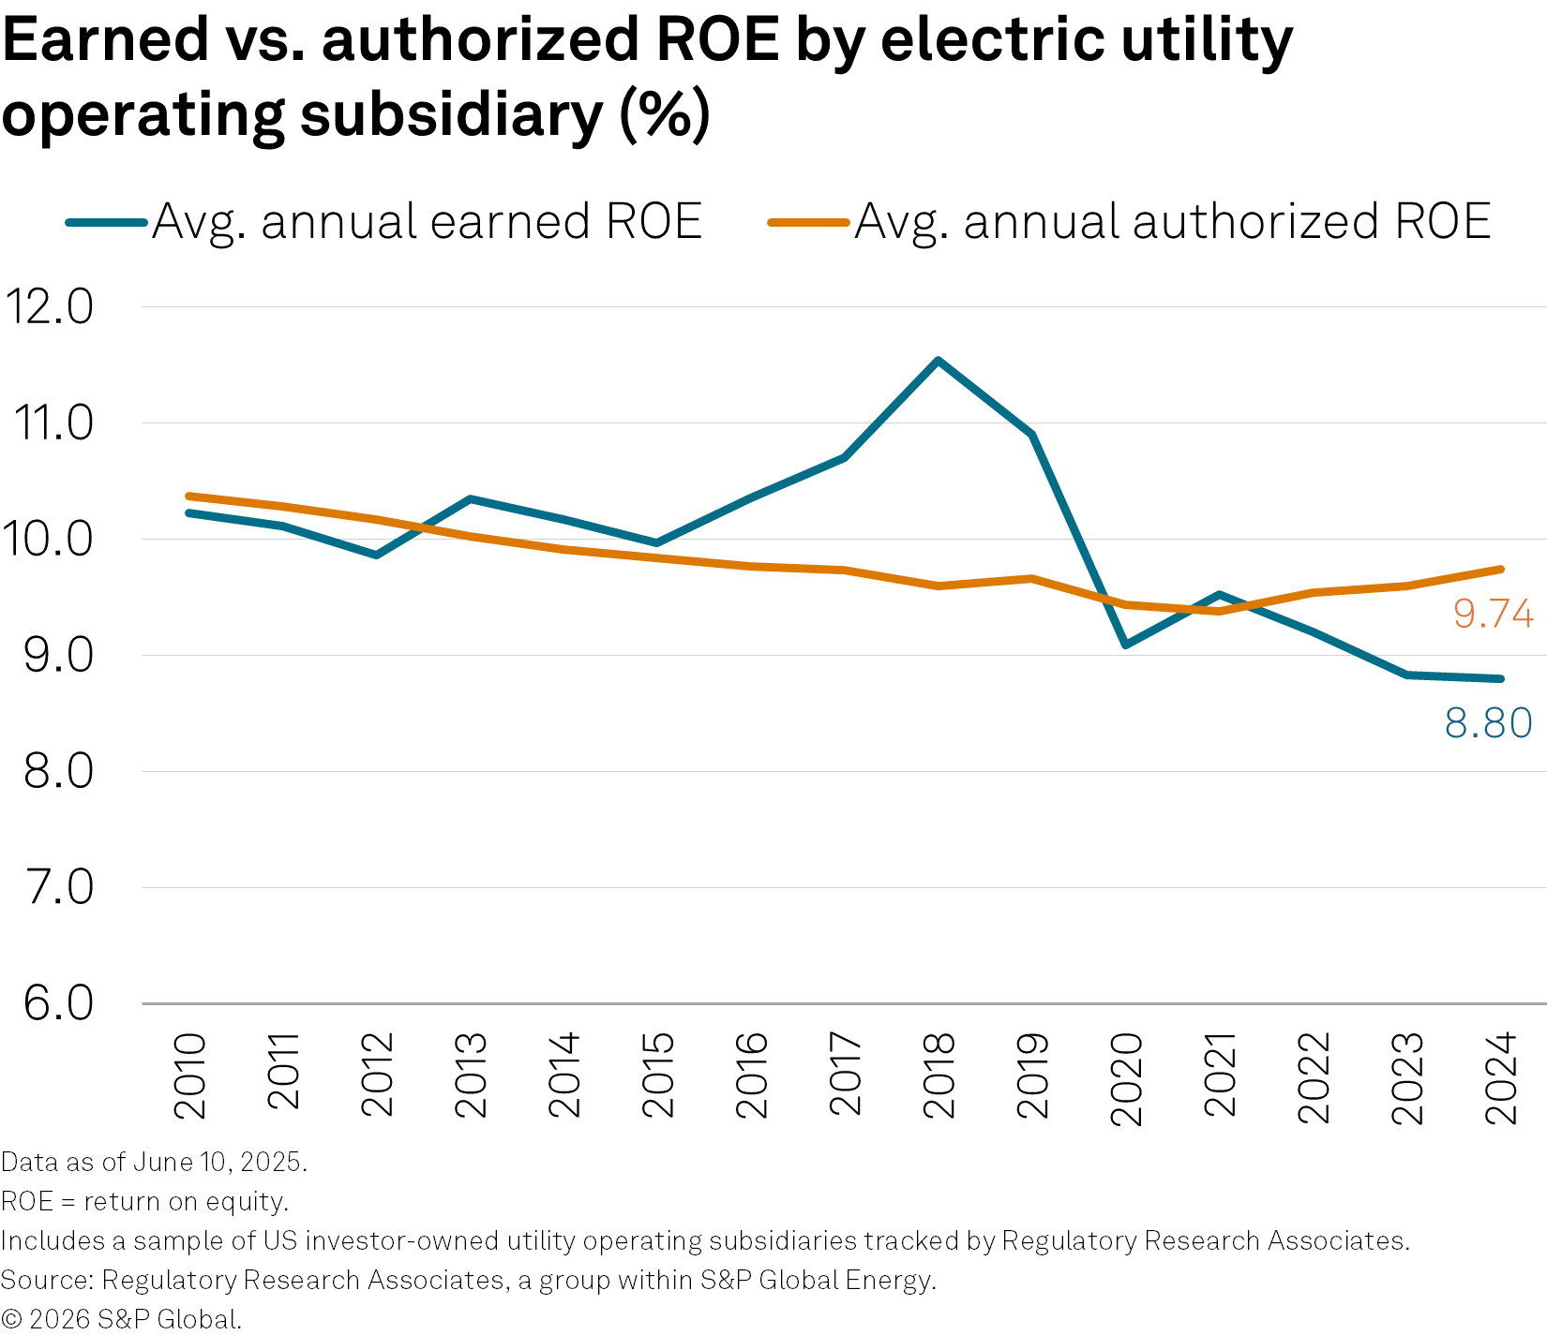
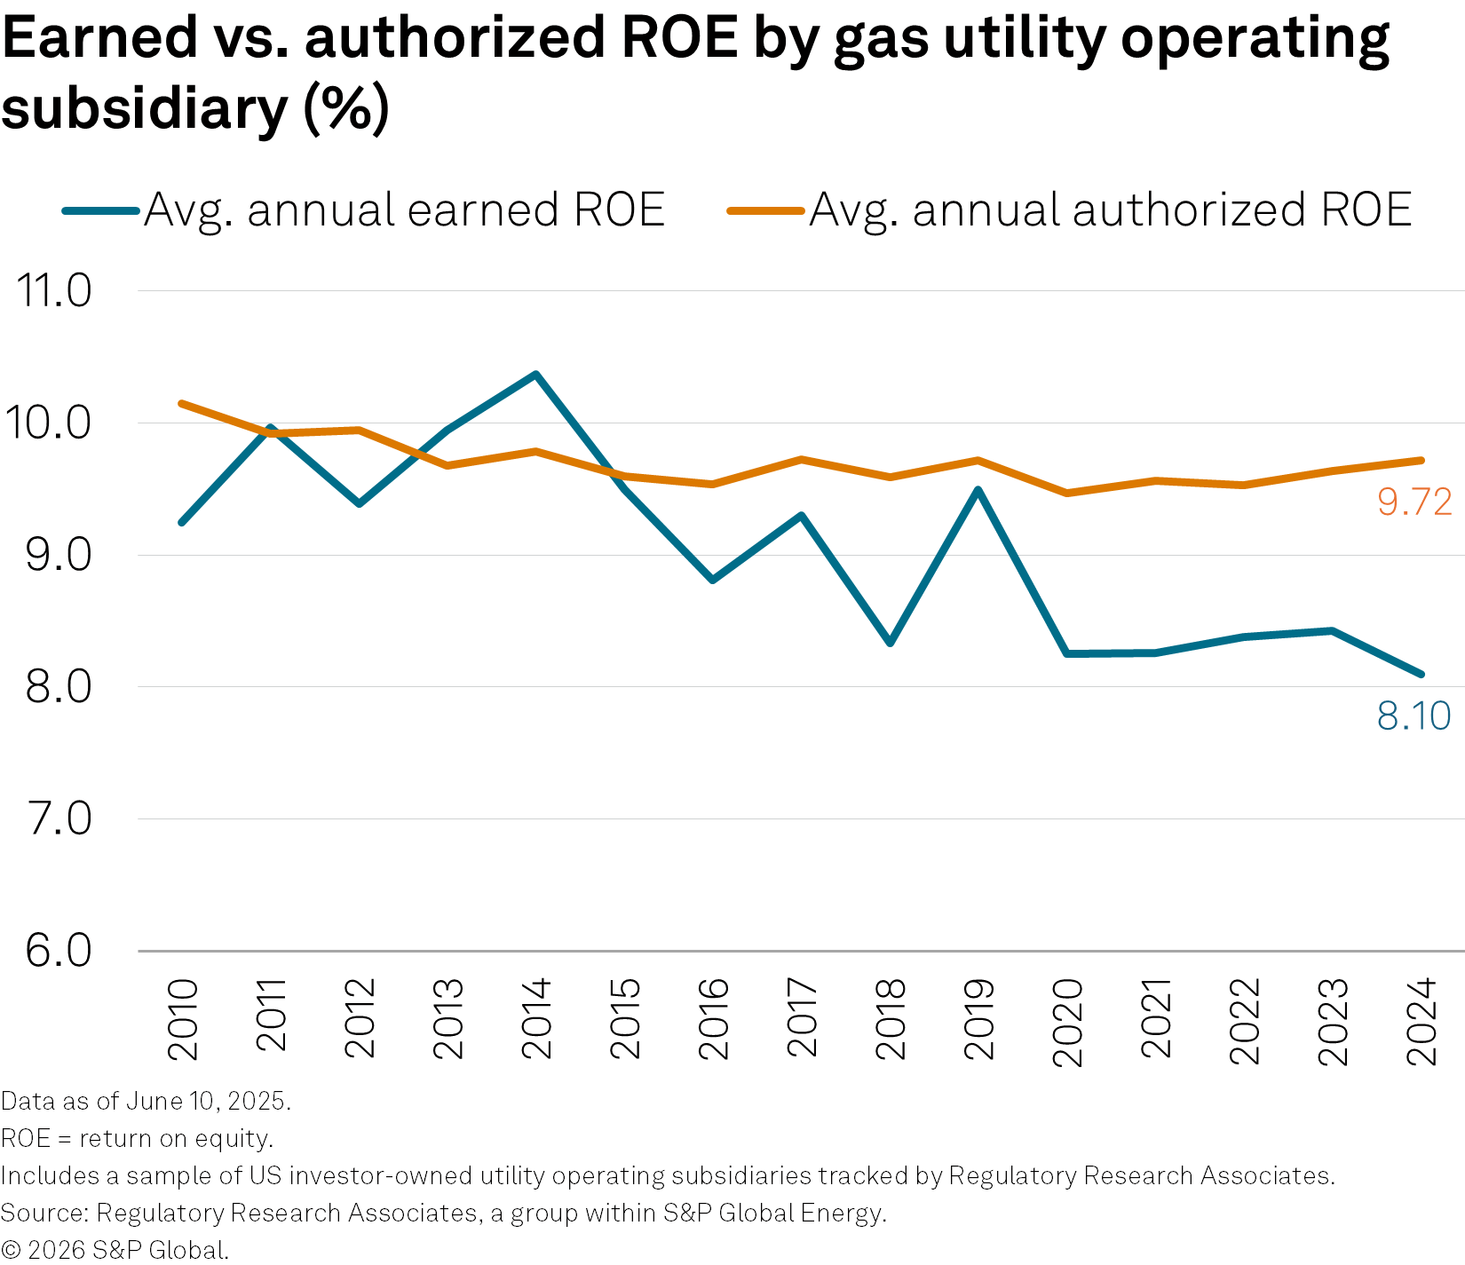
Utilities' earned vs. authorized ROE gap widens amid economic pressures
Industry study comprising 83 electric and 17 gas utility operating companies.
Between 2010 and 2024, the electric utility average earned ROE has overall been slightly higher than average authorized ROE, while gas utilities have underearned.
The largest negative difference between average earned ROE and average authorized ROE for both company types was in 2024.
Difficult operating environment characterized by:
Inflation
High interest rates
Volatile market conditions

Slide 5
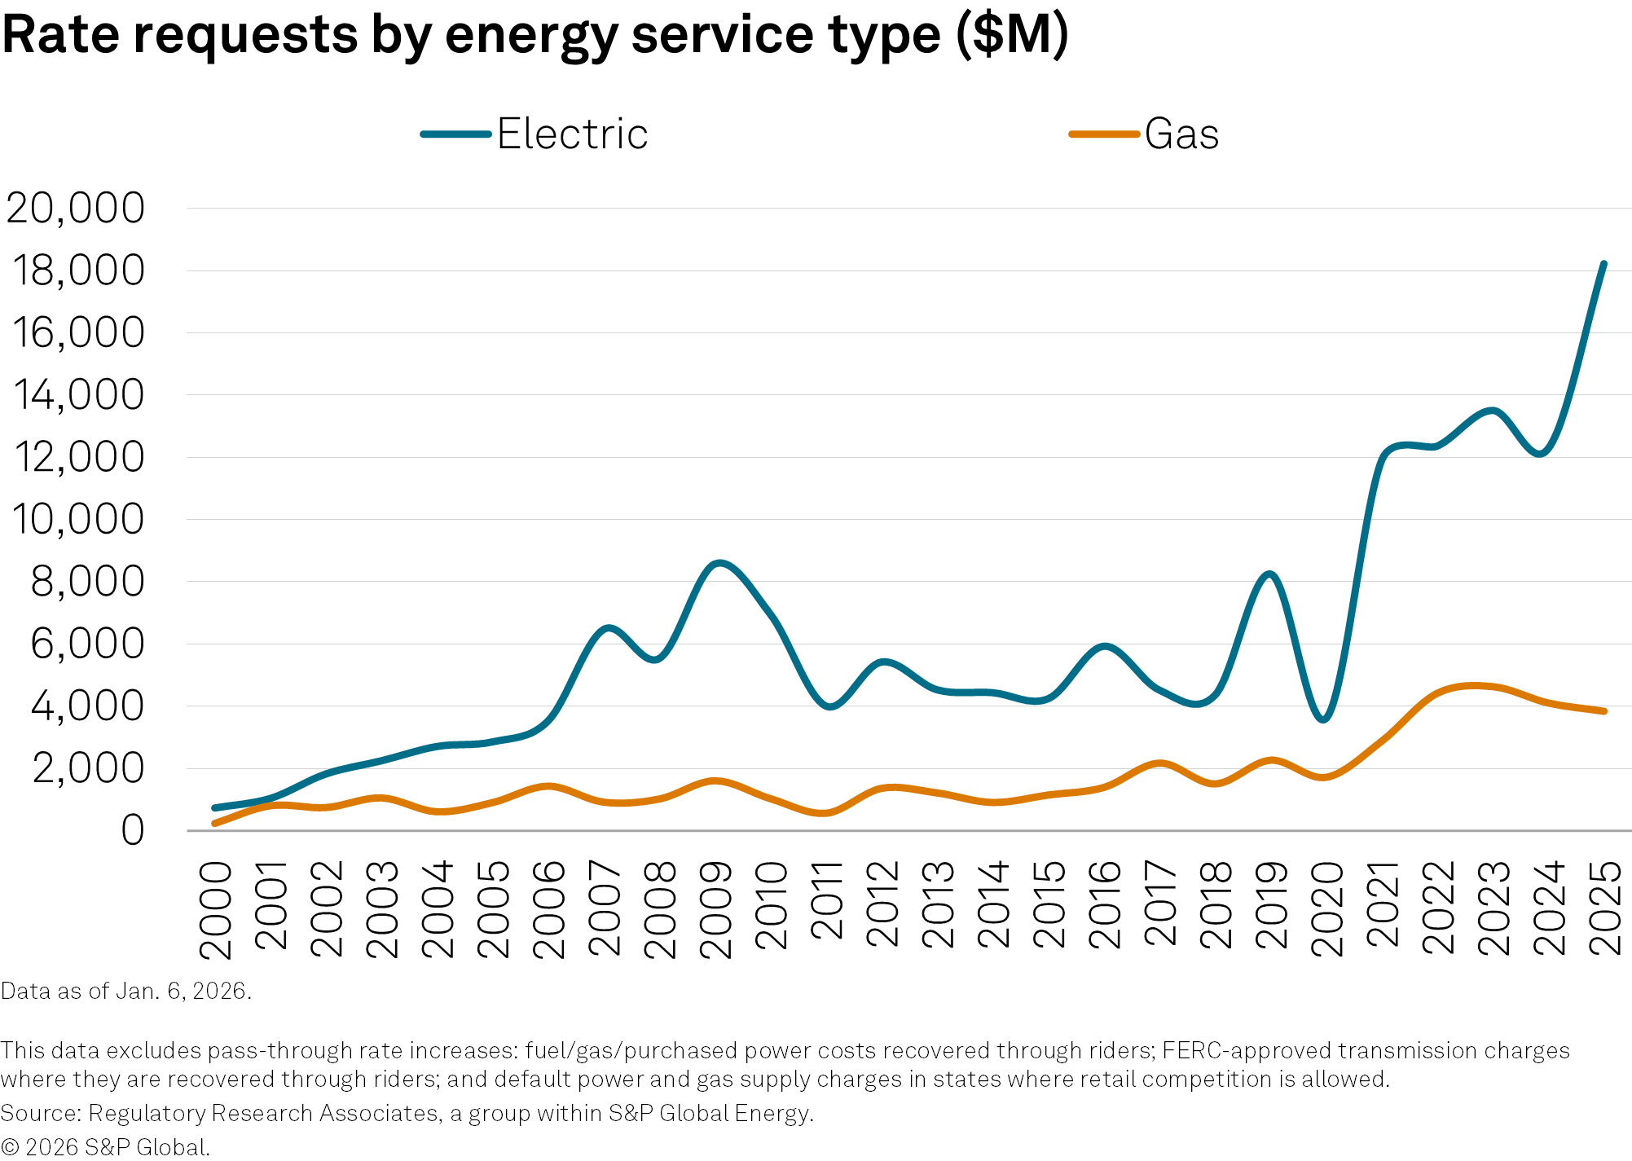
Magnitude of rate case increase requests rising steadily
Electric and gas net rate increases requested
Calendar 2025
$22.1 billion sought from state regulators
Electric: $18.2 billion
Gas: $3.9 billion
Calendar 2024
$16.4 billion requested
Electric: $12.3 billion
Gas: $4.1 billion
Pending as of March 31, 2026
101 cases pending
$15.3 billion requested
Electric: $12.0 billion
Gas: $3.3 billion

Slide 6
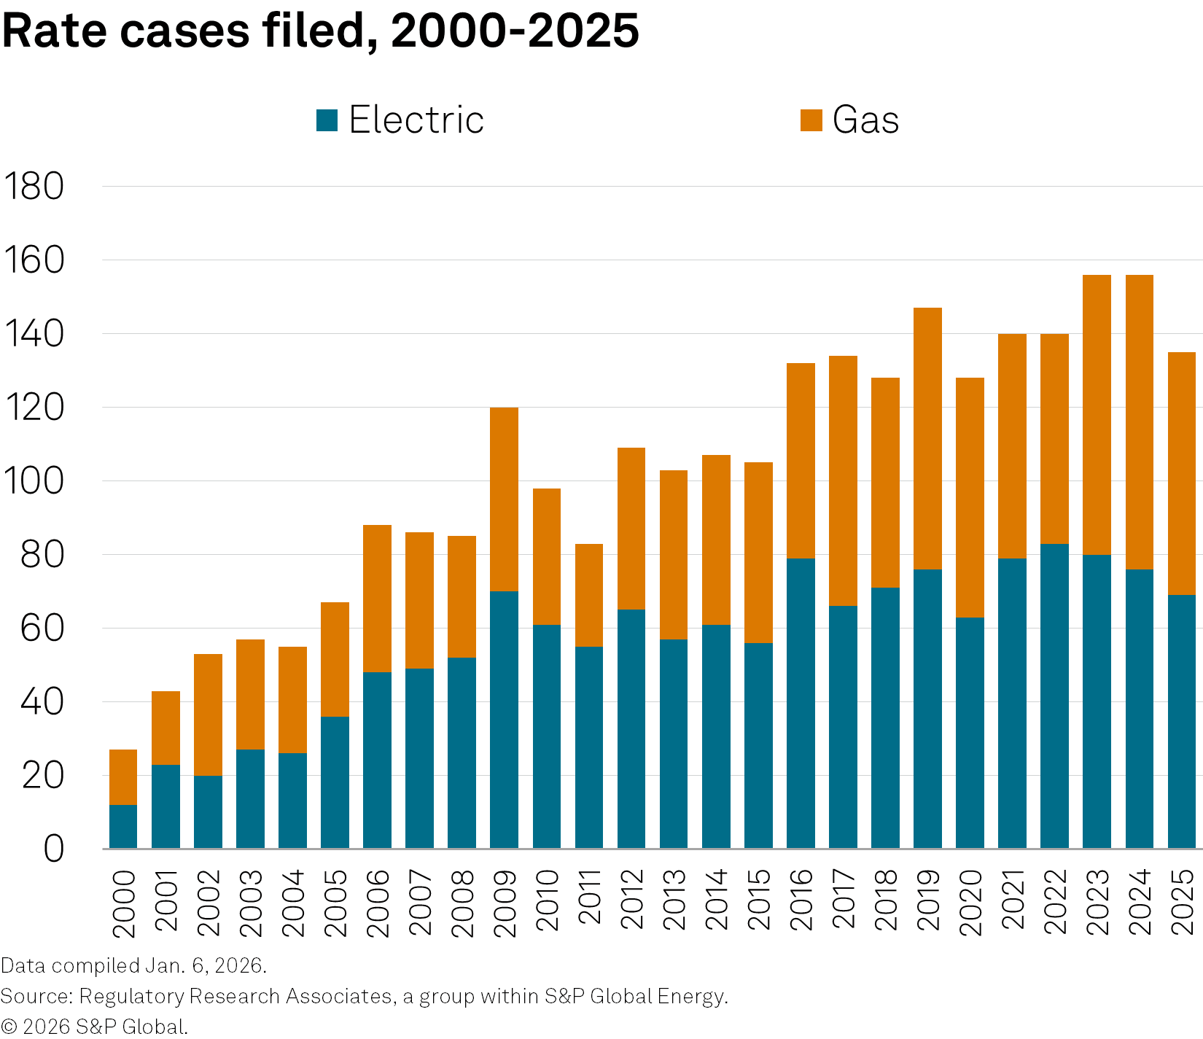
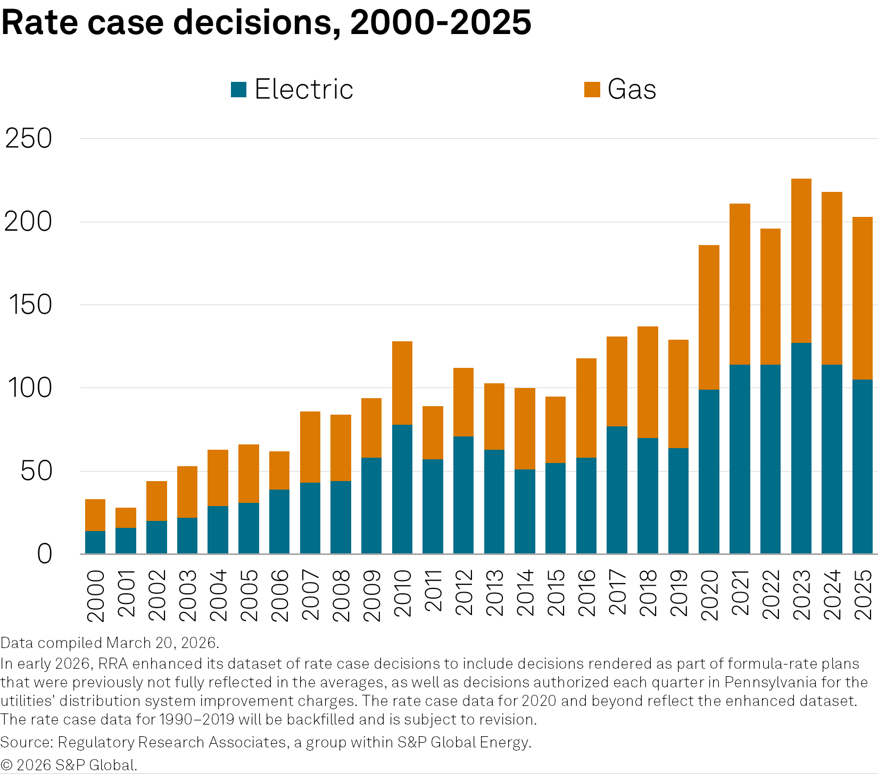
Affordability concerns arise following increase in rate case activity, resulting in heightened regulatory risk across the board
(unit)
(unit)

Slide 7
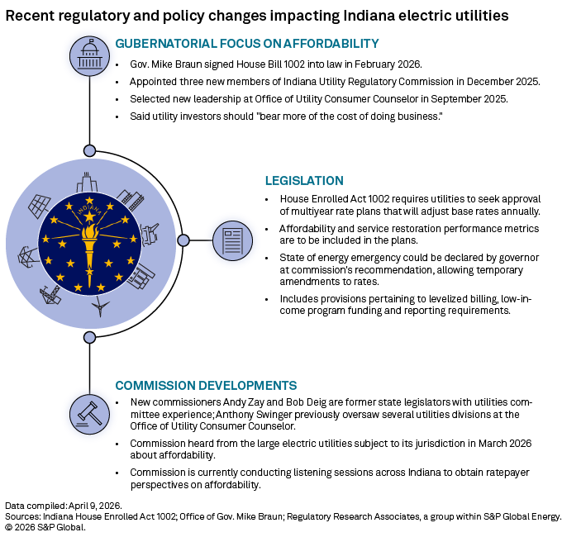
Select state-level actions taken to address affordability concerns
Indiana
Alternative regulation policies advanced through new legislation.
Utility commission initiated an affordability investigative inquiry; rate affordability a gubernatorial priority.
California
New CPUC president named; new commissioner added to address energy affordability
Commission reduced authorized ROEs for major IOUs, citing consumer affordability concerns
Massachusetts
DPU opened an investigation into electric and gas delivery rates, seeking to eliminate or roll reconciling mechanisms into base rates to improve affordability.
New Jersey
Executive orders direct the NJ BPU to scrutinize rate cases more closely and discourage increases where legally permissible.
Proposed legislation would shift policy and ratemaking authority between the administration and the BPU, limit annual rate increases and authorized ROEs, and incentivize in-state generation investment.

Slide 8
Alternative regulatory paradigms offer utility investors a degree of certainty
Formula-based ratemaking
Performance-based ratemaking
Framework set in a traditional cost-of-service proceeding; rates then adjust periodically for changes in expenses, revenue, and capital investment.
May be limitations on the percentage change that can be implemented in a given year or a period of years.
Ties a portion of utility revenues, returns or cost recovery to performance against specified metrics.
A collection of tools (performance incentive mechanisms, scorecards, benchmarking) deployed standalone or within broader plans.
Multiyear rate plans
Adjustment clauses
A succession of rate changes reflecting anticipated revenues, expenses, and rate base.
Often include true-up mechanisms to ensure the company follows through on committed investments.
Addresses volatile, policy-driven, or difficult-to-forecast expenses outside the traditional rate case.
Support timely cost recovery but shift risk from shareholders to customers; cumulative use of multiple clauses can compound bill impacts.
Rate freezes
Earnings sharing mechanisms
Typically originate in rate case settlements, merger proceedings, or alternative regulatory frameworks.
Ease resource demands on commissions, staff, and intervenors while giving utilities financial stability and retained cost savings.
Allocate earnings above or below a commission-set target or range between ratepayers and shareholders.
Can stand alone or pair with formula rate plans, multiyear plans, rate freezes, or merger filings.
Notes:
FRM - Framework set in a traditional cost-of-service proceeding; rates then adjust periodically for changes in expenses, revenue, and capital investment. Adjustments typically occur annually. May be limitations on the percentage change that can be implemented in a given year or a period of years, limiting bill impacts and mitigating rate shock for customers.
MYRP - A succession of rate changes reflecting anticipated revenues, expenses, and rate base, providing customers with greater bill predictability. ROE may be fixed or adjusted over the plan's term, limiting the frequency of rate case–driven increases. Often include true-up mechanisms to ensure the company follows through on committed investments, protecting customers from paying for unrealized projects. (ROE may be fixed or adjusted over the plan's term, reducing reliance on successive rate cases. True-up mechanisms hold the company accountable for committed investments, ensuring customers pay only for what is delivered.)
Rate freezes - Typically originate in rate case settlements, merger proceedings, or alternative regulatory frameworks. Provides customers with bill predictability. Ease resource demands on commissions, staff, and intervenors while giving utilities financial stability and retained cost savings. Double-edged sword: benefits erode when capital spending, interest rates, or operating costs rise faster than frozen rates allow.
PBR - Ties a portion of utility revenues, returns, or cost recovery to performance against specified metrics, including affordability. Affordability metrics may include bill impact caps, arrearage reduction, low-income program participation, or cost-per-customer benchmarks. Metrics may include reliability, customer service, safety, affordability, or clean energy deployment. Can complement broader affordability goals by rewarding cost discipline and penalizing spending that outpaces customer ability to pay. A collection of tools (performance incentive mechanisms, scorecards, benchmarking) deployed standalone or within broader plans.
Adjustment - Addresses volatile, policy-driven, or difficult-to-forecast expenses outside the traditional rate case — common uses include fuel, environmental compliance, energy efficiency, transmission, and capital programs. Support timely cost recovery but shift risk from shareholders to customers; cumulative use of multiple clauses can compound bill impacts. Oversight varies — some mechanisms face periodic review, while others allow near-automatic pass-throughs, with affordability implications tied to the level of scrutiny.
ESM - Allocate earnings above or below a commission-set target or range between ratepayers and shareholders. Can stand alone or pair with formula rate plans, multiyear plans, rate freezes, or merger filings to reinforce affordability protections. Share over-earnings with customers as bill credits or rate offsets, keeping returns aligned with authorized levels.

Slide 9
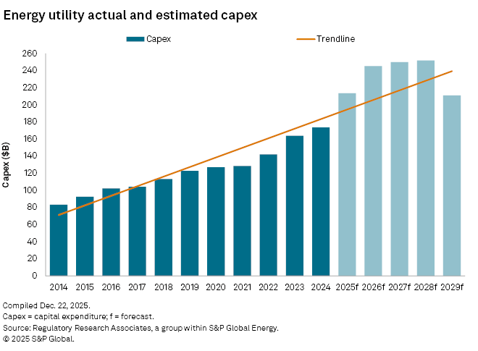
Capital spending a major driver of rate case activity over the last decade
Projected 2025 capital expenditures rose to $214.3 billion
From the $212 billion identified in RRA's Spring 2025 outlook
23% increase from the $173 billion spent in 2024
Incremental $749.8 billion expected in 2026-2028
Cumulative 10.8% increase over 2026-28 forecast spending levels in RRA’s Fall 2025 outlook
$246.2 billion in 2026
$252.0 billion in 2027
$251.6 billion in 2028
Factors (% 2025-2028 forecast total)
Reliability, resiliency
Electric T&D: 47.1%
Gas: 14.1%
Clean energy investments
Renewables: 19%
Customer growth
Generation: 15.1%
Other corporate purposes (5.2%)
Notes:
One headwind for higher electricity prices is that affordability remains a key issue shaping the US power and utility sector, moving from a background concern to a binding constraint on what utilities can earn and build. This shift is driven by mounting pressure at state and federal levels, with energy prices having risen much faster than inflation, and customer dissatisfaction at historic highs. Utilities are navigating multibillion-dollar capital expenditure programs, which risk further upward pressure on bills unless offset by new strategies. The upcoming election cycle and federal policy discussions are amplifying the focus on affordability, with industry groups and utility executives highlighting the need to moderate rate growth and maintain customer trust.

Slide 10
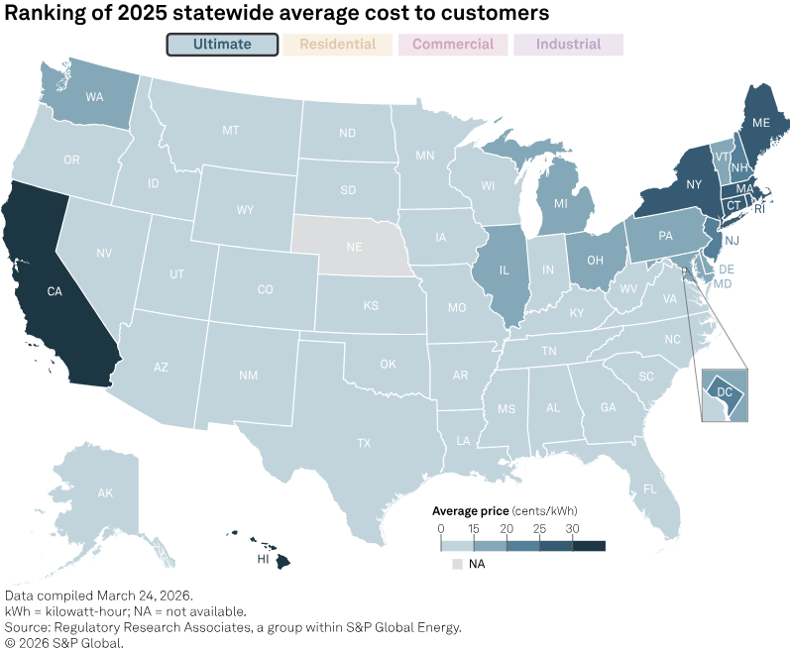
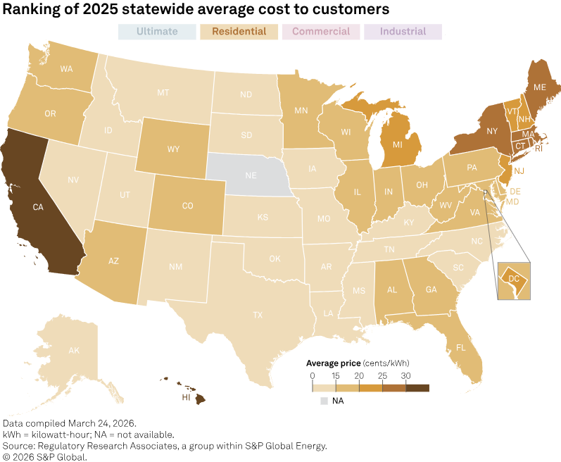
Additional factors driving increasing utility bills
Inflation
Employee healthcare, post-retirement benefits
Higher capital costs — post COVID
Fuel/wholesale power costs
Transmission costs (ISO/RTO pass-throughs)
Energy transition
Storm restoration and remediation
Regulatory compliance
Customer service enhancements
Low-income customer programs
Social justice and community development initiatives
State/local/municipal taxes

Slide 11
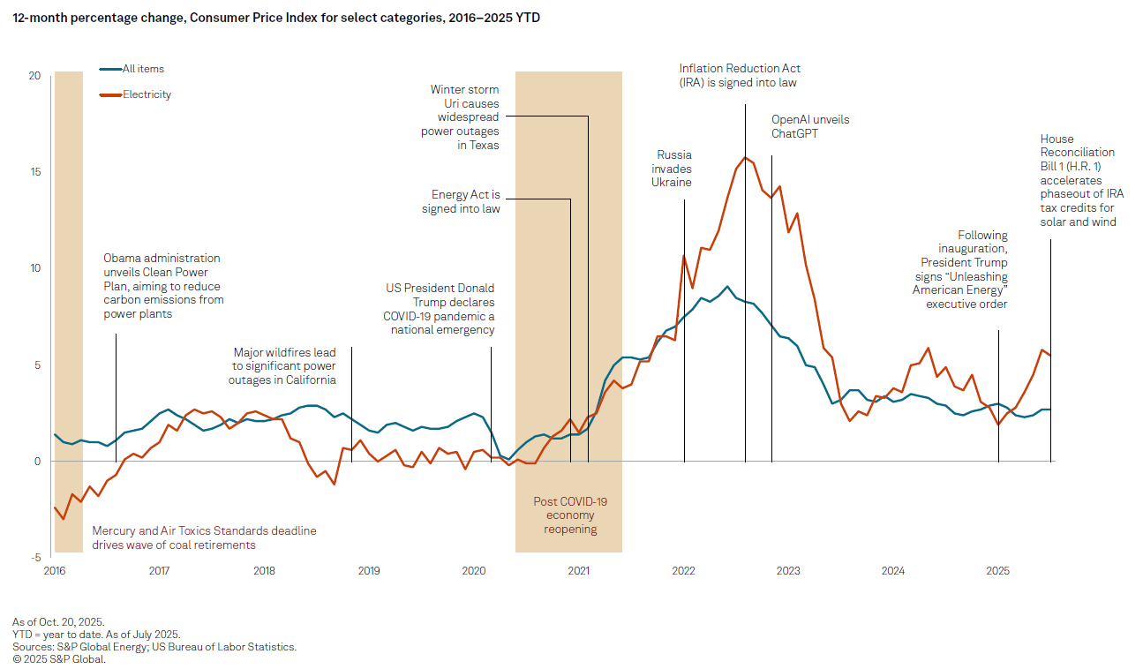
US retail electricity prices have risen faster than inflation over the past 5 years

Slide 12
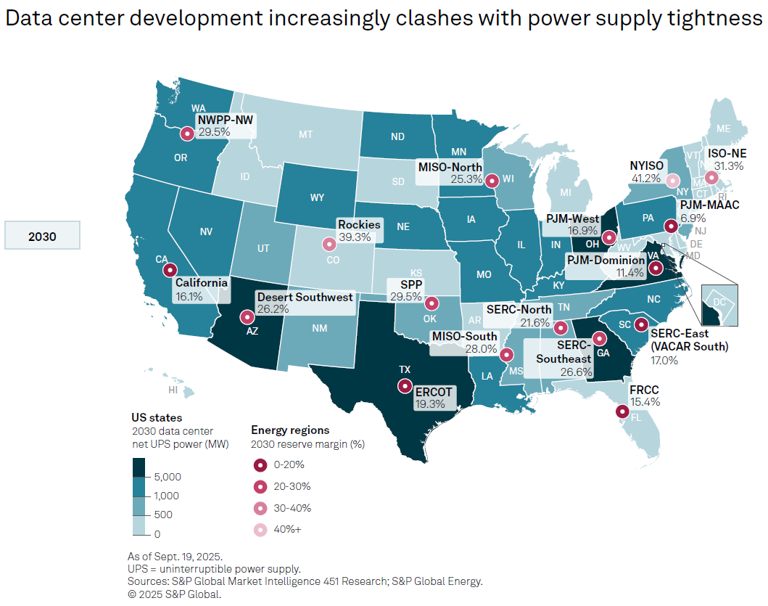
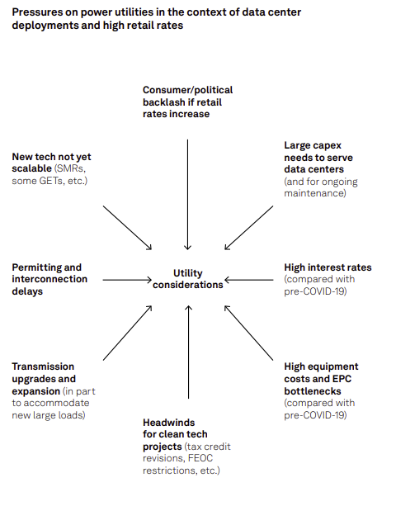
Increasing loads to serve datacenters creating political backlash

