Slide 1

Fun with Betas
Presented by:
Carla S. Nunes, CFA, ABV
April 17, 2026

Slide 2

Carla S. Nunes, CFA, ABV
Carla S. Nunes, CFA, ABV is a Managing Director in the Office of Professional Practice of Kroll (previously Duff & Phelps). She has almost 30 years of experience. In that role, Carla provides firm-wide technical guidance on a variety of valuation, financial reporting and tax issues. In addition, Carla is the Global Leader of Kroll's Valuation Digital Solutions group, which produces cost of capital thought leadership content and data housed in the Cost of Capital Navigator. She is a co-creator of the Cost of Capital Navigator online platform.
In 2011, Carla completed a one-year rotation in Kroll's London office, where she promoted the firm's IFRS education efforts and marketing initiatives, as well dealing with IFRS implementation issues.
Prior to these roles, Carla was part of the Valuation Advisory Services business unit, performing engagements primarily for financial reporting and tax purposes at Kroll’s predecessor firms, PricewaterhouseCoopers, Standard & Poor’s, and Duff & Phelps.
Carla has conducted numerous business and asset valuations for a variety of purposes, including purchase price allocations, goodwill impairment testing, M&A, corporate tax restructuring and debt analysis. She has been involved in multiple valuation assignments for a wide range of industries, including pharma & biotech, healthcare, vitamin retail, specialty chemicals, industrial manufacturing and gaming & hospitality. Carla has substantial experience with cross-border valuations, working with multinational corporations to address complex tax, international cost of capital and foreign exchange issues.
Carla is one of Kroll’s experts addressing valuation issues related to cost of capital. She authored a chapter titled “Cost of Capital for Divisions and Reporting Units” included in the 4th and 5th editions of the textbook Cost of Capital: Applications and Examples (2014), by Shannon Pratt and Roger Grabowski. She was also a contributing author to the chapter “Risk-free Rate” in the 5th edition. In addition, she is a co-author of the Duff & Phelps Valuation Handbook series (published annually between 2014 and 2019), now available exclusively online in the Kroll Cost of Capital Navigator, which she also co-created. Carla is a co-author of the 2021, 2022 and 2023 updates of the Valuation Handbook – International Guide to Cost of Capital: Summary Edition published by the CFA Institute Research Foundation. She also co-authored a chapter for The Art of Valuation, published by The Appraisal Foundation and a chapter titled “Cost of Capital for Companies in Distress” included in the eBook Valuation for INSOLvency Practitioners, published by INSOL. Carla was a co-author of the Kroll’s “ESG and Global Investor Returns Study” (2023) which examined the relationship between historical returns of over 13,000 publicly traded companies across a variety of geographies and industries and their ESG ratings to determine the correlation of ESG ratings to company performance. She also co-authors Kroll's annual U.S. and European Goodwill Impairment Studies.
Carla is a frequent speaker in webinars, conferences, and top business schools on the topics of cost of capital, the economy, ESG/sustainability, goodwill impairment, and valuation in general.
Carla has recently completed her term as Practitioner Director in the Board of the Financial Management Association (FMA) International and she is a member of the Education Committee of the International Institute of Business Valuers (iiBV), the Financial Reporting Committee (FRC) at the Institute of Management Accountants (IMA) and the ESG Working Group at the IVSC Standards Review Boards. Carla is also a board member of the Simon Women’s Alliance, and she was a Fellow of the (now-sunset) Kroll Institute.
Carla received her MBA in finance from the University of Rochester's Simon School, an honors degree in business administration from Lisbon's School of Economics and Management (ISEG Lisbon) and completed coursework (50%) for a Masters of Taxation from Villanova University School of Law. Additionally, she holds a Chartered Financial Analyst (CFA) designation, an Accredited in Business Valuation (ABV) credential, and passed the exam and fulfilled all the requirements for the Certified in Entity and Intangibles Valuations (CEIV) credential (now-discontinued). Carla also holds an ESG Executive Certificate for Financial Professionals Program awarded by The Wharton School, University of Pennsylvania.
Managing Director
Philadelphia, PA
Carla.Nunes@kroll.com

Slide 3
Disclaimer
Any positions presented in this session are those of the panelists and do not represent the official position of Kroll, LLC. This material is offered for educational purposes with the understanding that neither the authors nor Kroll, LLC or its affiliates are engaged in rendering legal, accounting or any other professional service through presentation of this material.
The information presented in this session has been obtained with the greatest of care from sources believed to be reliable, but is not guaranteed to be complete, accurate or timely. The authors and Kroll, LLC or its affiliates expressly disclaim any liability, including incidental or consequential damages, arising from the use of this material or any errors or omissions that may be contained in it.

Slide 4
Different Beta Types
Beyond CAPM Betas – Multi-factor Models
Appendix A: Beta Recommendations and Practical Issues
Appendix B: Adjusting for Financial Risk (Unlevering and Relevering)
Appendix C: About the Cost of Capital Navigator

Slide 5
Different Beta Types

Slide 6
What is CAPM Beta?
Beta is a measure of systematic (i.e., “market”) risk of a stock; the tendency of a stock’s price to correlate with changes in a specific market index. Beta does not measure unsystematic risk.
Beta (β) is the CAPM measure of risk:
E(R_{i})
R_{f}
β
ERP

Slide 7
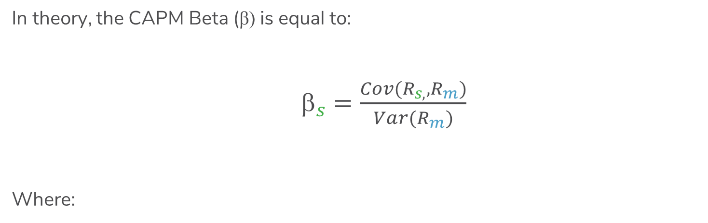
How do You Compute the CAPM Beta?
In theory, the CAPM Beta (β) is equal to:
$_{s}=\frac{Cov(R_{s,},R_{m})}{Var(R_{m})}$
Where:
=
Beta of the stock of company s
β
s
Cov(R
s
,R
m
)
=
Expected covariance between the excess returns
of company s (R
s
in the equation) and the excess
returns of the “market” (R
m
in the equation)
Var(R
m
)
=
Expected variance of returns of the "market"

Slide 8

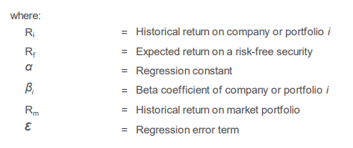
What is an OLS (Historical) Beta – Alternative Computation
Ordinary Least Squares (OLS) is also referred to as ‘least squares’ regression, or simply, a regression. A regression is the analysis between one variable (the dependent variable) and one or more variables (the independent variables), assuming a linear relationship.
In the context of CAPM, the historical beta is estimated via an OLS regression (hence the term, OLS beta).
The textbook CAPM OLS beta is the slope of the regression line, where the returns of a security are regressed against the returns on the market portfolio.
Bloomberg calls this a “Raw Beta”.

Slide 9
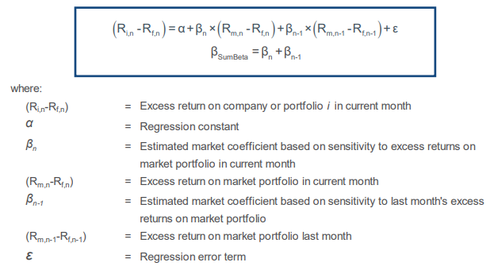
What is a Sum Beta?
A Sum Beta is obtained through a multiple regression of a stock's current month's excess returns (over the 30-day T-Bill rate) on:*
  The market's current month's excess returns; and
  The market's previous month's excess returns.
  The Sum Beta is computed by summing up the resulting beta coefficients (current and lagged).
Sum Betas have been shown to be better predictors of smaller companies’ expected returns within the context of the CAPM.
* If using monthly data. Sum Betas can also be used for other return frequencies.

Slide 10
Beta Estimation Basics – Five Considerations
There are choices you will have to make when calculating a beta using historical data*
  The market benchmark
  Amount of history (1 year, 3 years, 5 years, etc.)
  Stability over time
  Frequency (daily, weekly, monthly, etc.)
  Statistical quality
  *There may be other things of course, but these are the “biggies”.

Slide 11
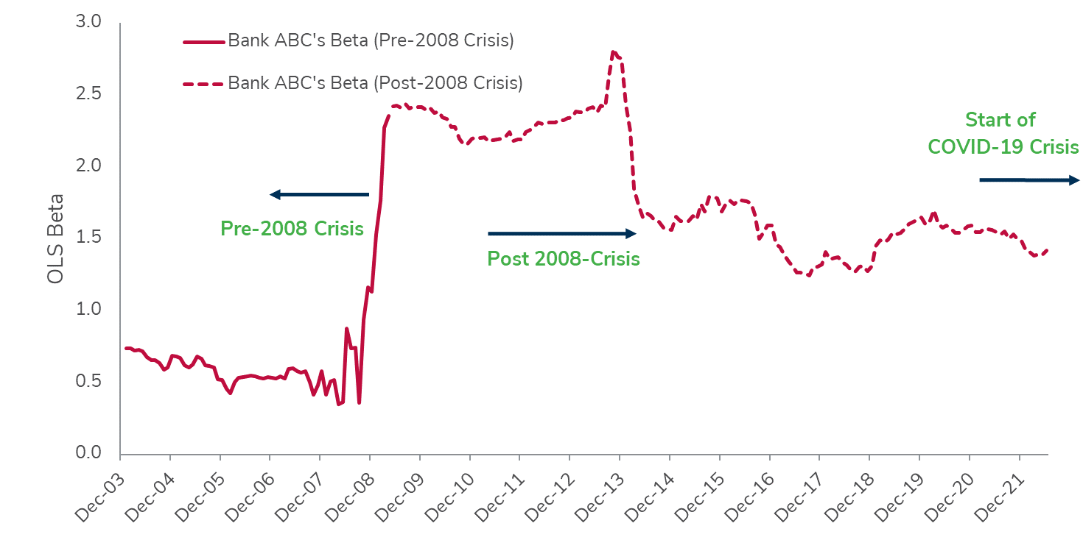
Beta Estimation Basics – Stability Over Time
Is Bank ABC’s “pre-crisis” beta or its “post-crisis” beta more representative of risk going forward?
Jun-22
Notes:
This is actually Bank of America.

Slide 12
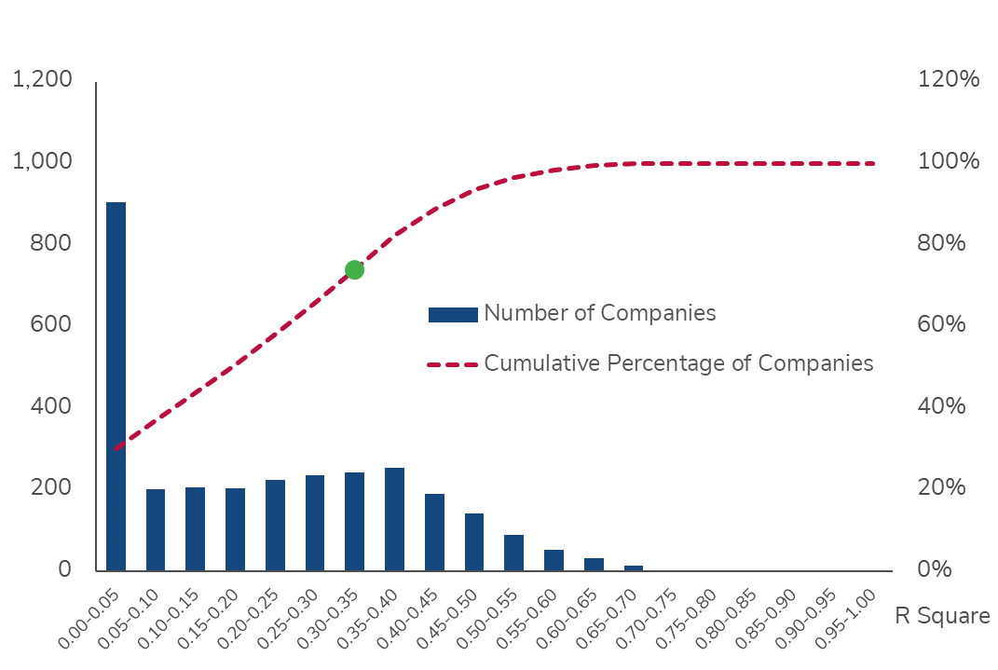
Beta Estimation Basics – Statistical Quality
R-Squared
Commonly referred to as “Goodness of fit”.
Most R-Square values on beta regressions are less than 20% to 30%, indicating that other company or industry factors explain realized returns on a security
Notes:
{Section end slide}

Slide 13
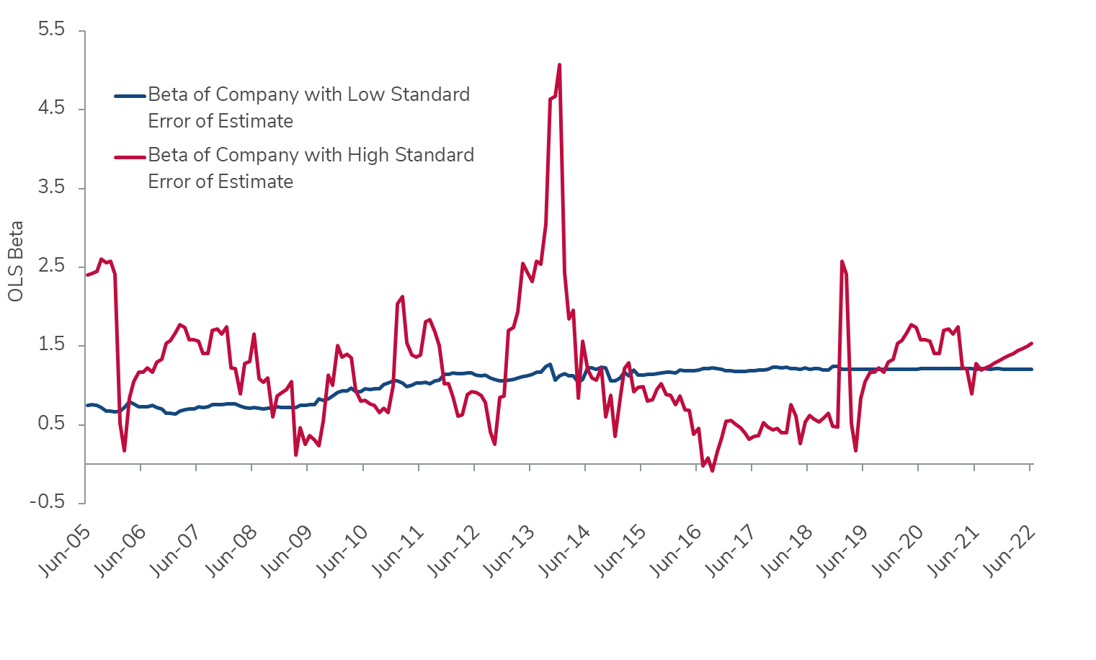
Beta Estimation Basics – Statistical Quality
Standard Error of Estimate
Measures likelihood that true beta is captured by the estimate of beta derived through the regression equation

Slide 14
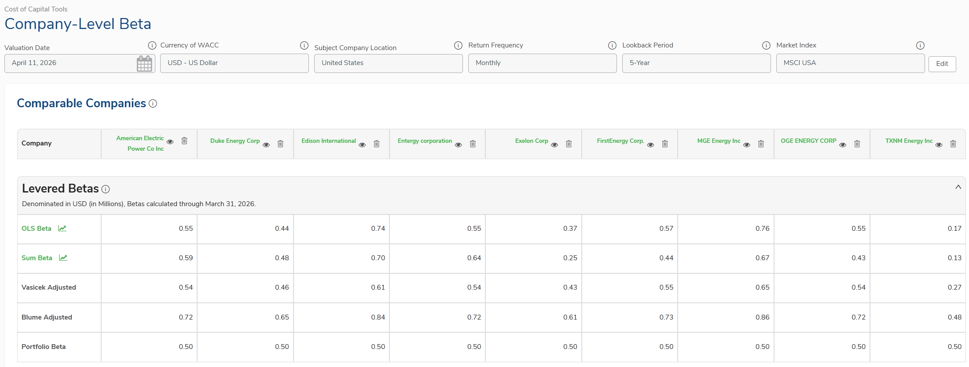
Beta Estimates – Statistical Significance
5-Year Monthly
Source: Kroll Cost of Capital Navigator

Slide 15
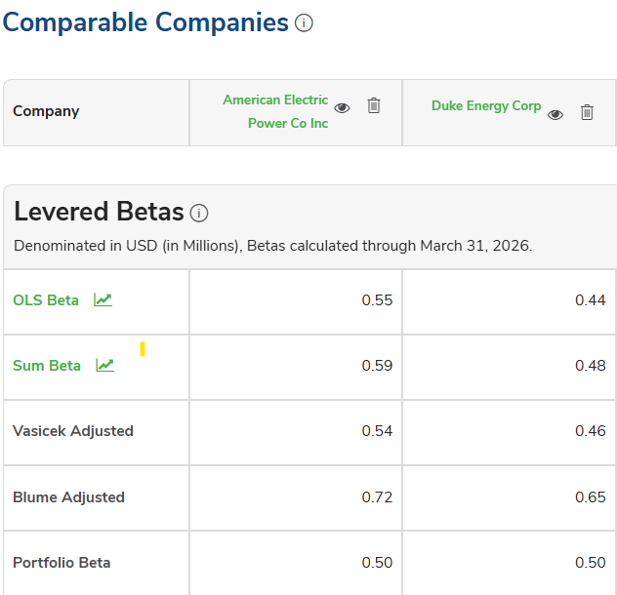
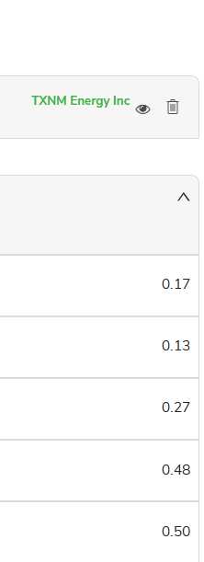
Beta Estimates – Statistical Significance (Continued)
5-Year Monthly
(…)
Source: Kroll Cost of Capital Navigator

Slide 16
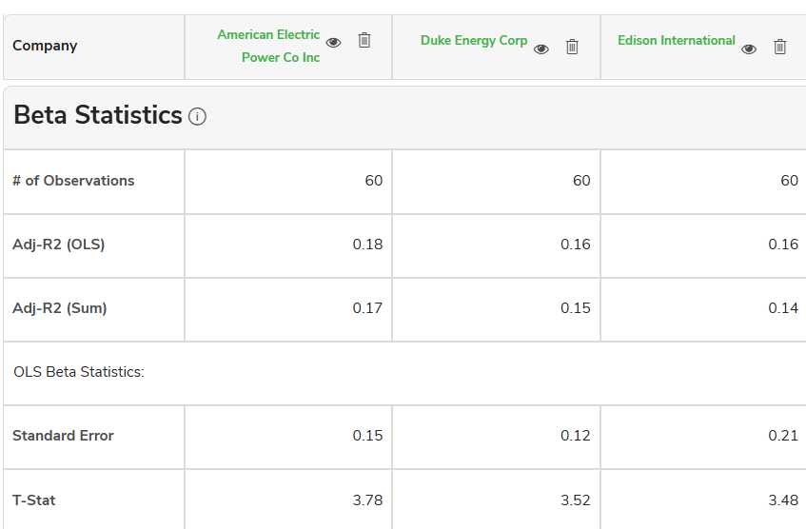
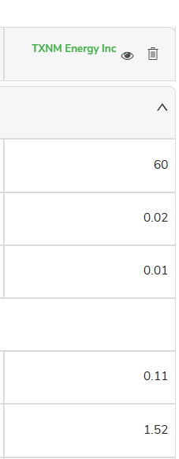
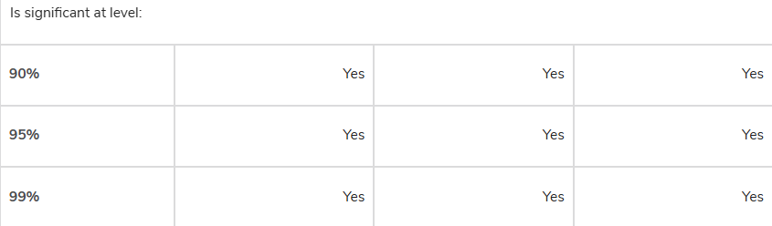

Beta Estimates – Statistical Significance (Continued)
(…)
5-Year Monthly
Source: Kroll Cost of Capital Navigator

Slide 17
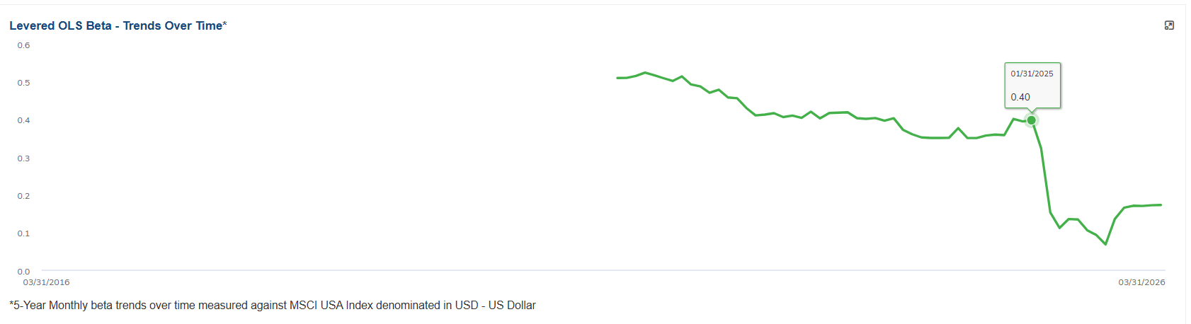
10-Trailing Betas Over Time – TXNM Energy Inc
5-Year Monthly
Source: Kroll Cost of Capital Navigator

Slide 18

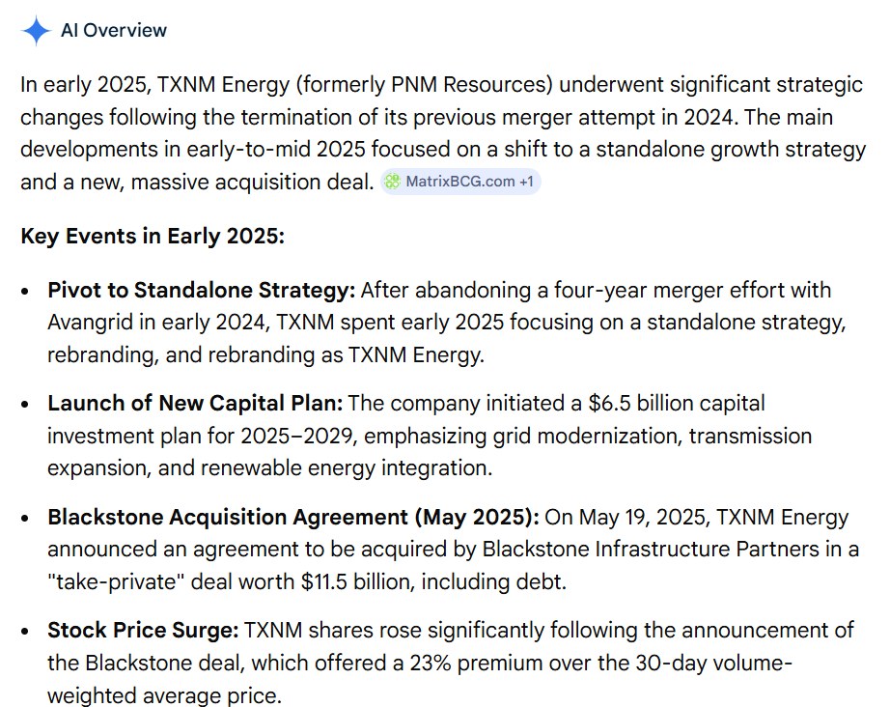
Did Anything Happen to TXNM Energy Inc in Early 2025?

Slide 19
A Forward-looking Beta is What We Really Want
Three Common Adjustments for Making a Beta More “Forward-looking”
Like the cost of capital itself (and all of its inputs), beta is a forward-looking concept. We are trying to estimate “future” beta.
In practice, however, beta is often estimated using historical return data. In this sense, beta is forward looking……but only to the degree that the past is expected to repeat itself.
Can a beta calculated using historical data be made more “forward-looking”? There are a few common adjustments to do this:
  The Blume Adjustment (adjusts to the “market” beta)
  The Vasicek Adjustment (adjusts to the “industry” beta)
  The Portfolio (Peer Group) Beta (adjusts to “peers”/”industry”)

Slide 20
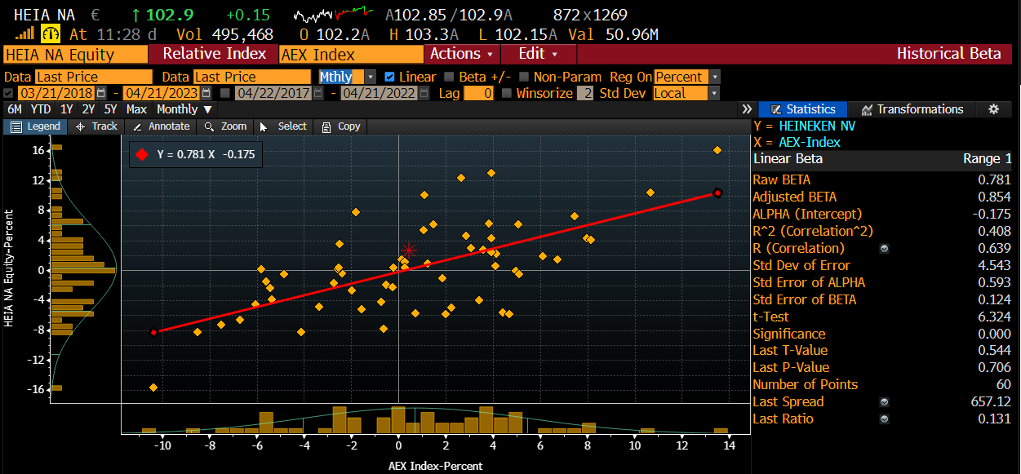
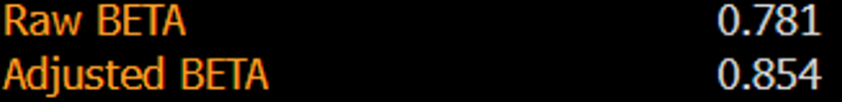
Bloomberg’s Adjusted Beta is based on the Blume Adjustment
Adjusted Beta = (0.33 x 1.0) + [0.67 x historical (Raw) beta]
0.854 = (0.33) + (0.67 x 0.781)

Slide 21
Why Use 0.33 in the Blume Adjustment?
Prospective Beta = (0.33) + (0.67 x historical beta)
The adjustment is a simplification (1/3 vs. 2/3) and not an exact replication of Blume’s original analysis in his 1971 paper.
The original Blume adjustment was (based on an average of several periods from 1926 through 1968 using 7-year monthly betas):
This simple adjustment of 0.33 makes the Blume adjustment a “one size fits all” adjustment.
Prospective Beta = (0.371) + (0.635 x historical beta)
Source: The original paper, “On the Assessment of Risk”, The Journal of Finance, Vol. 26, No. 1, (Mar 1971), pp. 1-10

Slide 22
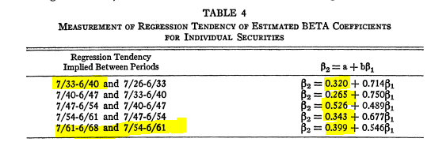
Why Use 0.33 in the Blume Adjustment?
Prospective Beta = (0.371) + (0.635 x historical beta)
The original Blume adjustment was (based on an average of several periods from 1926 through 1968 using 7-year monthly betas):
Source: The original paper, “On the Assessment of Risk”, The Journal of Finance, Vol. 26, No. 1, (Mar 1971), pp. 1-10

Slide 23
A Few Thoughts on the Blume Adjustment…
Blume said in his 1971 paper that:
The coefficients themselves will change over time (i.e., the ratio at which a beta moves to the market beta of 1.0)
The use of a historical regression to correct for the future ratio:
  Will not perfectly adjust betas
  May overcorrect by introducing larger errors than in the unadjusted beta
Caution
If your project may end up in litigation, be aware of these limitations
You may not be able to defend the adjustment in court [See: Delaware Court of Chancery case “GT LP and Global GT LTD v. Golden Telecom, Inc.”]

Slide 24
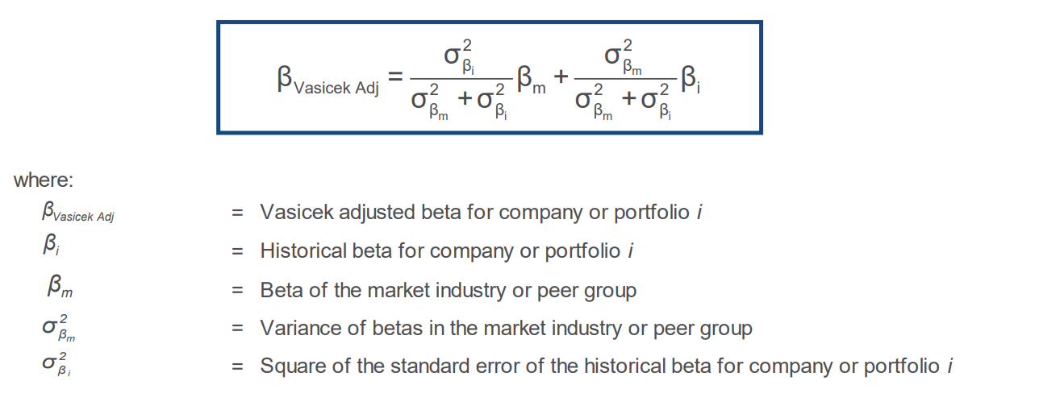
The Vasicek Adjustment
Betas with higher standard error (i.e., lower statistical quality) are the least reliable estimates, and therefore are adjusted toward the market/peer group/industry average more than are betas with higher statistical quality.
Also known as a “shrinkage” or “smoothing” technique.
The Vasicek Adjustment is not “one size fits all”.

Slide 25
Best Practices by Beta Type
OLS Beta
  Best to only use betas that are “statistically significant”. A short-cut is to look at t-stats > 2.0
  Be careful if a company underwent a significant transaction (e.g., acquisition, divestiture, etc.), as the underlying business risk may have changed materially.
  Look at trailing betas over time (e.g., over the last 10 years) to analyze beta stability.
Sum Beta
  Preferably, use only for small or thinly-traded comparable companies.
  Sum betas have been shown to be better predictors of smaller companies’ expected returns within the context of the CAPM.
Vasicek Adjusted
  Can be used for any project.
  Particularly important when standard errors of individual betas are large (look at the size of the standard error relative to the beta estimate).

Slide 26
Beyond CAPM Betas
– Multi-factor Models

Slide 27
Back to Basics: What are Multi-Factors Models?
E(R_{i})
R_{f}
β₁
RP₁
RP₃
β₂
RP₂
β₃
….

Slide 28
What are the Most Common Factors included in Multi-Factor Models Nowadays?
Market
(Textbook CAPM only captures this factor)
Size
(Modified CAPM used by practitioners)
Value
(vs. Growth)
Momentum
Investment
Quality
Fama-French
3-Factor Model

Slide 29
What are the Most Common Factors included in Multi-Factor Models Nowadays?
Market
(Textbook CAPM only captures this factor)
Size
(Modified CAPM used by practitioners)
Value
(vs. Growth)
Momentum
Investment
Quality
Fama-French
5-Factor Model

Slide 30
What are the Most Common Factors included in Multi-Factor Models Nowadays?
Market
(Textbook CAPM only captures this factor)
Size
(Modified CAPM used by practitioners)
Value
(vs. Growth)
Momentum
Investment
Quality
Liquidity
Low
Volatility
Yield /
Income
More recent factors, but more popular with asset managers →
Also see:
(i) “… and the Cross-Section of Expected Returns” by Harvey, Liu, and Zhu (2015),
(ii) “A Census of the Factor Zoo” by Harvey and Liu (2019)

Slide 31
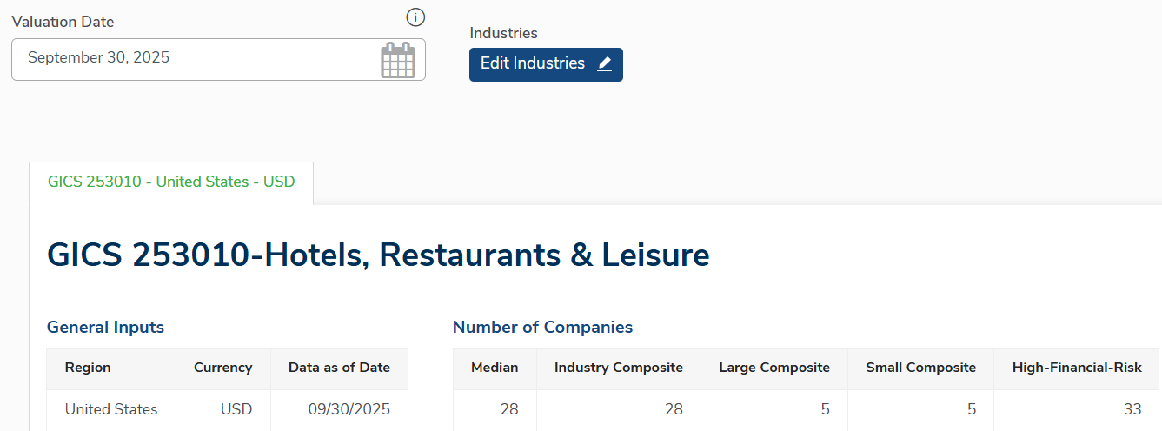
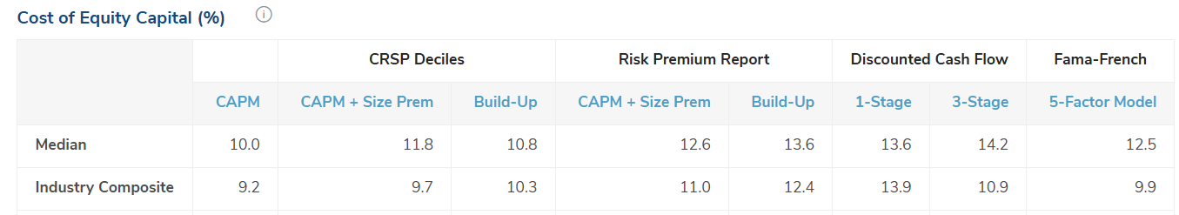
What Am I missing If I Just Use Textbook CAPM?
Kroll Cost of Capital Navigator: Cost of Equity Using CAPM vs. Fama-French 5-Factor Model
Source: Kroll Cost of Capital Navigator, U.S. Industry Benchmarking. Data as of September 30, 2025

Slide 32
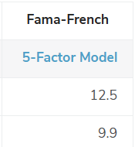


What Am I missing If I Just Use Textbook CAPM?
Industry Cost of Equity Using CAPM vs. Fama-French 5-Factor Model
Source: Kroll Cost of Capital Navigator, U.S. Industry Benchmarking. Data as of September 30, 2025

Slide 33
What Am I missing If I Just Use Textbook CAPM?
Industry Cost of Equity Using CAPM vs. Fama-French 5-Factor Model – Median
Source: Kroll Cost of Capital Navigator, U.S. Industry Benchmarking. Data as of September 30, 2025. Based on the company-level cost of equity for each company in each of the size categories

Slide 34
What Am I missing If I Just Use Textbook CAPM?
Industry Cost of Equity Using CAPM vs. Fama-French 5-Factor Model – Average
Source: Kroll Cost of Capital Navigator, U.S. Industry Benchmarking. Data as of September 30, 2025. Based on the company-level cost of equity for each company in each of the size categories.

Slide 35
Average and Median Difference Between Fama-French and CAPM COE
Source: Kroll Cost of Capital Navigator, U.S. Industry Benchmarking. Data as of September 30, 2025. Based on the difference in company-level cost of equity using the two difference models for each company in each of the industries.

Slide 36
Key Takeaways
Start with comparable companies that closely reflect your subject company’s underlying business risk
Use multiple methods to estimate your betas (but don’t mix and match different methods)
Be critical about the methods you are using and the results you obtain
CAPM beta only captures a portion of systematic risk or of realized returns

Slide 38
Appendix A:
Beta Recommendations and Practical Issues

Slide 39
Recommendations & Practical Issues
RECOMMENDATIONS
Use public comparables or guideline companies as proxies when valuing a private company.
Consider differences between subject company and public comparables.
Use betas from consistent source.
Be cautious of data from small firms without an active market: true betas tend to be underestimated. Therefore, consider avoiding betas from thinly-traded companies.
Be careful with betas of highly levered companies: Miles-Ezzel or Harris-Pringle unlevering methodologies should be used in such cases.
Consider avoiding unlevered (asset) beta that is 0.10 or lower. Such estimate is likely not statistically different from zero.
Consider impact of unusual effective tax rates on unlevering Beta (e.g., negative tax rate).
May want to adjust Betas of companies with large cash balances (objective is to estimate underlying (asset) beta of operations).
PRACTICAL ISSUES
The beta of a portfolio is always the market-value weighted average of the betas of the individual investments in that portfolio. For example, the beta of a mutual fund is the weighted average of the betas of the stocks and other investments in that portfolio.
The beta of a company after a merger is the market-value weighted average of the betas of the companies involved in the merger
The beta of an overall company is the market-value weighted average of the businesses (i.e., divisions and/or projects) comprising the overall company.
Notes:
{Section end slide}

Slide 40
Reminders: Best Practices for Return Frequency and Lookback Period
Most common or “standard” historical period used to measure returns = 5 years of monthly returns (i.e., 60 months). Another period often used = 2 or 3 years of weekly returns (i.e., 104 or 156 weeks).
If company characteristics change significantly (e.g., major divestiture or acquisition, significant deregulation), it may be more appropriate to use a shorter period (e.g., weekly returns).
The shorter the time period, the more “noise” is introduced, reducing the statistical quality of the regression.
Care should be taken such that the sample size is not too small. For example, a beta based on less than 30 monthly observations may not be reliable (i.e., not statistically significant). Likewise, a beta based on less than 104 weeks may be unreliable.
Be careful with companies that went through an IPO within the last year, as those betas are often unreliable and not a good proxy for their future risk.

Slide 41
Appendix B:
Adjusting for Financial Risk (Unlevering and Relevering)

Slide 42
There are Various Formulas for Unlevering and Relevering Betas
These alternative formulas vary depending on the likelihood that tax deductions on interest will be realized.
We will focus on 3 of these formulas:
Harris- Pringle
Hamada
Miles- Ezzell
IMPORTANT!
Because of interest deductibility limitations introduced by the 2017 U.S. Tax Reform, you may need to adjust your tax rate assumptions in your unlevering/levering calculations.

Slide 43
Hamada Beta Unlevering/ Relevering Formulas
Is the most commonly used formula.
Is applicable in situations where the absolute amount of debt is fixed.
Consistent with theory that there is no risk surrounding the ability to get full tax deductions
Miles- Ezzell
Hamada
Harris- Pringle

Slide 44
Miles Ezzell Beta Unlevering/Relevering Formulas
    Assumes that the risk of realizing the tax deductions is greater than is assumed in the Hamada formulas.
    Year 1: The discount rate used to calculate the value of the tax shield equals the cost of debt capital during the first year (i.e., the tax shield has the same risk as debt).
    Years 2 and beyond: The discount rate used to calculate the value of the tax shield in years 2 and beyond equals the cost of equity calculated using the asset beta of the firm (i.e., the risk of the tax shield after the first year is comparable to the risk of the operating cash flows).
  Market value of debt capital remains at a constant percentage of equity capital, which is equivalent to saying that debt increases in proportion to increases in the net cash flow of the firm (net cash flow to invested capital) in every period.
Miles- Ezzell
Harris- Pringle
Hamada

Slide 45
Harris Pringle Beta Unlevering/ Relevering Formulas
Assumes the tax shield is even riskier.
Consistent with theory that tax deductions are as risky as operating cash flows and the discount rate on those deductions equals cost of equity
Assumes the market value of debt capital remains at a constant percentage of equity capital, which is equivalent to saying that debt increases in proportion to the net cash flow of the firm (net cash flow to invested capital) in every period.
Miles- Ezzell
Harris- Pringle
Hamada

Slide 46
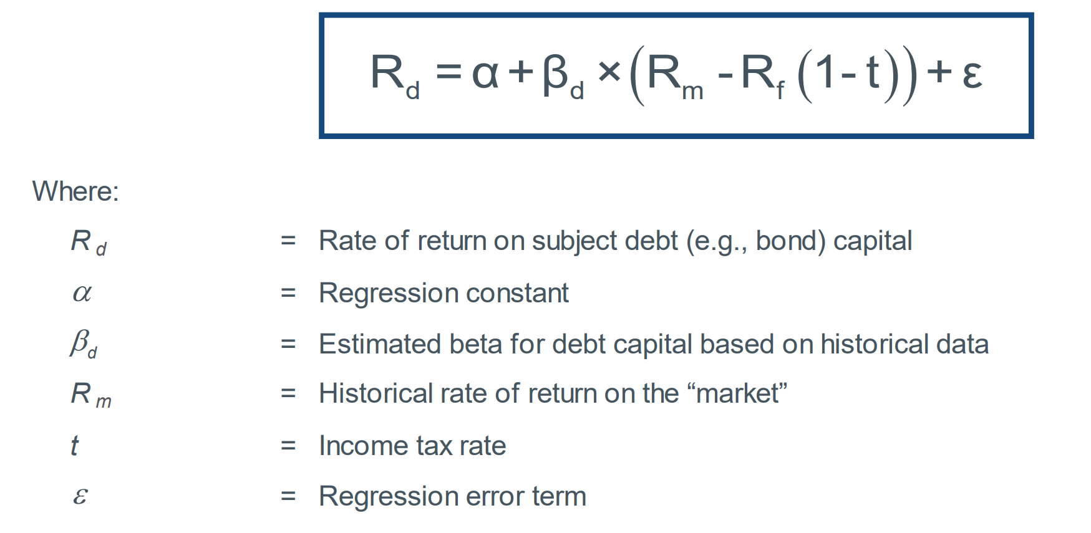

What about Debt Betas?
The risk of debt capital can be measured by the beta of the debt capital (β_{d}).
In cases where the debt capital is publicly traded, the β_{d} can be measured in a manner identical to measuring the beta of equity. For publicly traded debt, a regression of returns provides an estimate of β_{d}.
$$β_{debt}$$

Slide 47
Debt Beta – World Region
As of December 31, 2025
 |  | EUR | USD | GBP
Aaa |  | 0.00 | 0.00 | 0.00
Aa |  | 0.28 | 0.40 | 0.19
A |  | 0.28 | 0.40 | 0.19
Baa |  | 0.31 | 0.43 | 0.22
Ba |  | 0.40 | 0.47 | 0.32
B | * | 0.40 | 0.47 | 0.32
Caa | * | 0.40 | 0.47 | 0.32
Source: Kroll Cost of Capital Navigator – International Benchmarking Module
*B and Caa grade debt betas use the Ba calculation due to a lack of quality data for lower investment grades. “World” debt betas are used for all regions in the analysis within the International Industry Benchmarking dataset.

Slide 48
U.S. Debt Betas (by credit grade) Over Time
December 2006 – December 2022
2008 Financial Crisis
COVID-19
Source: Cost of Capital Navigator

Slide 49
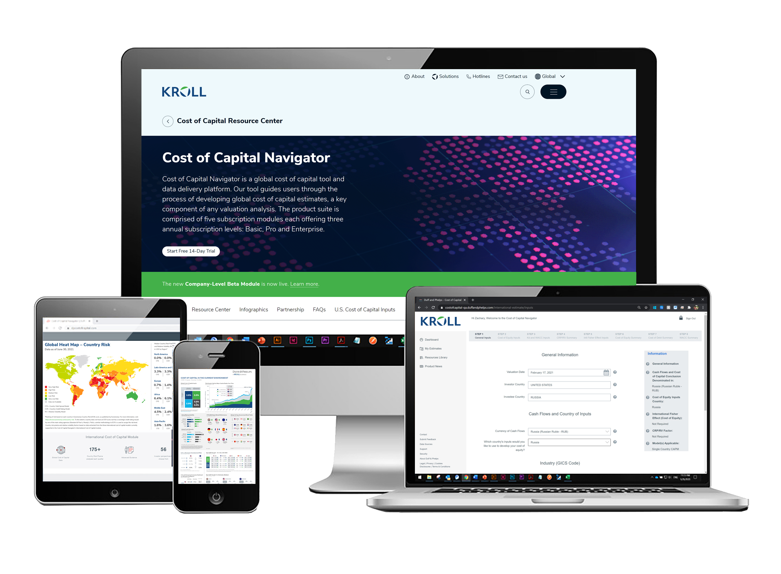
Appendix C:
About the Cost of Capital Navigator

Slide 50


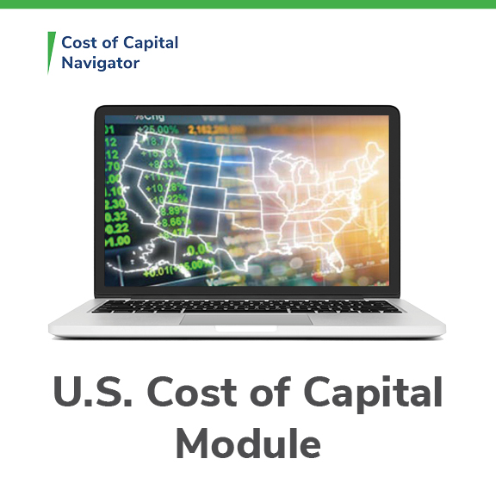



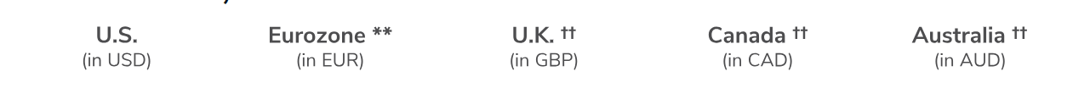
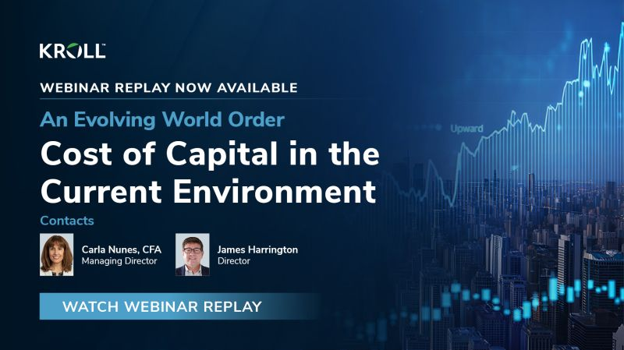
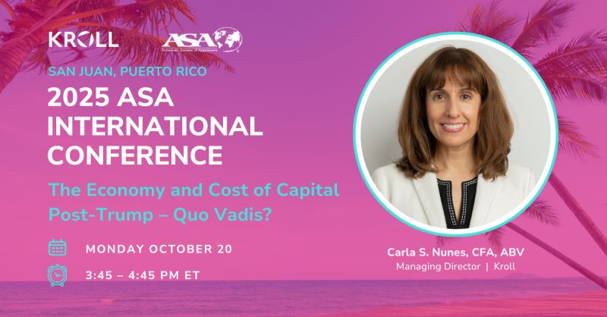
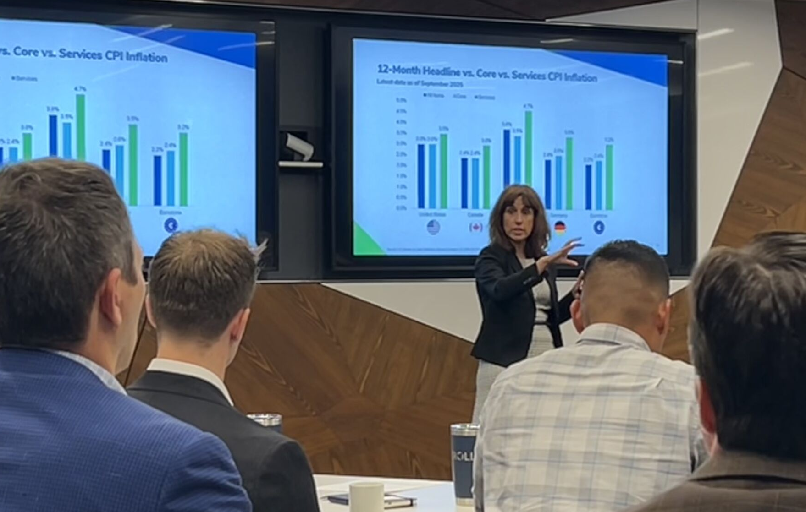
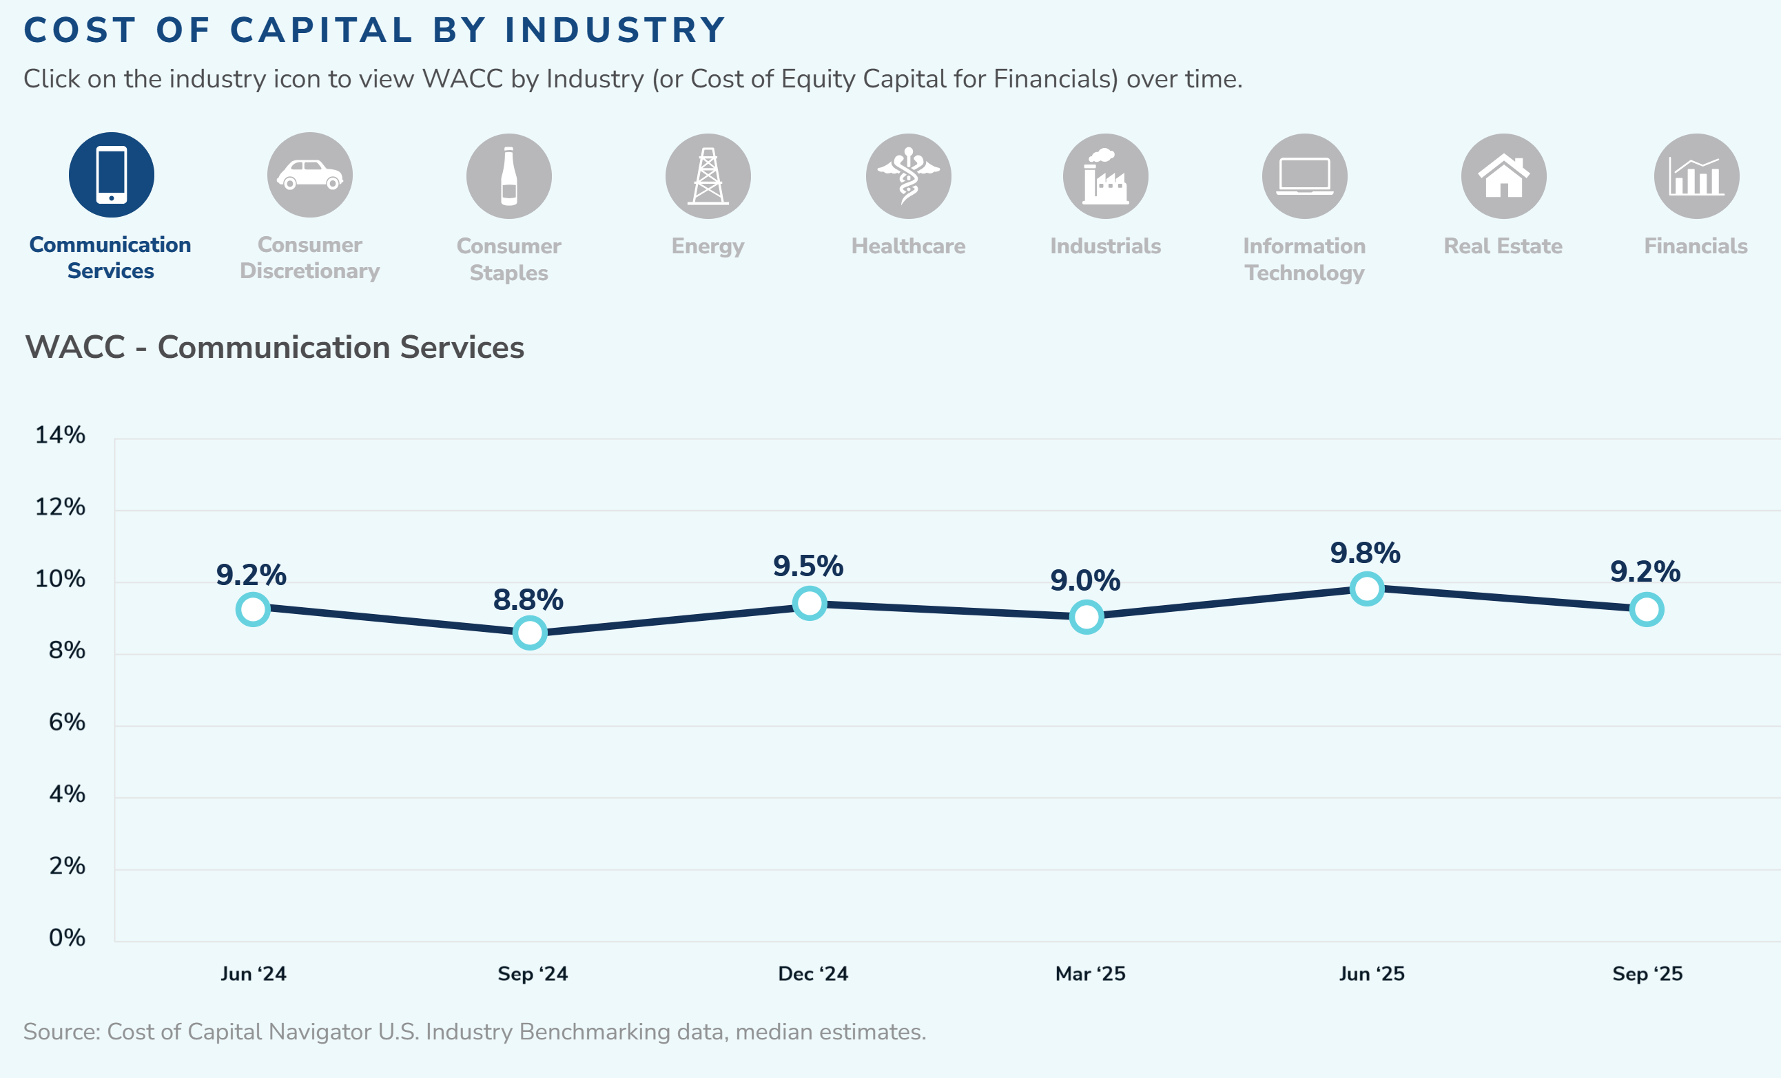

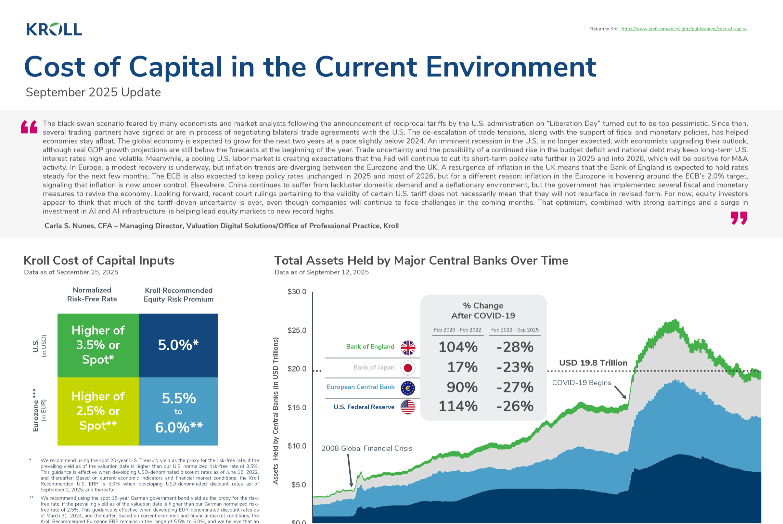
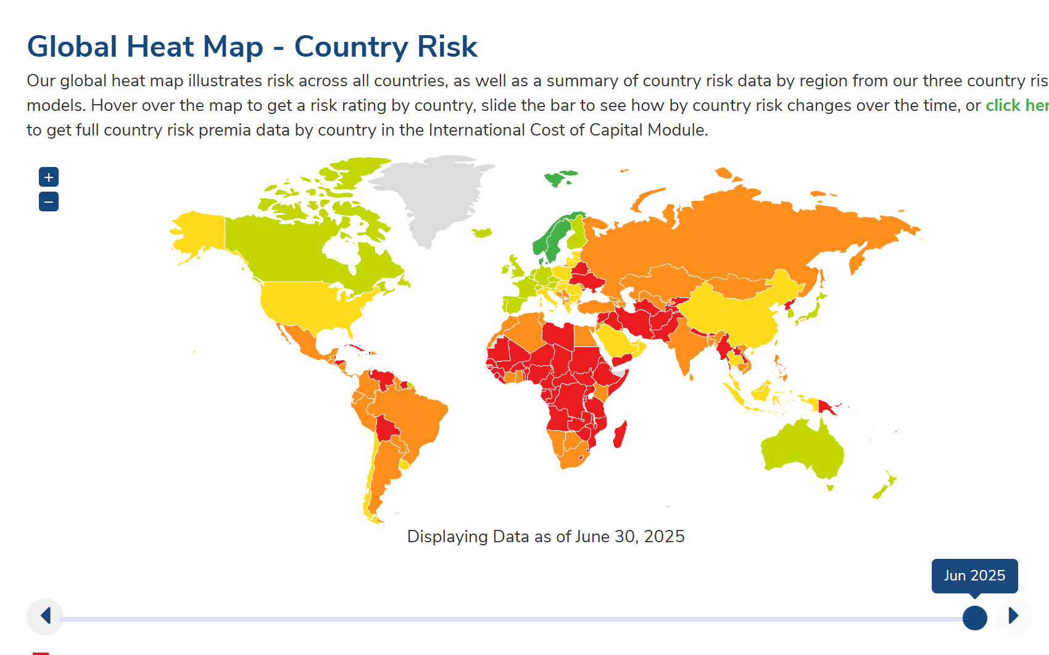
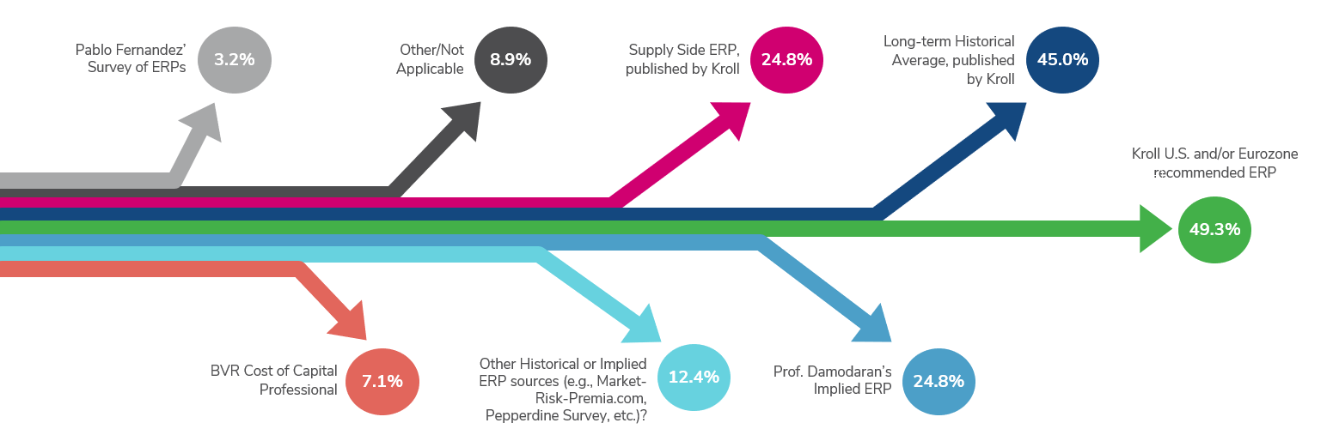

Cost of Capital Thought Leadership Overview
As the world’s premier valuation provider, we are a trusted expert in the field of cost of capital. For more than two decades, our professionals have published books, conducted studies, provided recommendations and built digital tools to help businesses and valuation professionals calculate cost of capital. Our databases are developed with rigorous analysis and based on the latest trends and insights.
Subject Matter Experts
Cost of Capital Navigator
The Cost of Capital for Companies in Distress
Key Cost of Capital Recommendations Data as of March 23, 2026
Our best-in-class, all-in-one solution, the Cost of Capital Navigator digital platform is built upon decades of valuation data and relies on established cost of capital theory and methodologies.
Our experts contributed a chapter to INSOL’s “Valuation for INSOLvency Practitioners” eBook, discussing how to incorporate distress when valuing companies, including how to adjust cost of capital.
Kroll regularly reviews fluctuations in the global economic and financial market conditions. These reviews warrant a periodic reassessment of the equity risk premium (ERP) and the accompanying risk-free rate and key inputs used to calculate the cost of equity capital in the context of the Capital Asset Pricing Model (CAPM) and other models used to develop discount rates.
Carla S. Nunes, CFA
Managing Director, Kroll
Higher of
3.5% or Spot*
Higher of
2.5% or Spot†
Higher of
4.0% or Spot‡
Higher of
3.5% or Spot§
Higher of
3.5% or Spot#
Anas Aboulamer, Ph.D.,
Director, Kroll
James P. Harrington
Director, Kroll
Normalized Risk-free Rate
Our Valuation Digital Solutions experts strive to empower companies and finance professionals with cost of capital thought leadership and high-quality valuation data that enables them to make sound business decisions.
The U.S. and International Cost of Capital Modules provide everything you need for U.S.- and International-centric cost of capital calculations all in one place.
The Kroll High-Financial-Risk Study, available in Kroll’s Cost of Capital Navigator, provides data and guidance for making adjustments to the cost of equity of a company experiencing distress.
5.0%
5.5%
to
6.0%
n/a
n/a
n/a
Learn more
†
Equity Risk Premium
Learn more
Webinars and Conferences
Cost of Capital Infographic, Country Risk Heatmap and Other Innovative/Interactive Tools
Kroll Recommended ERP is the benchmark reference in valuation
* We recommend using the spot 20-year U.S. Treasury yield as the proxy for the risk-free rate, if the prevailing yield as of the valuation date is higher than our U.S. normalized risk-free rate of 3.5%. This guidance is effective when developing USD-denominated discount rates as of June 16, 2022, and thereafter. Based on current economic indicators and financial market conditions, the Kroll Recommended U.S. ERP is 5.0% when developing USD-denominated discount rates as of September 2, 2025, and thereafter.
† We recommend using the spot 15-year German government bond yield as the proxy for the risk-free rate, if the prevailing yield as of the valuation date is higher than our German normalized risk-free rate of 2.5%. This guidance is effective when developing EUR-denominated discount rates as of March 31, 2024, and thereafter. Based on current economic and financial market conditions, the Kroll Recommended Eurozone ERP remains in the range of 5.5% to 6.0%, and we believe that an ERP towards the lower end of the range (i.e., closer to 5.5%) is likely more appropriate when developing EUR-denominated discount rates as of September 2, 2025, and thereafter.
‡ We recommend using the spot 20-year U.K. Gilt yield as the proxy for the risk-free rate, if the prevailing yield as of the valuation date is higher than our U.K. normalized risk-free rate of 4.0%. This guidance is effective when developing GBP-denominated discount rates as of October 18, 2022, and thereafter.
§ We recommend using the spot Government of Canada Benchmark Long-Term Bond yield as the proxy for the risk-free rate, if the prevailing yield as of the valuation date is higher than our Canada normalized risk-free rate of 3.5%. This guidance is effective when developing CAD-denominated discount rates as of October 18, 2022, and thereafter.
# We recommend using the spot 10-year Australia Commonwealth Government bond yield as the proxy for the risk-free rate, if the prevailing yield as of the valuation date is higher than our Australia normalized risk-free rate of 3.5%. This guidance is effective when developing AUD-denominated discount rates as of October 31, 2022, and thereafter.
** German normalized risk-free rate and Eurozone equity risk premium (ERP) for use in EUR-denominated discount rates from a German investor perspective. Additional country risk adjustments may be warranted when estimating discount rates for other countries in the Eurozone.
†† Although currently we do not have an official Kroll Recommended ERP for the U.K., Canada and Australia, historical and other forward-looking ERP information for these countries is available in the International Cost of Capital Inputs dataset within the Cost of Capital Navigator.
~50%
of participants said that they use our recommended U.S. ERP*
View full report
With deep technical expertise, our team continually presents in live webinars, conferences and workshops on how cost of capital and valuations are being impacted by the latest trends in the global economy and financial markets, industry developments, and much more.
We provide insights and tools to
assist users with quantifying risk during uncertain times, when performing
cross-border valuations and more.
*Based on polling during our September 2025 webinar, “An Evolving World Order: Cost of Capital in the Current Environment ” of ~322 non-Kroll, external live participants.
www.kroll.com/cost-of-capital-resource-center

Slide 51

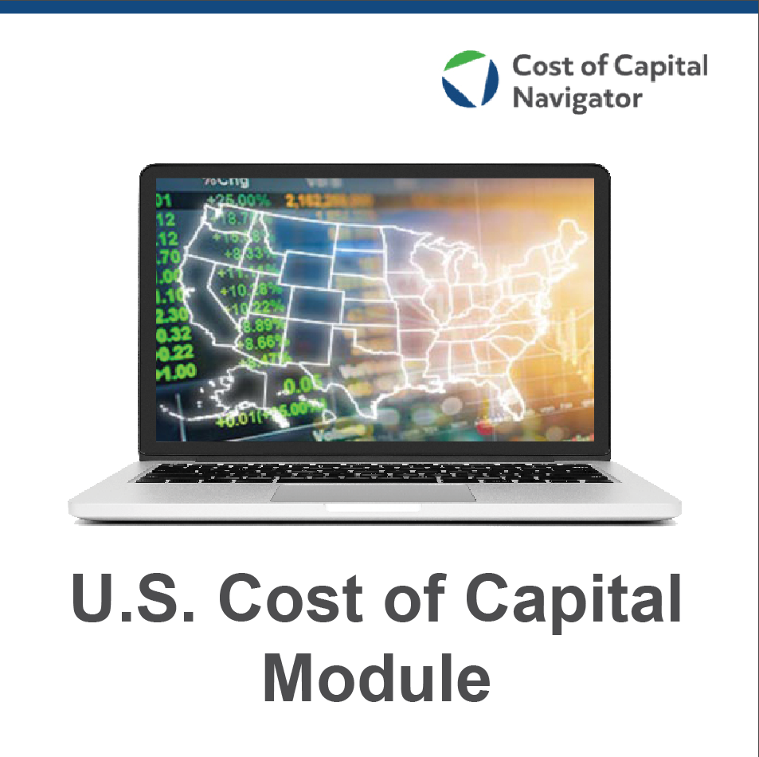
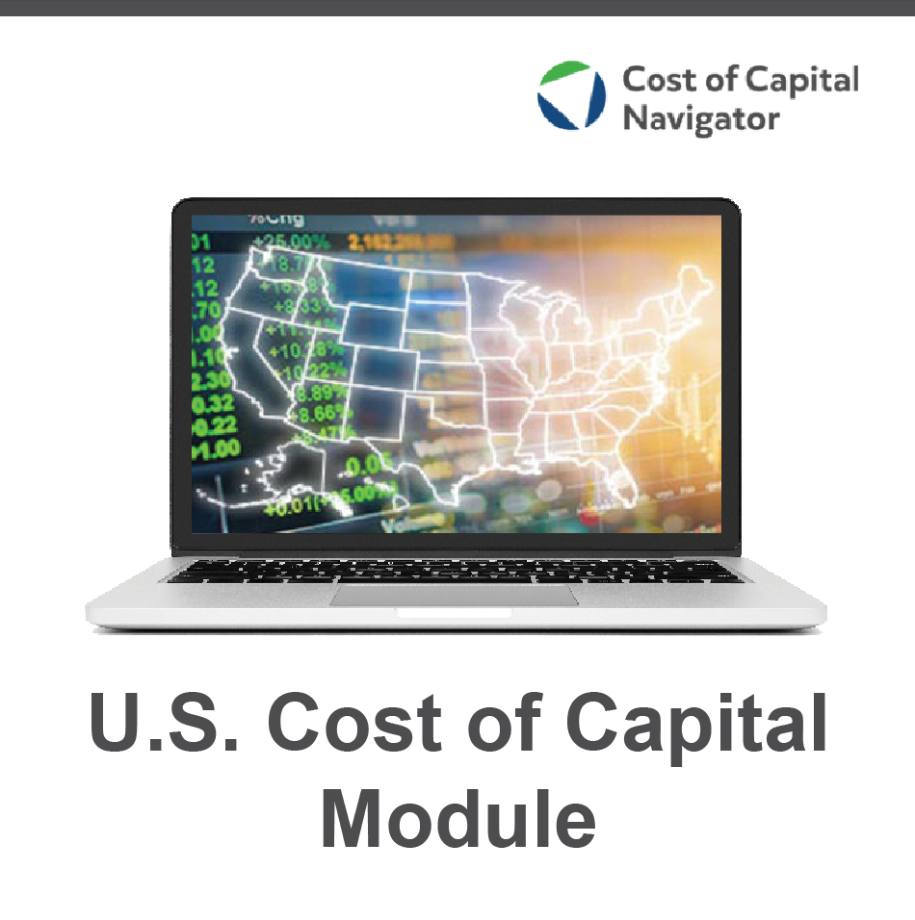











A Brief History
Cost of Capital Navigator Datasets
Valuation Handbook – U.S. Guide to Cost of Capital
Cost of Capital Navigator – U.S. Cost of Capital Inputs dataset
The Cost of Capital Navigator includes two subscription products:
U.S. Cost of Capital Module
International Cost of Capital Module
Valuation Handbook – U.S. Industry Cost of Capital
Cost of Capital Navigator –
U.S. Industry Benchmarking dataset
Valuation Handbook – International Guide to Cost of Capital
Cost of Capital Navigator – International Cost of Capital Inputs dataset
Valuation Handbook – International Industry Cost of Capital
Cost of Capital Navigator –
International Industry Benchmarking dataset
Includes all historical data for these datasets:
Includes all historical data for these datasets:
Cost of Capital Navigator –
Company-Level
Betas datasets
U.S. Cost of Capital Inputs
U.S. Industry Benchmarking
U.S. Company-Level Betas
International Cost of Capital Inputs
International Industry Benchmarking
International Company-Level Betas
Learn More
2014
2015
2016
2017
2018
2019
2020
2021
2022
2023
2024
Kroll.com/costofcapitalnavigator

Slide 52
Available Modules and Datasets
U.S. Cost of Capital Inputs
Risk-free Rates
Equity Risk Premia (ERPs)
Size Premium
Risk Premium Over the Risk-free Rate
Betas and Industry Risk Premia
U.S. Industry Benchmarking
170+ industries analyzed each quarter
Cost of equity, cost of debt and WACC estimates
Performance statistics and ratio analysis
Valuation multiples
Levered and Unlevered Betas
Capital structure inputs
U.S. Company-Level Betas
8,000+ U.S. Companies
Currency: USD
Market index: MSCI USA Index
Levered, Unlevered, and Relevered Betas
Statistical Quality of Betas
Company-Level Metrics
International Cost of Capital Inputs
Country risk premia (CRPs) for 175+ countries
Relative volatility (RV) factors for 70+ countries
Risk-free rates
Equity Risk Premia (ERPs)
Long-term inflation expectations
Statutory corporate tax rates
International Industry Benchmarking
200+ industries analyzed each quarter
Cost of equity, cost of debt and WACC estimates
Performance statistics and ratio analysis
Valuation multiples
Levered and Unlevered Betas
Capital structure inputs
International Company-Level Betas
35,000+ Companies located in 110+ countries
140+ currencies
30+ equity market indices in the MSCI universe
Levered, Unlevered, and Relevered Betas
Statistical Quality of Betas
Company-Level Metrics
Learn More
Learn More
Kroll.com/costofcapitalnavigator

Slide 53
Carla S. Nunes, CFA
Managing Director
Valuation Digital Solutions
Kroll, LLC
Carla.nunes@kroll.com
LinkedIn:
https://www.linkedin.com/in/carlasnunes/

