Slide 1

Beta in Cost of Capital
An exploration of empirical estimation methods, CAPM limitations, and regulatory outcomes.
Rodney Sullivan, CFA, CAIA
Executive Director, Richard A. Mayo Center for Asset Management
CHARLOTTESVILLE, VA
WASHINGTON, DC
SAN FRANCISCO, CA
SHANGHAI, CHINA

Slide 2


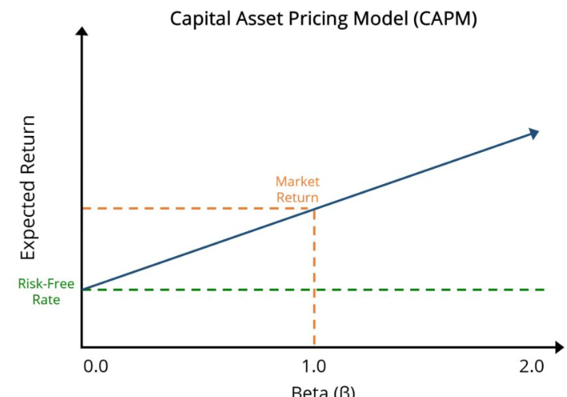

What does beta actually measure?
CAPM relies on a single measure of systematic risk
Beta is estimated empirically
Investment and Regulatory outcomes depend heavily on beta
How should Beta be measured?>

Slide 3
Limitations of Empirical Beta Estimates
BETA IS AN ESTIMATE ➔ DRIVEN BY CHOICES
NOT DIRECTLY OBSERVED
Estimated from historical data
Small changes to methodology can materially change allowed returns
SENSITIVE TO SAMPLE PERIOD
AND FREQUENCY
.
2-yr vs 5-yr window
Monthly vs weekly data
Market benchmark selection
.
.
CHANGES OVER TIME
Changes with volatility and correlations
Different in calm vs stressed markets

Slide 4
BLUME vs. VASICEK Adjustment
Blume Adjustment
Vasicek Adjustment
Shrink toward market beta (1.0)
Shrink toward chosen prior (often industry)
Weight depends on estimation error
- More weight to prior when estimation error is high
Both assume mean reversion, but anchors differ
REVERSION TO WHAT?

Slide 5


SECTOR REALITIES: Industry vs. Market Assumption
Investors evaluate beta relative to peers
Utilities: Typical range 0.5–0.7
Technology: Typically 1.2–1.5+
Market adjustments compress differences
Industry-based views preserve structure

Slide 6
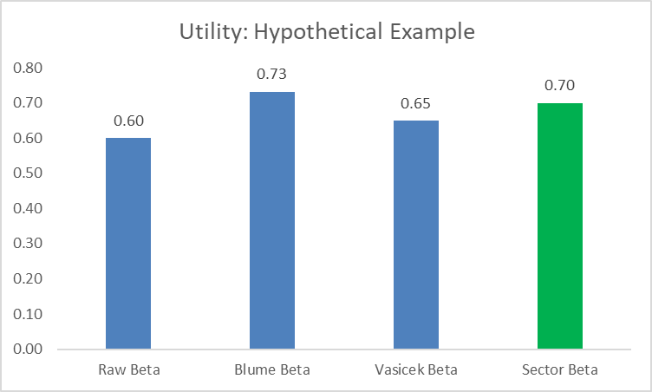
IMPACT ON BETAS
For Typical Utility:
Blume ➔ beta higher than sector beta
Is this economically justified?

Slide 7
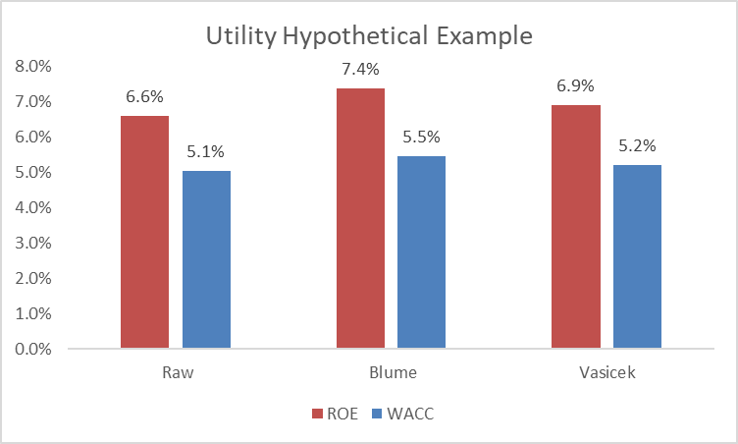
RESULTING IMPACT ON ALLOWED ROE & WACC
Beta adjustments are not neutral
Allowed ROE
~100 bps impact
Total WACC
~50 bps impact
Assumptions: Rf 3.0%, ERP 6.0%, Debt 4.5%, Tax Rate 25%
Equity: 52%, Debt: 48%

Slide 8


GARCH : Time-Varying Beta
Return relationships are not stable: volatility clusters and correlations change
Models time-varying volatility and covariance
Gives more weight to recent observations when vol is elevated
Assumes recent conditions are more relevant
Produces time-varying (conditional) Beta
Same beta- Different estimation method
Not necessarily better
More responsive, but not necessarily more relevant for long-term horizons

Slide 9


MODEL COMPARISONS: Windows vs. GARCH
Fixed Windows
GARCH
2Y is responsive but noisy
5Y is stable but lagging
Dynamic Weighting
Emphasizes recent data when volatility rises
Retains full history without equal weighting
Same Beta Definition
Different Estimation
Method

Slide 10
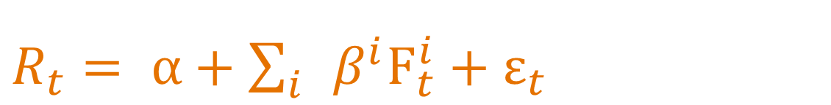
BEYOND CAPM: Academic Research Factors
Captures multiple systematic risk premia, beyond market (β) risk
Betas (factor loadings) are well-tested across time and academic studies
Capture multiple dimensions of risk (does not produce a single cost of equity estimate)
CAPM estimates Ke =➔ Factors explain how returns are generated
$R_{t}= α+\sum_{i}{ }β^{i}F_{t}^{i}+ε_{t}$
Research factors ➔ refine CAPM to more fully capture risk exposure

Slide 11
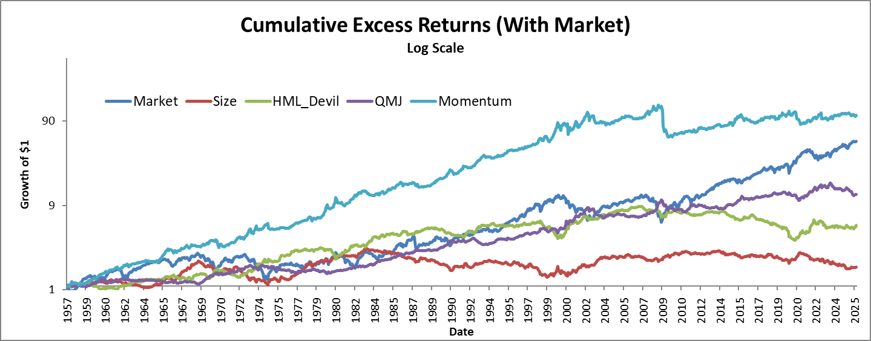
BEYOND CAPM: Academic Research Factors
Beta is one dimension -- Market explains a lot—but not all

Slide 12
BEYOND CAPM: Academic Research Factors
A few things to note…
CAPM beta total market risk
Research
Factors
Research Factors Decompose return to various exposures
Lower FF market Beta Lower Risk

Slide 13

Idiosyncratic Risk (IVOL)
Often called non-diversified risk
IN THEORY
SHOWS
CAPTURES
IN PRACTICE
Diversifiable
What Beta Doesn’t Capture
May not be
Firm/ Business
Risk
$R_{t}= α+\sum_{i}{ }β^{i}F_{t}^{i}+ε_{t}$

Slide 14


Key Takeaways
Models
Adjustments
Blume/Vasicek: where beta goes
GARCH: when beta changes
CAPM is a single factor
Multi-factor : multiple risks
IVOL: residual risk
Must Decide: Reversion to what — and over what horizon?

Slide 15
Beta in Cost of Capital
An exploration of empirical estimation methods, CAPM limitations, and regulatory outcomes.
Rodney Sullivan, CFA, CAIA
Executive Director, Richard A. Mayo Center for Asset Management
CHARLOTTESVILLE, VA
WASHINGTON, DC
SAN FRANCISCO, CA
SHANGHAI, CHINA

