Slide 1

Capital Structure Analysis:
Avoiding Default Thinking
Steve Kihm, DBA, CFA
Regulatory Strategist and Chief Economist
Citizens Utility Board of Wisconsin
Society of Utility and Regulatory Financial Analysts
55th Financial Forum
Regulated Utilities 2024: An Industry in Transition
April 11, 2024
Richmond, VA

Slide 2

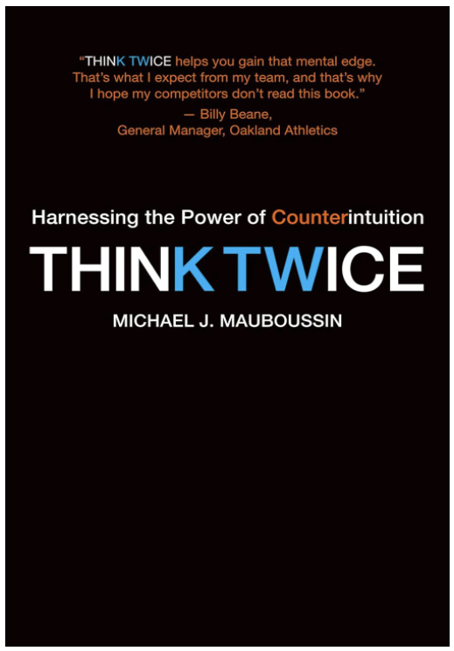
No one wakes up thinking, “I am going to make bad decisions today,” and yet we all make them. What is particularly surprising is some of the biggest mistakes are made by people who are, by objective standards, very intelligent.

Slide 3
Smart people make poor decisions because they have the same factory settings on their mental software as the rest of us ..Our minds frequently want to see the world one way—the default—while a better way to see the world takes some mental effort.

Slide 4
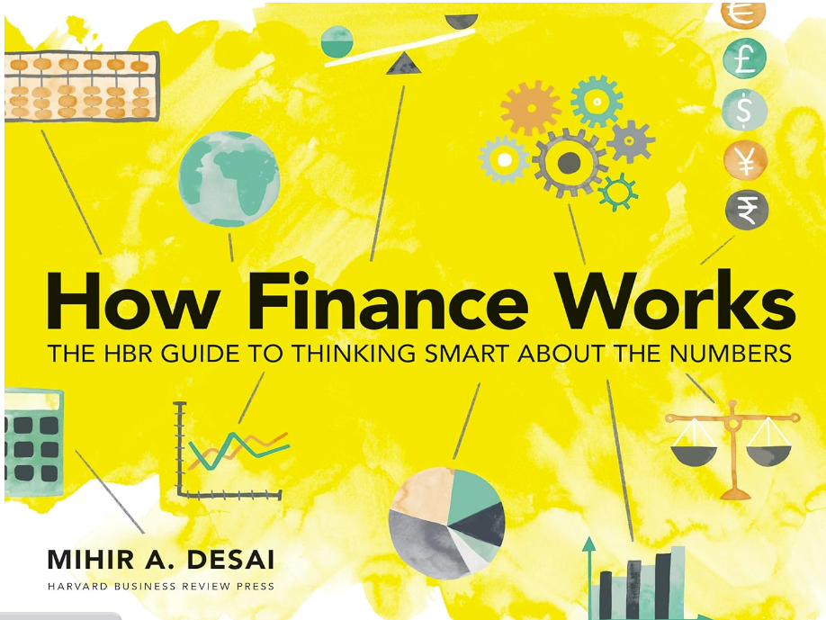
The central intuitions of
finance are slippery.

Slide 5
Default thinking
A stronger bond rating lowers the cost of debt
A stronger bond rating lowers the cost of equity
The only way the utility raises capital is with debt
or equity and both are less expensive at a
stronger bond rating
Therefore, customers will pay less for capital over
the long run if the utility has a strong bond rating

Slide 6
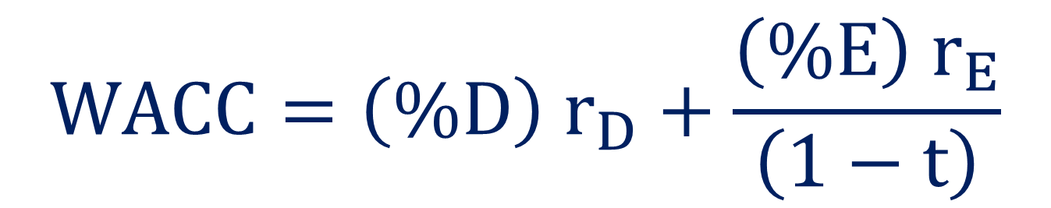
The cost of capital equation
$$WACC=\left(\%D\right) r_{D}+\frac{\left(\%E\right) r_{E}}{\left(1−t\right)}$$

Slide 7
The cost of capital equation
$$WACC=\left(\%D\right) r_{D}+\frac{\left(\%E\right) r_{E}}{\left(1−t\right)}$$
We’re trying to draw a conclusion about the cost of capital by
examining only two of the five variables that determine it

Slide 8
The cost of capital equation
$$WACC=\left(\%D\right) r_{D}+\frac{\left(\%E\right) r_{E}}{\left(1−t\right)}$$
The simultaneous changes in the mix of debt and equity
make it difficult to see the answer intuitively

Slide 9
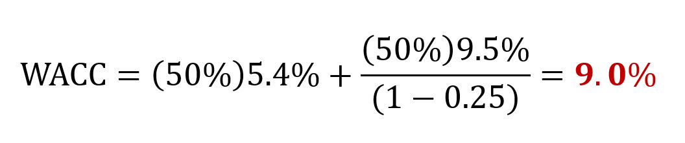
Base case (Baa/BBB bond rating)

Slide 10
Damodaran (NYU)
speculative
investment grade

Slide 11
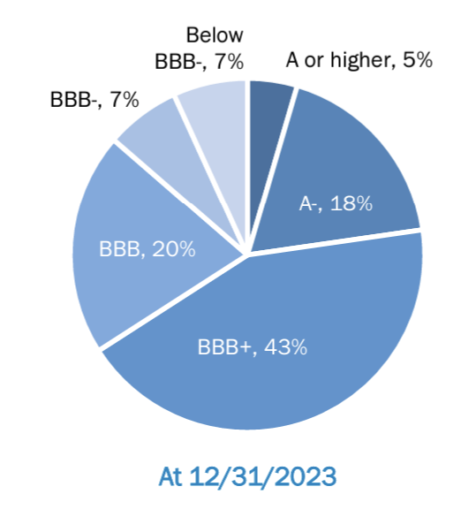
Source:
Edison Electric Institute

Slide 12
Damodaran (NYU)
88% of U.S. investor-owned
electric utilities have bond
ratings in this range

Slide 13
Damodaran (NYU)
88% of U.S. investor-owned
electric utilities have bond
ratings in this range
only 30 basis points

Slide 14
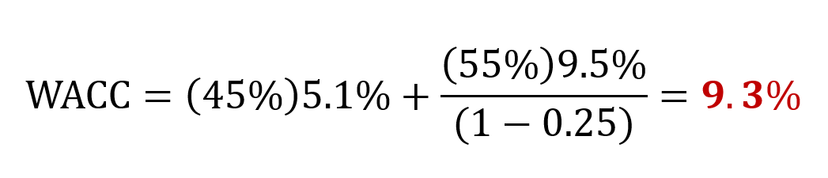
Proposal (A- bond rating)

Slide 15
Comparison—the stronger bond rating increases customer costs
Baa/BBB
A-

Slide 16
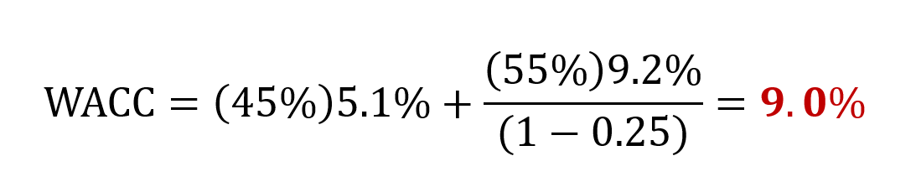
Just to get back to no increase in costs, the utility has to lower the ROE to 9.2%
Baa/BBB

Slide 17
Source:
Edison Electric Institute

Slide 18
Bond rating agencies are doing their job.
Those ratings were never intended to
indicate what it costs a company to raise
capital overall, but rather how risky
its bonds are.

Slide 19
Recognizing the Value of Debt
In the late 1970s and early 1980s the finance research suggested that firms used too little debt
This was more than just conjecture. Firms found that when they used debt financing, instead of equity financing, their stock prices rose.
AAA bond ratings were then a sign of inefficient management, and fewer and fewer firms strove for that rating.

Slide 20
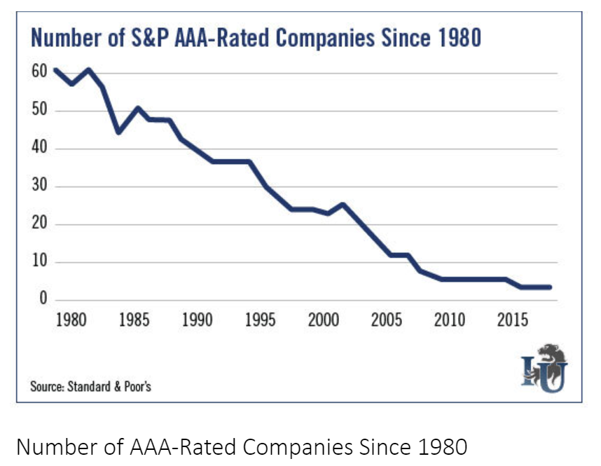
Source: Wall Street Insider

Slide 21
The Trouble with Triple A’s
Clearly, none of these businesses has been adversely
impacted since losing its AAA status.
The company’s discovered that it was actually less
expensive to raise capital as they moved away from
AAA bond ratings (even though both the cost of debt
and the cost of equity had increased—counterintuitive)
https://www.thewallstreetinsider.com/trends/why-only-two-companies-are-left-with-the-aaa-rating

Slide 22
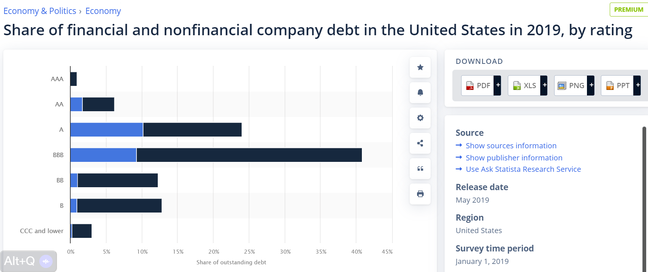

Slide 23
Analysis of major corporations
Microsoft with its AAA/Aaa bond rating is NOT minimizing it cost of capital (about 10% debt)
Coca Cola and PepsiCo with their A bond ratings appear to be at or near their cost of capital minimums (30% to 40% debt)
Gardner, J., McGowan, C., and Moeller, S. 2013. Using Coke-Cola and Pepsico to demonstrate optimal capital structure theory. Journal of Finance and Accountancy.

Slide 25
Steve Kihm
Citizens Utility Board of Wisconsin
kihm@cubwi.org

